Slide 1
Nurse Support Program II
Technical Assistance Meeting
December 11, 2015
Priscilla Moore, MHEC
Oscar Ibarra, HSCRC
Peg Daw, MHEC

Slide 2
Nurse Support Program
Nurse Support Program started by the Health Services Cost Review Commission in 1986.
Nurse Support Program I (2001) Evaluation completed 2007 (continued) Evaluation 2012 (continued)
  Next Evaluation Due 2017
Nurse Support Program II (2005) Evaluation completed 2015 (continued)
  Next Evaluation Due 2020
Each Nurse Support Programs (NSP I- hospital based) & (NSP II- education based) is funded by 0.1% hospital revenue

Slide 3
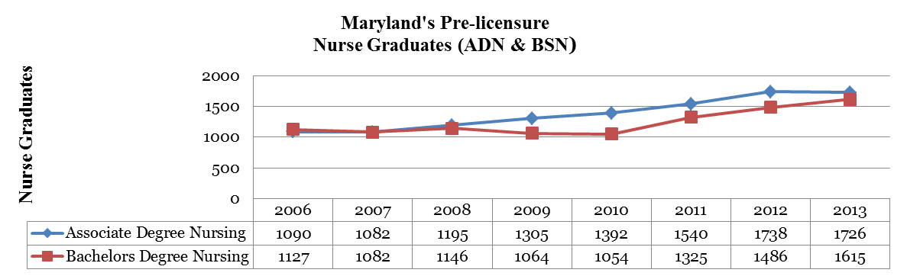
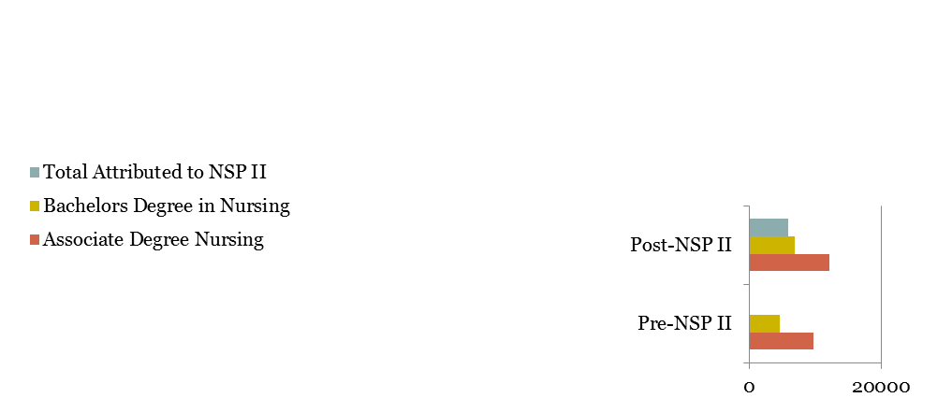
NSP II Measurement and Evaluation
5800 or 27% total 20,967 pre-licensure graduates attributed to NSP II
In 2013, 1,726 ADNs (58% increase)
In 2006, 1,090 ADNs
In 2013, 1,615 BSNs (43% increase)
In 2006, 1,127 BSNs

Slide 4
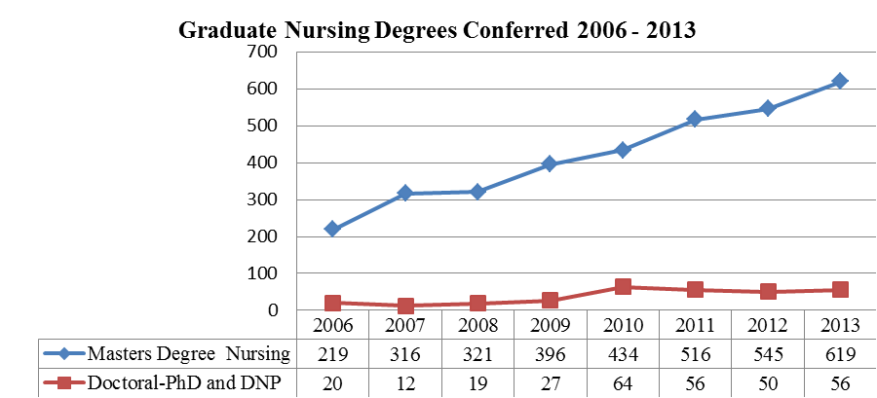
NSP II Measurement and Evaluation
No impact on
PhD graduates
2005- 87 PhDs
2013- 88 PhDs
621 new MS and 203 new DNP degrees directly attributed to NSP II
New graduate degree programs (MSN and DNP) and Scholarships

Slide 5
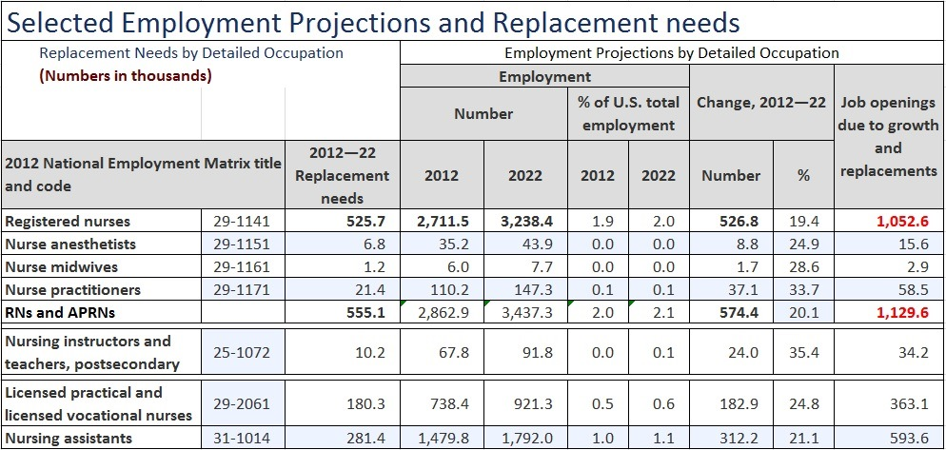
Registered Nurse Projections 2012-2022

Slide 6
HRSA Workforce Evaluation
 | 2012 | 2025 Projected
State | Supply & Demand | Demand | Supply | Difference
Maryland | 60,600 | 72,000 | 59,900 | -12,100
Virginia | 69,900 | 87,300 | 106,700 | +19,400
Pennsylvania | 145,000 | 152,600 | 178,400 | +25,800
Delaware | 10,600 | 12,500 | 16,200 | +3,700
West Virginia | 20,600 | 21,100 | 29,000 | +7,900
US | 2,897,000 | 3,509,000 | 3,849,000 | + 340,000
HRSA Report released mid-December, 2014
Strongly Influenced
HSCRC’s decision
Critical timing
1 of 16 states in US
projected to have shortage of RNs
Assumptions-
Supply and demand equal in 2012 and RNs remain in state of training
Source: HRSA (2014).The Future of the Nursing Workforce: National and State Level Projections, 2012-2025 Notes: Projections assume demand and supply are equal in 2012 and nurses remain in their state of training.

Slide 7
FY 2016- FY 2020 NSP II Funding
The NSP II Program Evaluation for FY 2006- FY 2015 (the first 10 years of funding) was completed in December, 2014. The HSCRC accepted the report and approved continued funding.
See NSP II Program Evaluation at:
http://www.hscrc.state.md.us/documents/commission-meeting/2014/12-10/HSCRC-Post-Commission-Meeting-Documents-2014-12-10.pdf
http://www.hscrc.state.md.us/documents/commission-meeting/2015/01-14/HSCRC-Post-Commission-Meeting-2015-01-15.pdf
The Health Services Cost Review Commission accepted the NSP II Program Evaluation Report on 1/14/15 and renewed the education focused workforce intervention for an additional 5 years with up to 0.1% of hospital patient revenue ($75 mil/5 yrs).

Slide 8
NSP II Evaluation Recommendations
Adopt goals (initiatives) and metrics (mandatory data tables) that address the following Institutes of Medicine (IOM) recommendations from The Future of Nursing, (2010) Report
IOM Recommendation #4: Increase the proportion of nurses with a baccalaureate degree to 80% of all RNs in the workforce.
IOM Recommendation #5: Double the number of nurses with a doctorate by 2020.
IOM Recommendation #6: Ensure that nurses engage in lifelong learning.
IOM Recommendation #7: Prepare and enable nurses to lead change to advance health.

Slide 9
FY 2017 Request for Applications
FY 2017 RFA Documents
http://www.nursesupport.org/nurse-support-program-ii/grants/competitive-institutional-grants/
Important Dates
Proposals Due: January 15, 2016
Review Panel Process
HSCRC Meeting: April 13, 2016
Notifications: After HSCRC Approval
Grants Begin: July 1, 2016
Annual Reports Due: August 31, 2017

Slide 10
Eligible Initiatives and Priorities for Competitive Grants
Initiatives to increase Nursing Pre-Licensure Enrollments and Graduates
Initiatives to Advance the Education of Students and RNs to BSN, MSN and Doctoral Level
Initiatives to Increase the Number of Doctorally Prepared Nursing Faculty
Initiatives to Build Collaborations Between Education and Practice that Develop New Models that Promote a Patient Centered Continuum of Care
Initiatives to Increase Capacity Statewide

Slide 11
Proposal Guidance: Submission
Due: January 15, 2016 by 4:00 pm
Please submit proposals to:
  Maryland Higher Education Commission (MHEC)
  6 N. Liberty Street, 10th Floor
  Baltimore, MD 21201
Please include:
  One (1) Signed Original
  Eight (8) Paper Copies
Electronic proposals including excel budget documents are required by deadline. Electronic files should be submitted to: priscilla.moore@maryland.gov.
If inclement weather causes either MHEC or the applicant institution to close that day, the proposal will be due the next full business day of both MHEC and the applicant institution.

Slide 12
Proposal Guidance: Format
Cover Sheet
  Appendix A
  Required Data Set (Detailed Data Requirements: Page 6-9)
Abstract
  Limit to 150 words or less
Table of Contents
Proposal Narrative
  Maximum of 15 Single-Spaced Pages
    Does not include appendix materials
Budget and Cost Effectiveness
  Sample Budget Forms – Appendix A
  Sample Budget Narrative – Appendix A
Memorandum(s) of Understanding
  If Applicable
Assurances
  Appendix A
* Detailed Proposal Requirements: Page 15-21*

Slide 13
Proposal Guidance:
Evaluation & Selections Criteria
Criteria | Maximum Points
Abstract | 5
Overview of Proposed Initiative | 10
Project Goals and Objectives | 15
Management Plan | 15
Scope of Proposed Initiative (Plan of Operation) | 15
Project Evaluation | 20
Budget and Cost Effectiveness | 20
Total | 100

Slide 14
Proposal Guidance: FY 2017 RFA Changes
Timeline
  New Proposals Due: January 15, 2016
  Annual Reports Due: August 31st
Forms
  Annual Report Template: Projected Outcomes & Dissemination Section
  Annual Report Budget Summary: Actual Expenditures
Site Visits
  Financial Oversight
Continuation Grants

Slide 15
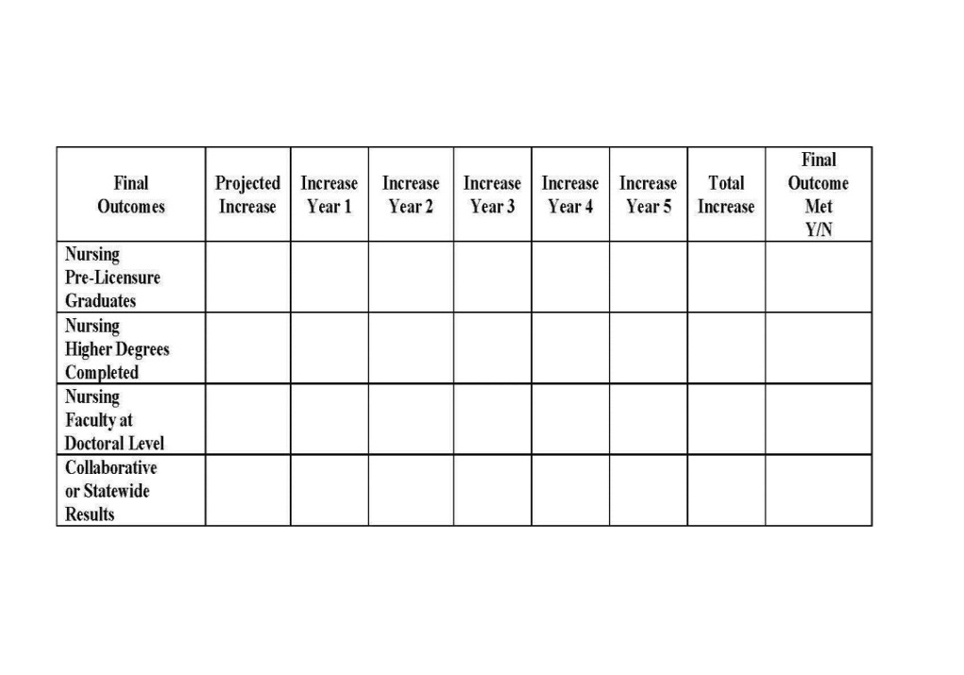
Annual Reporting
Important Changes
Projected Outcomes Table
Due Date: August 31st
Budget Summary: Actual Expenditures
Annual Report: Projected Outcomes & Dissemination Sections
Carryover: Linked to Performance

Slide 16
Financial Oversight
Supporting Documentation Examples
Financial Audits
Random & Focused
Included in Site Visits
Review of Expenditures & Supporting Documentation
Invoices & Receipts
Payment Vouchers
Statements & Cancelled Checks
Payroll Records & Employment Contracts
Contract & Sub-award Documents

Slide 17
NSP II Planning & Focused Grants
These are limited in scope of funding to less than $100K and considered short-term support to meet specific goals that may not be easy to describe in RFA initiatives or outcomes charts
Planning Grants: Used when the proposal is too early to present- approvals are not completed, MOUs are not signed, the partners are not engaged and important areas of planning need to be done before a full proposal could be submitted
Focused Grants: Used when a program is facing major issues with seeking or regaining accreditation, meeting MBON targets for NCLEX-RN first time test pass rates, or in state of change with too rapid growth or reduction in size due to any of the above concerns

Slide 18
Continuation Grant Opportunities
Continuation Grants: NSP II Continuation Grants are available for successful grant projects that are recommended for funding beyond the initial grant period to expand on models or programs that have potential for greater impact with additional funding. Continuation grants are only available for projects invited to apply. Consideration for continuation grants will include a review of project impact, progress towards stated goals and objectives, financial management of funds, and compliance with reporting requirements. Priority for continuation funding will be given to those projects that are innovative, focus on the future of nursing, and have a regional or statewide impact. Projects invited to apply for continuation funding will be required to submit a modified continuation grant proposal. Invitations for NSP II Continuation Grants will be sent to project directors during the final year of funding. An invitation to submit a continuation grant proposal does not guarantee continuation funding. Continuation grant proposals are reviewed by the review panel and approved on the Competitive Institutional Grants schedule.
http://www.nursesupport.org/assets/files/1/files/nspii/fy-2017-rfa-competititve-institutional-grants.pdf Pg. 11
Example from FY 2016
NSP II 13-110 Eastern Shore Faculty and Mentoring Academy Initiative (ES-FAMI)
Indicators: Meeting or Exceeding Original Proposal Goals and Outcomes
Presentation and Publication of Project Citing HSCRC Funding
Importance to NSP II Overall Goals/Missions

Slide 19
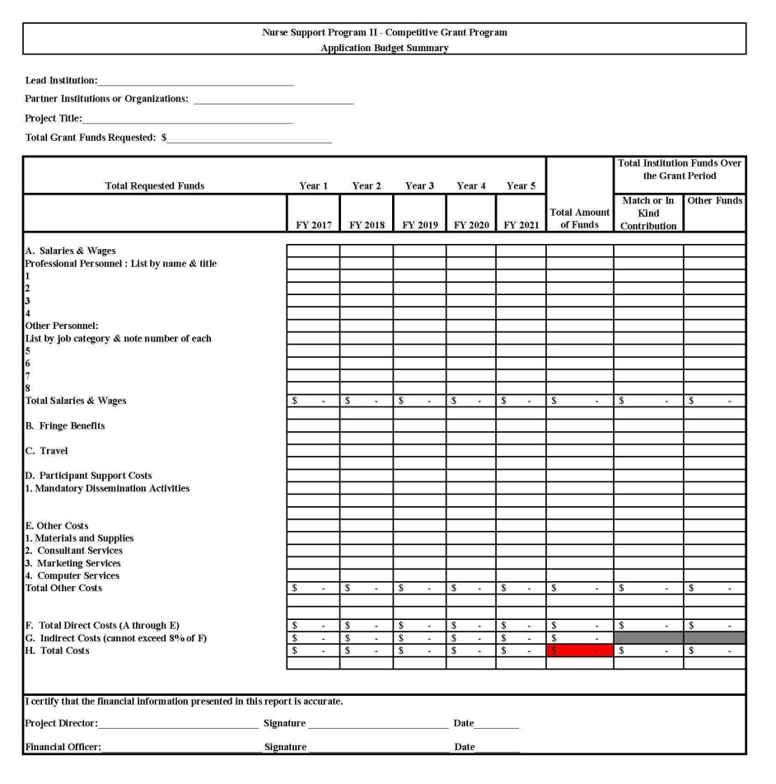
Budget Guidance
Application Budget Summary
Budget Tips
Accuracy: Check and Double Check Figures
Fringe Benefits: Ensure the Cost Allocated for Fringe Benefits is Reasonable
Budget Narrative: Ensure Budget and Budget Narrative Match

Slide 20
Please Note:
Project titles should be brief.
All pages of proposal should be numbered.
Applications must be received by the deadline.
Electronic copies of application must be received by deadline.
Electronic submissions must include signed budget documents and excel versions.

Slide 21
A Few Final Words of Wisdom
Strong Proposals:
Clear & Succinct
Structured
Realistic Outcomes
Reasonable Budgets
Include Match/In kind
Justify Program Need
Include Partners- MOUs, Letters of Support, Agreements, Etc.
Weak Proposals:
Redundant & Confusing
Unstructured
Unrealistic Outcomes
Inflated Budgets
Missing Match/In kind
No Partners/ Not Inclusive

Slide 22

Nursesupport.org
New Features:
  Forms Section: Current Competitive Grant & Statewide Initiative Forms & Documents
  Meetings Section: Announces Technical Assistance & Project Director Meeting Details
  Dissemination Section: Provides Examples of Mandatory Dissemination
On the Horizon:
  Possible Submission of Proposals, Applications, and/or Reports through Nurse Support Website

Slide 23
Network, Collaborate and Disseminate
To network and plan for teams with similar projects to make presentations in Maryland at:
MNA Conference: Kathy Ogle, kogle@towson.edu
Deans/Director’s Meetings:
Betty Webster, ewebster@ccbcmd.edu
MADDN: Mary Kay DeMarco, mdemarco@ccbcmd.edu
MDAC: Jane Kirschling, kirschling@son.umaryland.edu
MONE: Barbara S Jacobs, bjacobsrn@gmail.com
MCCSUN: June 7-8, 2016
Myra Dennis, mgdennis@aacc.edu

Slide 24
Maryland Action Coalition (MDAC)
Pillar 1: Advancing Education Transformation
Nurse Residency – Sherry Perkins (sperkins@aahs.org ) & Joan Warren (joan.warren@medstar.net)
Academic Progression – Linda Cook (cook@son.umaryland.edu) & Laura Polk (laurap@csmd.edu)
Continuing Education – Beth Kilmoyer (bkilmoye@mdmercy.com) & Laura Petri (Laura.Petri@stagnes.org)
Pillar 2: Removing Barriers to Practice and Care
Shannon Idzik (idzik@son.umaryland.edu)
Pillar 3: Nursing Leadership
Jane Kirschling (kirschling@son.umaryland.edu & Patricia Travis (ptravis2@jhmi.edu)
Pillar 4: Data
Rebecca Wiseman (wiseman@son.umaryland.edu)

Slide 25


2015 Update on The Future of Nursing
IOM’s Future of Nursing- Leading Change
Advancing Health (FON) report was released
in 2010.
Major Higher Ed Goals:
1. Increase the # of RNs with BSN degrees from 50% to 80% by 2020.
2. Double the # of RNs with a doctoral degree by 2020.
Transforming Education to meet healthcare’s growing demands through seamless transitions to higher degree programs.
The next slides are excerpted from the following preliminary report:
National Academies of Sciences, Engineering, and Medicine. 2015. Assessing progress on the Institute of Medicine Report The Future of Nursing. Washington, DC: The National Academies Press. https://youtu.be/sMOjACA2ats

Slide 26
2015 Assessment and Findings
Assess the changes in the field of nursing and peripheral areas over the last 5 years as a result of the IOM report on The Future of Nursing: Leading Change, Advancing Health.
Broad Findings
Significant progress toward implementing the recommendations of the Future of Nursing report
• Galvanized the nursing community
• Met or exceeded expectations in many areas
Moving forward, engage a broader network of stakeholders in its work

Slide 27
2015 Progress Report on Key Areas
Removing Barriers to Practice and Care
Achieving Higher Levels of Education
Promoting Diversity
Collaborating and Leading in Care Delivery and Redesign
Improving Workforce Data Infrastructure

Slide 28
1. Removing Barriers to Practice & Care
Conclusion
Continued work is needed to remove scope-of-practice barriers. The policy and practice context has shifted since The Future of Nursing report was released. This shift has created an opportunity for nurses, physicians, and other providers to work together to find common ground in the new context of health care, and to devise solutions that work for all professions and patients.
Recommendation 1: Build Common Ground Around Scope of Practice and Other Issues in Policy and Practice.
Broaden coalition to include more diverse stakeholders.
Build on successes and work with other health professions groups, policy makers, and the community to build common ground around removing scope-of-practice restrictions, increasing inter-professional collaboration, and addressing other issues to improve health care practice in the interest of patients.

Slide 29
2. Achieving Higher Levels of Education
Conclusions
As the RN population shifts to becoming increasingly baccalaureate-prepared, unintended consequences (employment, earning power, skills, and roles and responsibilities) for those nurses who do not achieve higher education may occur.
Further evaluation of transition-to-practice residencies is needed to prove their value with measurable outcomes; in particular, more attention is needed to determine the effect of these programs on patient outcomes.
Additional efforts are needed to clarify the roles of PhD and DNP nurses, especially with regard to teaching and research.
The current health care context makes inter-professional continuing education more important than ever. Current efforts by health care delivery organizations, accreditors, and state regulatory boards to promote these programs need to be expanded. (IOM, 2015)

Slide 30
2015 Recommendations for Higher Ed
Recommendation 2:
Continue Pathways Toward Increasing the Percentage of Nurses with a Baccalaureate Degree.
The Future of Nursing: Campaign for Action, the nursing education community, and state systems of higher education should continue efforts aimed at strengthening academic pathways for nurses toward the baccalaureate degree—both entry-level baccalaureate and baccalaureate completion programs.

Slide 31
2015 Recommendations for Higher Ed
Recommendation 3:
Create and Fund Transition-to-Practice Residency Programs. The Future of Nursing: Campaign for Action, in coordination with health care providers, health care delivery organizations, and payers, should lead efforts to explore ways of creating and funding transition-to-practice residency programs at both the registered nurse and advanced practice registered nurse levels.
Such programs are needed in all practice settings, including community-based practices and long-term care.
These efforts should include determining the most appropriate program models; setting standards for programs; exploring funding and business case models; and creating an overarching structure from which to track and evaluate the quality, effectiveness, and impact of transition-to-practice programs.

Slide 32
2015 Recommendations for Higher Ed
Recommendation 4:
Promote Nurses’ Pursuit of Doctoral Degrees.
The Future of Nursing: Campaign for Action should make efforts, through incentives and expansion of programs, to promote nurses’ pursuit of both the doctor of nursing practice (DNP) and PhD degree so as to have an adequate supply of nurses for clinical care, research, faculty, and leadership positions.
More emphasis should be placed on increasing the number of PhD nurses in particular.
To maximize the potential value of their additional education, nurses should be encouraged to pursue these degrees early in their careers.
PhD and DNP programs should offer coursework that prepares students to serve as faculty, including preparing them to teach in an evolving health care system that is less focused on acute care than has previously been the case.

Slide 33
2015 Recommendation for Higher Ed
Recommendation 5:
Promote Nurses’ Interprofessional and Lifelong Learning.
Encourage nursing organizations, education programs, and professional societies, as well as individual nurses, to make lifelong learning a priority so that nurses are prepared to work in evolving health care environments.
Lifelong learning should include continuing education that will enable nurses to gain, preserve, and measure the skills needed in the variety of environments and settings in which health care will be provided going forward, particularly community-based, outpatient, long term care, primary care, and ambulatory settings.
Nurses should work with other health care professionals to create opportunities for interprofessional collaboration and education. Bring together stakeholders from multiple areas of health care to discuss opportunities and strategies for interdisciplinary collaboration.

Slide 34
3. Promoting Diversity
Conclusions
By making diversity one of its pillars, the Campaign has shone a spotlight on the issue of diversity in the nursing workforce.
Community colleges, associate’s degree programs, and baccalaureate completion programs provide important pathways for diverse and disadvantaged students to enter the nursing profession; these educational pathways need to be maintained and strengthened.
The high proportions of underrepresented minorities among LPNs/LVNs and other health occupations requiring less education than RNs provides a potential pool of candidates for a more diverse nursing workforce.

Slide 35
2015 Recommendation for Diversity
Recommendation 6:
Make Diversity in the Nursing Workforce a Priority.
The Future of Nursing: Campaign for Action (the Campaign) should continue to emphasize recruitment and retention of a diverse nursing workforce as a major priority for both the national Campaign and the state Action Coalitions.
In broadening its coalition to include more diverse stakeholders, the Campaign should work with others to assess progress and exchange information about strategies that are effective in increasing the diversity of the health workforce.

Slide 36
4. Collaborating/Leading in Care Delivery and Redesign
Conclusions
True inter-professional collaboration can be accomplished only in concert with other health professionals, not within the nursing profession alone.
To assess progress on leadership development, it is necessary to track programs and courses in leadership, entrepreneurship, and management in which nurses are participating.
Recommendation 7. Expand Efforts and Opportunities for Interprofessional Collaboration & Leadership Development for Nurses.
Recommendation 8. Promote the Involvement of Nurses in the Redesign of Care Delivery and Payment Systems.
Recommendation 9. Communicate with a Wider and More Diverse Audience to Gain Broad Support for Campaign Objectives.

Slide 37
5. Improving Workforce Data Infrastructure
Conclusions
The greatest progress has been made on expanding data collected within, but not across, the health professions.
Opportunities will increase for the use of data from the Centers for Medicare & Medicaid Services to assess the services provided by APRNs, but only if APRNs bill for the services they provide under their own NPI.
Significant progress has been made on accelerating uptake of the MDS for the collection of data on the supply, demand, and education of nurses among State Nursing Workforce Centers.
Recommendation 10. Improve Workforce Data Collection.
Create more robust datasets and consider how various data sets can be organized and made available to researchers, policy makers, and planners.

Slide 38
Is there a shortage of nurse educators?
Yes
According to Stuart Altman, there is a shortage not only in the number of faculty but also in the institutions and colleges that acknowledge and address the shortage.
He recommended a two pronged attack.
More institutions need to recognize the importance of expanding nursing education programs
And, provide funding for them
According to Paula Gubard, the shortage is especially affected by aging, since most of the faculty are currently in their late 50s and mid-60s. There are not enough younger faculty to back them up.
Funding is needed for the advanced education required to be Nurse Faculty.

Slide 39
Why was NSP II Funded?
Two Primary Aims:
1. Increase the number of Registered Nurses
(Increase Educational Capacity- Competitive Institutional Grants)
2. Increase the number of Nurse Faculty
(Institutional Grants for Programs + GNF, NNFF, NEDG for Faculty)
Incorporate the “blueprint” in the IOM Goals:
Increase % BSN from 50% to 80% by 2020
Double the number of Doctoral prepared RNs
See Initiatives 1-5 on Proposal Cover Sheet & Slide 10
Increase clinical simulation, interprofessional education, diversity, seamless academic pathways and nursing leadership for changes in health care and nursing education

Slide 40
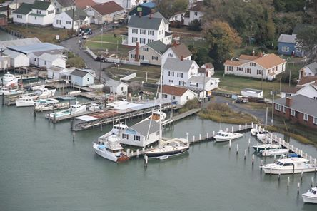
Questions?

Slide 41
References
Institute of Medicine. (2010). The future of nursing: Leading change, advancing health. Retrieved from http://books.nap.edu/openbook.php?record_id=12956&page=R1
Institute of Medicine. (2015). Assessing progress on the IOM Report The Future of Nursing. Retrieved from http://iom.nationalacademies.org/Reports/2015/Assessing-Progress-on-the-IOM-Report-The-Future-of-Nursing.aspx
Included in NSP II TA: Slides 20-33 from webinar 12/4/15 on Update- Full Presentation accessed at https://youtu.be/sMOjACA2ats?t=563
Nurse Support Program, www.nursesupport.org
Maryland Higher Education Commission, https://www.mhec.state.md.us/Grants/NSPII/NSPII.asp
Health Services Cost Review Commission, http://www.hscrc.state.md.us/aboutHSCRC.cfm
Bureau of Labor Statistics. (2013). Report accessed at Occupational Employment Projections from 2012-2022.

