Slide 1
Maryland Higher Education Commission division: CAREER AND Workforce education
Annual Report Training
Monday, August 5, 2019
10:00 am – 12:00 pm
Ashley Wallace, Ph.D.
Associate Director, Career and Workforce Education
Notes:
Delete this slide when you finish preparing the other slides.

Slide 2
agenda
Introductions (10:00 am – 10:15 am)
Annual Report – Refresher (10:15 am – 11:15 am)
HB464
Practice with Excel Template (11:15 am – 11:45 am)
Break / Refreshments (12:00 pm – 12:30 pm)
Special Guests and Giveaways!

Slide 3
Overview & Purpose
All private career schools are required to submit an Annual Report.
Completing the report poses a challenge for many schools.
COMAR 13B.01.01.06
.06 School Reports.
A. Annual School Report. An approved school is required to submit an annual report each year on forms and on a schedule provided by the Secretary. This report covers the fiscal and managerial aspects of the school's operation and other information as required by the Secretary.

Slide 4

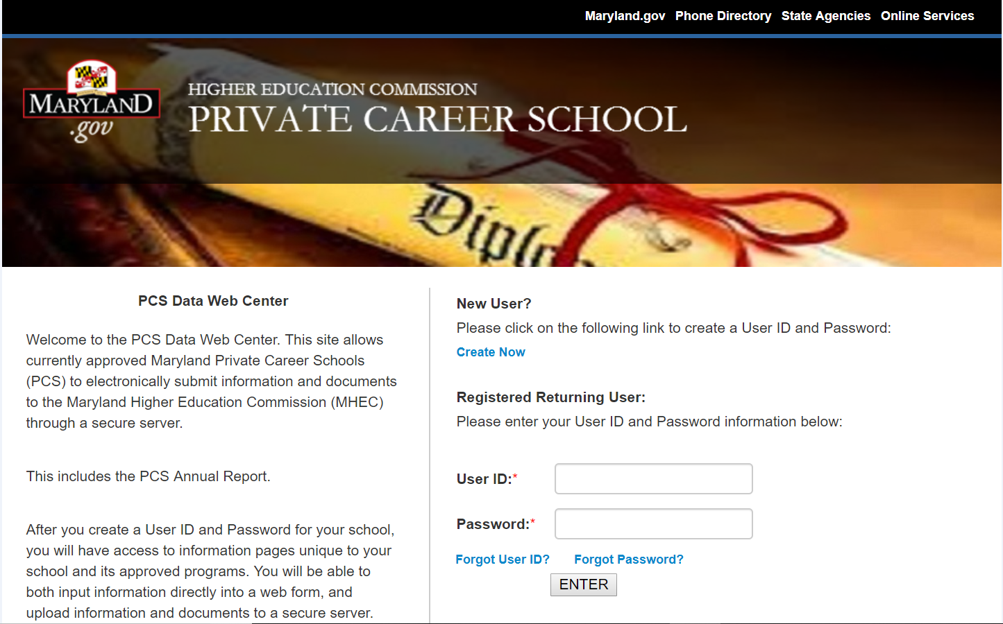
ANNUAL REPORT
PCS DATA WEB CENTER
Due every October 1
Assessment Period: July 1, Year 1 through June 30, Year 2
No longer a paper version
Website: https://pcsdata.mhec.maryland.gov/MHECPCSWEB/Login.aspx
Proper recordkeeping all year long is critical to your success.

Slide 5
PCS Data Web center
Returning Users:
  Use Login Credentials
New Users:
  Click on “Create Now”
Please remember login credentials!

Slide 6
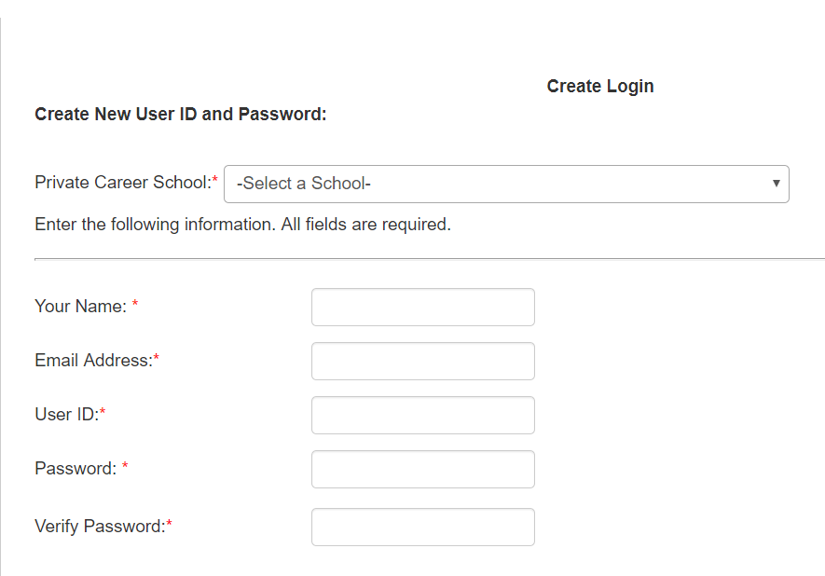
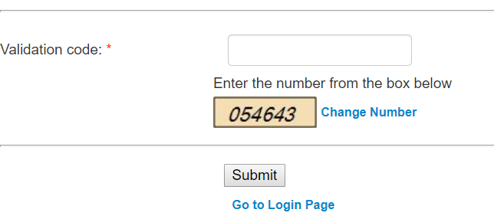
PCS Data Web center
For NEW Users:
You will see
this page
after you click
“Create Now”.

Slide 7

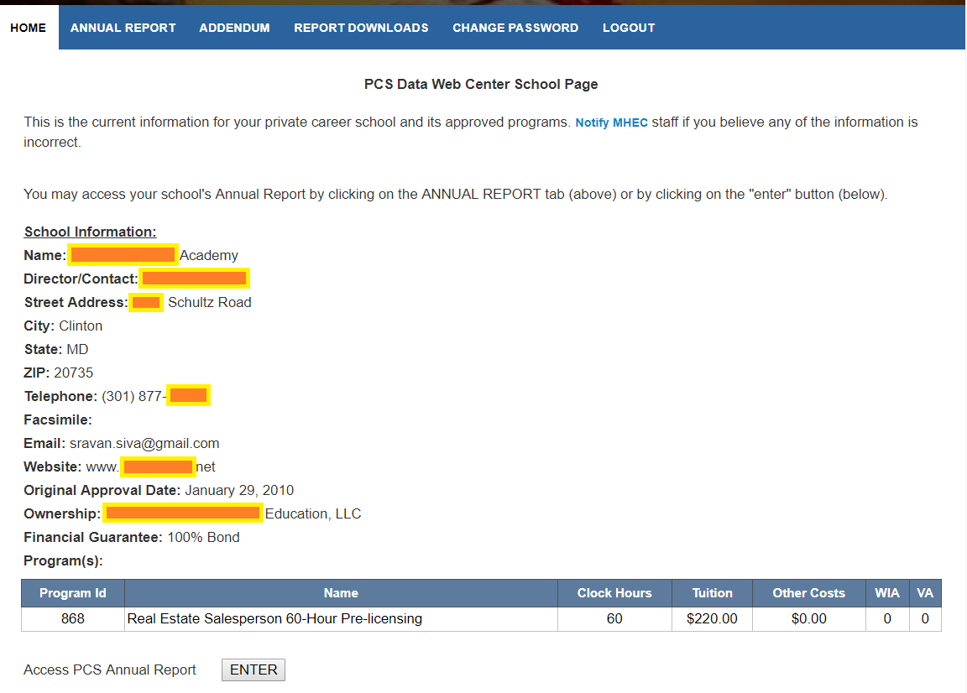
Annual report – Home Page
Once you log-in, you will see the “HOME” page of the PCS Data Web Center.
Two Methods of Accessing the Annual Report
Contact MHEC if something is incorrect.

Slide 8
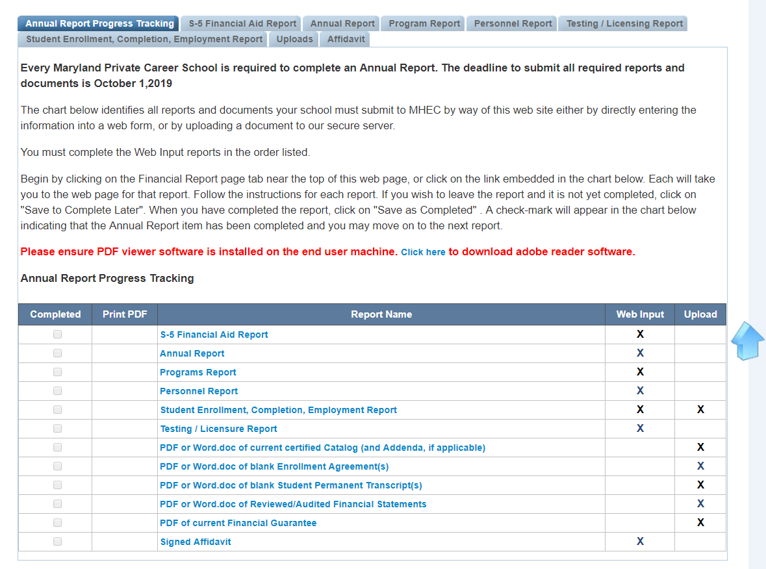
Annual report – Progress Tracking
Progress Tracking Tab
Completed?
Ways to submit documents

Slide 9
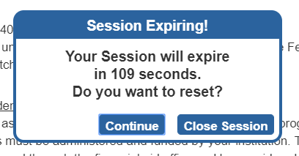
Annual report – progress tracking
If you are idle for too long, you will see the following pop-up message:

Slide 10

stATEMENT:
SOME OF MY STUDENTS RECEIVED FINANCIAL AID LAST YEAR.
POLL

Slide 11
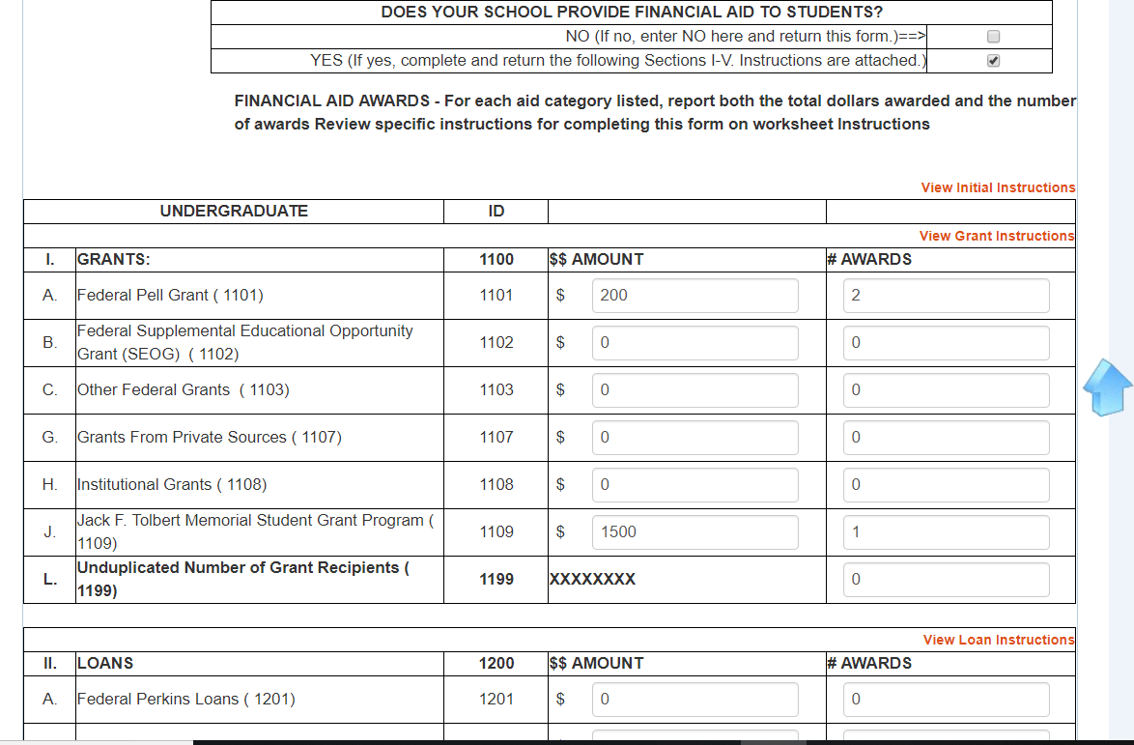
Annual report – “S-5” Financial Aid
IF THIS DOESN’T APPLY, CLICK “NO” AND SAVE.
IF YOUR STUDENTS RECEIVED FINANCIAL AID, CLICK “YES” AND SAVE. YOU WILL BE UNABLE TO ENTER NUMBERS IN THE FIELDS BELOW IF THE “NO” CHECK BOX IS HIGHLIGHTED.

Slide 12
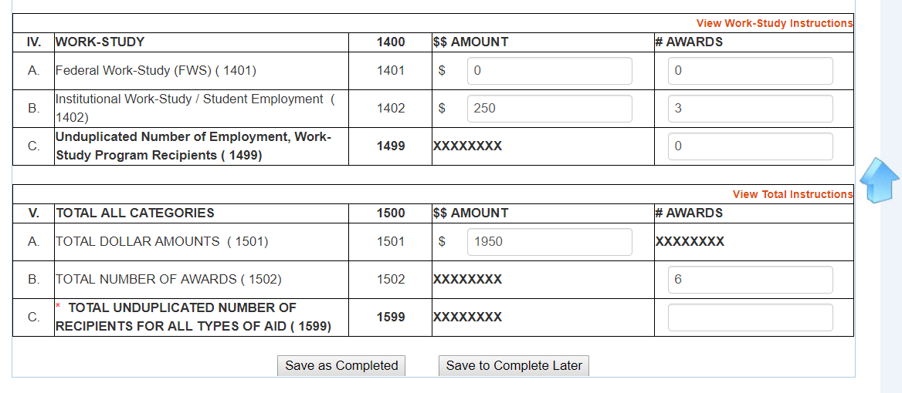
Annual report – “S-5” Financial Aid
Totals in each column will auto populate.
Award Amounts
Number of Awards
You must manually enter the “TOTAL UNDUPLICATED NUMBER OF RECIPIENTS…”
SAVE…

Slide 13
Question:
My school’s adjusted gross tuition received for the past year was $50,000. My GSTF payment is: $125.00 [$50,000 * .25%].
QUIZ
Answer: FALSE. The minimum payment for any school is $250.

Slide 14
Statement:
My school failed to enroll any students last year therefore we did not collect any tuition and we do not have to pay into the GSTF.
QUIZ
Answer: FALSE. Even if your adjusted gross tuition is $0, you must still make the minimum GSTF payment.

Slide 15
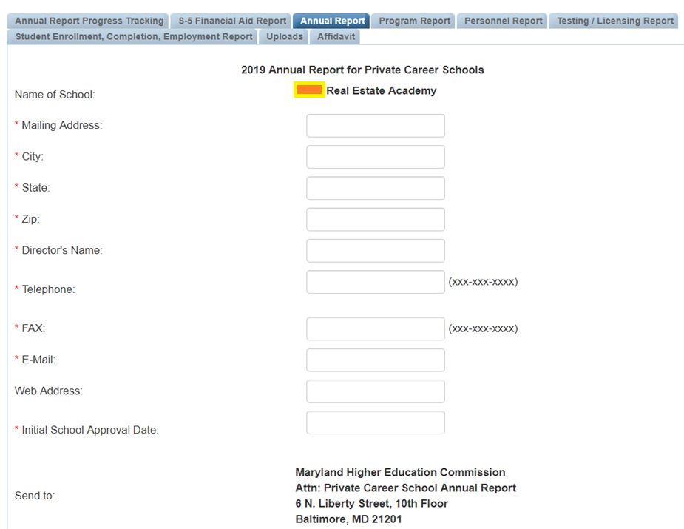
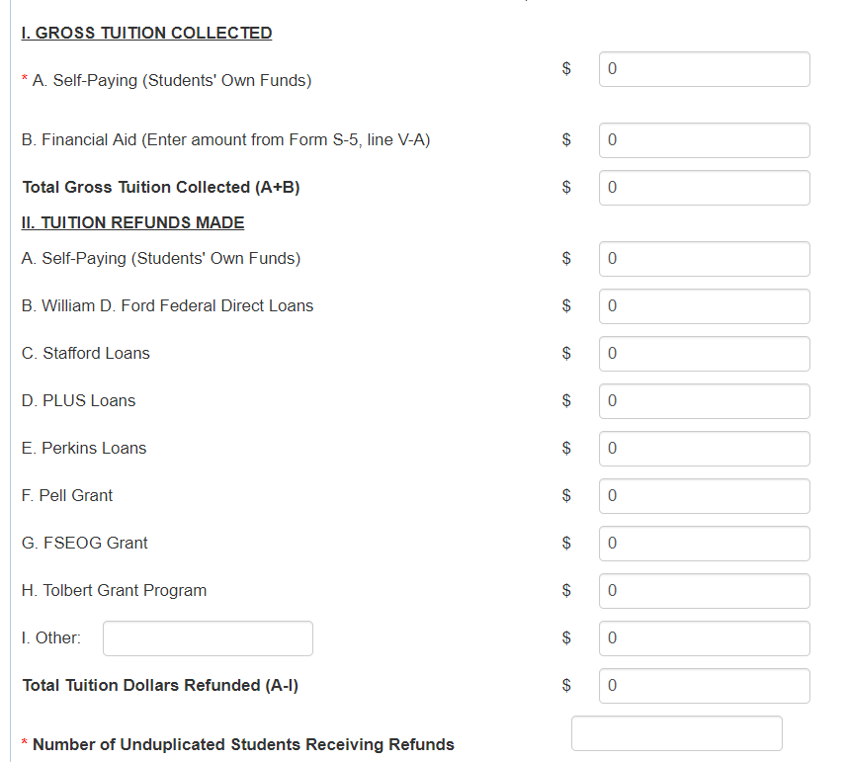
Annual report – “Annual report” tab

Slide 16
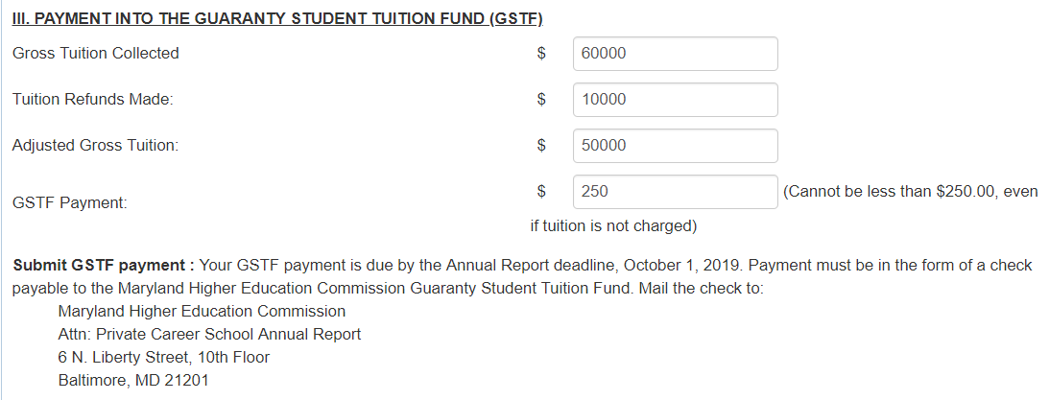
Annual report – “Annual report” tab

Slide 17
Annual report – “Annual report” tab
BUSINESS ORGANIZATION
BANKRUPTCY
CHANGE OF OWNERSHIP AND/OR CONTROL
PRIVATE STUDENT LOAN PROGRAMS
INSURANCE AND INSPECTIONS
ACCREDITATION
ADVERSE GOVERNMENT AND ACCREDITATION REPORTS
ADDITIONAL INFORMATION
JUDGEMENTS AND LIENS
AFFIDAVIT
Additional Information that you must provide… Upload all required documents.

Slide 18
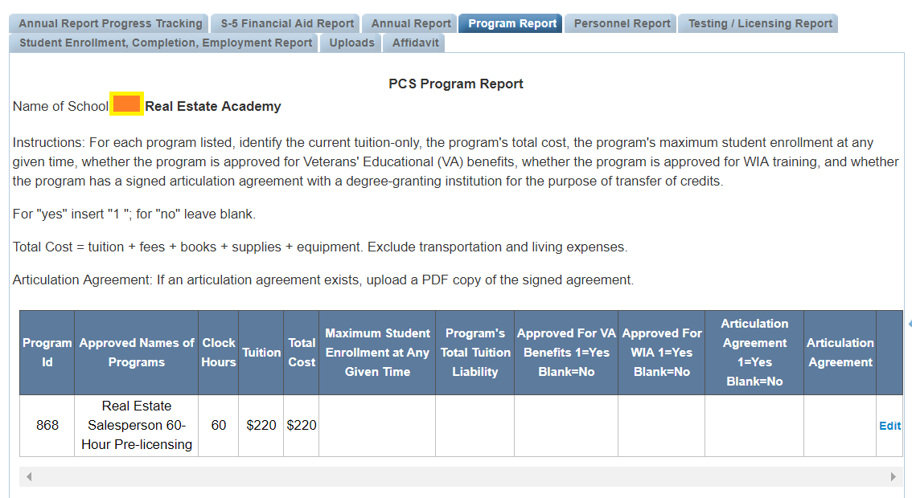
Annual report – “program report”
Program ID becomes important for Excel Template.
Click on “Edit”.

Slide 19
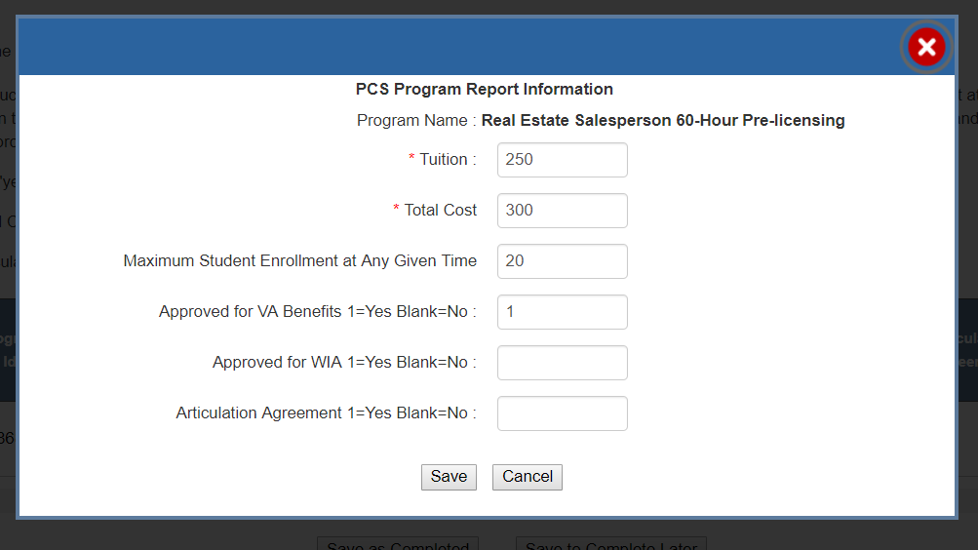
Annual report – “program report”
Use the pop-up box to make modifications and include information about VA Benefits, WIA, and Articulation Agreements.

Slide 20
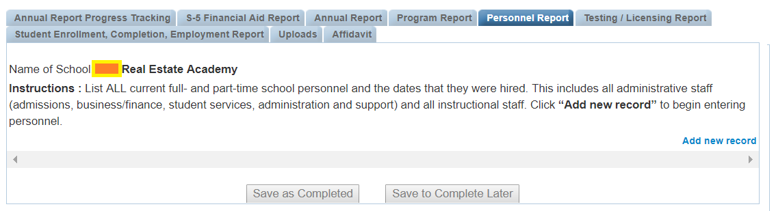
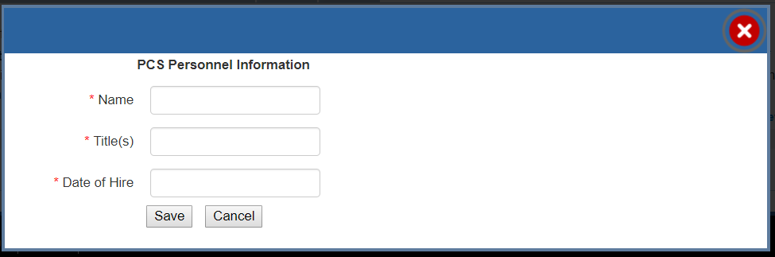
Annual report – “personnel”
Click on “Add new record”.

Slide 21
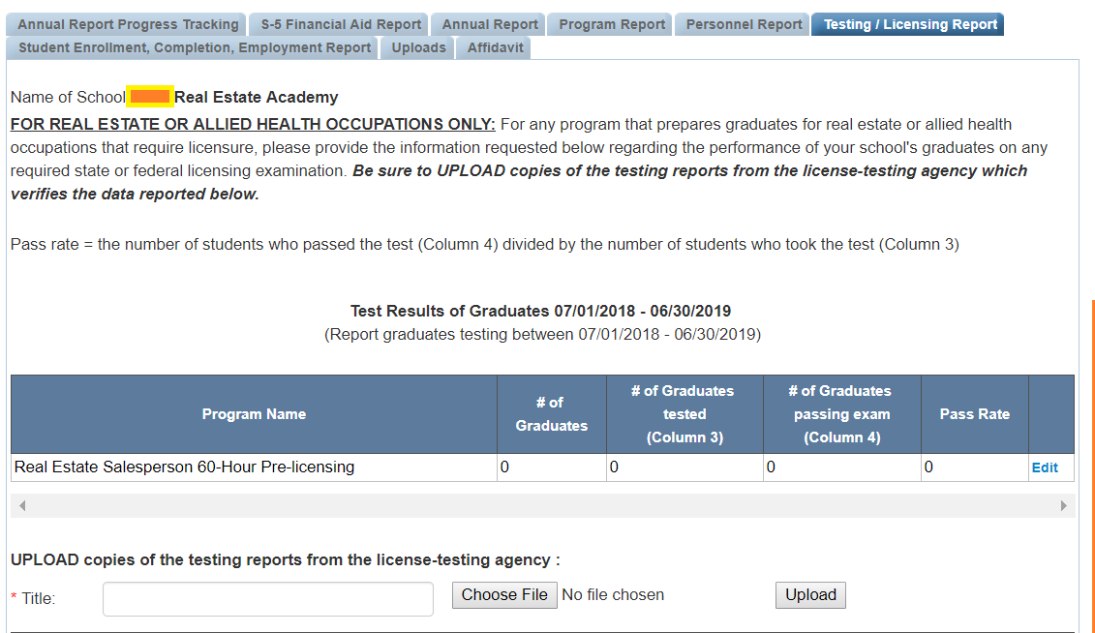
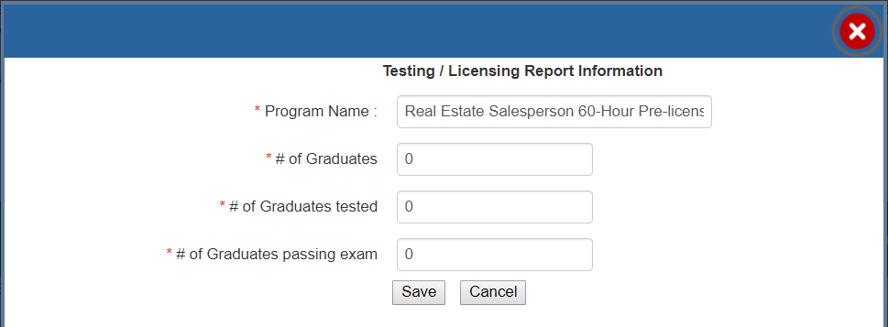
Annual report – “Testing / Licensing”
Upload testing reports

Slide 22
Annual report – “Testing / Licensing”
Testing/Licensing information on graduates is required of
Real Estate Programs and Allied Health Training (Only)
REMEMBER:
For Real Estate Schools, when looking at PSI testing reports, always report the smallest number between the 2 available (e.g. National vs. State).
Students must pass both National and State exams.
The data reported should reflect how students performed on their first try.

Slide 23
Statement:
My real estate school offers a 60-clock hour “principles and Practices of real estate” program. To be in compliance, the school needs to demonstrate a 50% graduation rate and a 33% test passage rate.
QUIZ
Answer: TRUE.

Slide 24
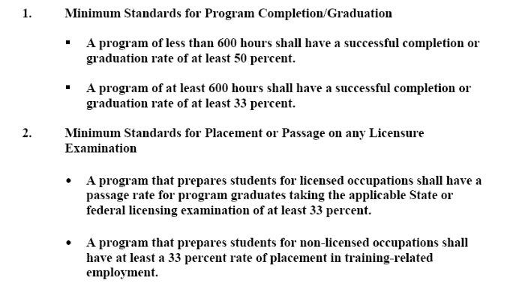
“Minimum standards”

Slide 25
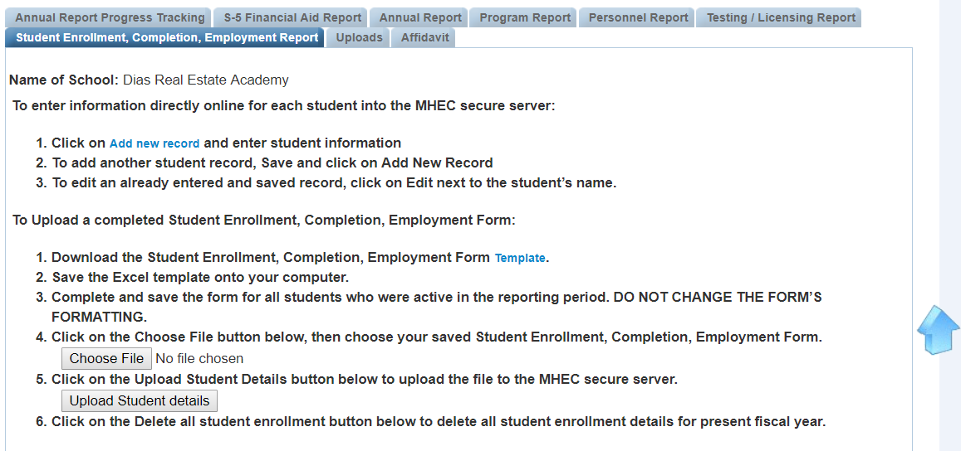
Annual Report – student report
FOCUS ON:
(1) STUDENT ENROLLMENT
(2) STUDENT COMPLETION
(3) STUDENT EMPLOYMENT
METHOD 1
(Preferable when you have a few students.)
METHOD 2
(Preferable when you have many students.)

Slide 26
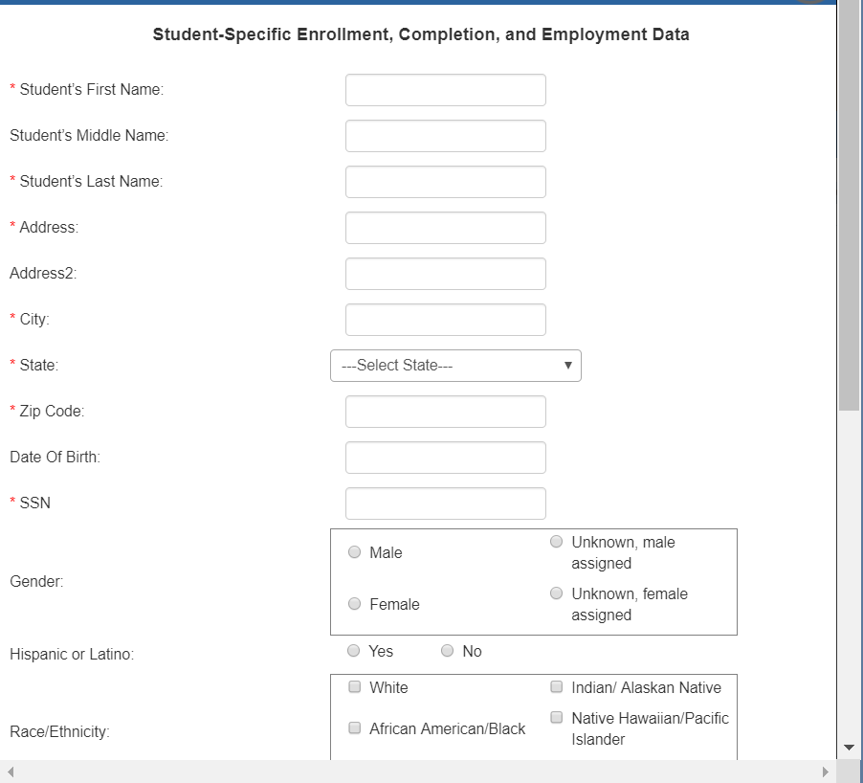
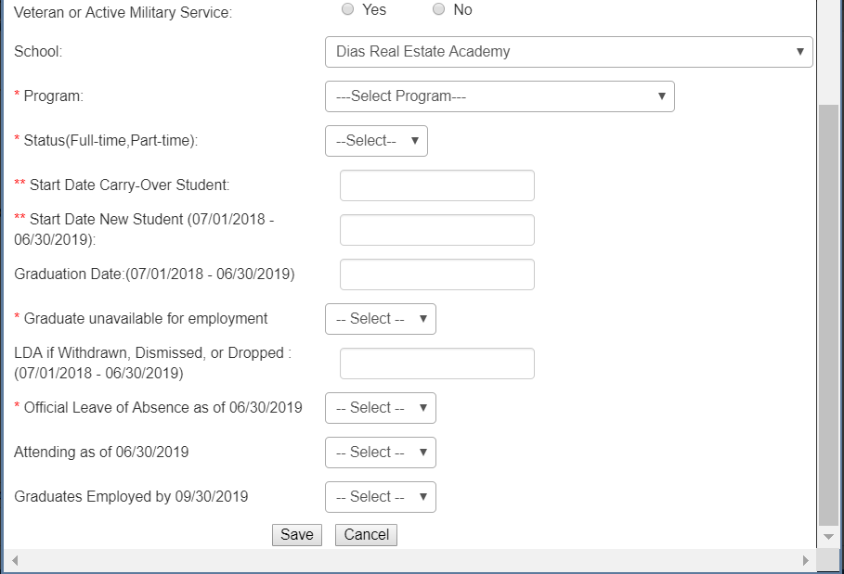
Annual Report – student report
METHOD 1: Entering individual student records directly into the system

Slide 27
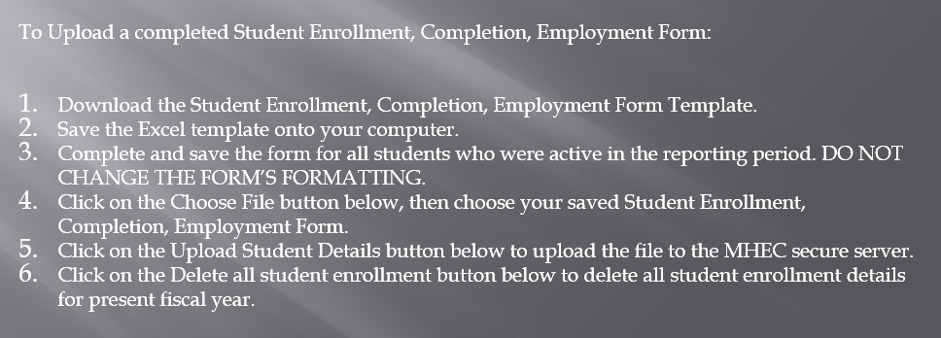
Annual Report – student report
METHOD 2: Use the EXCEL Template

Slide 28
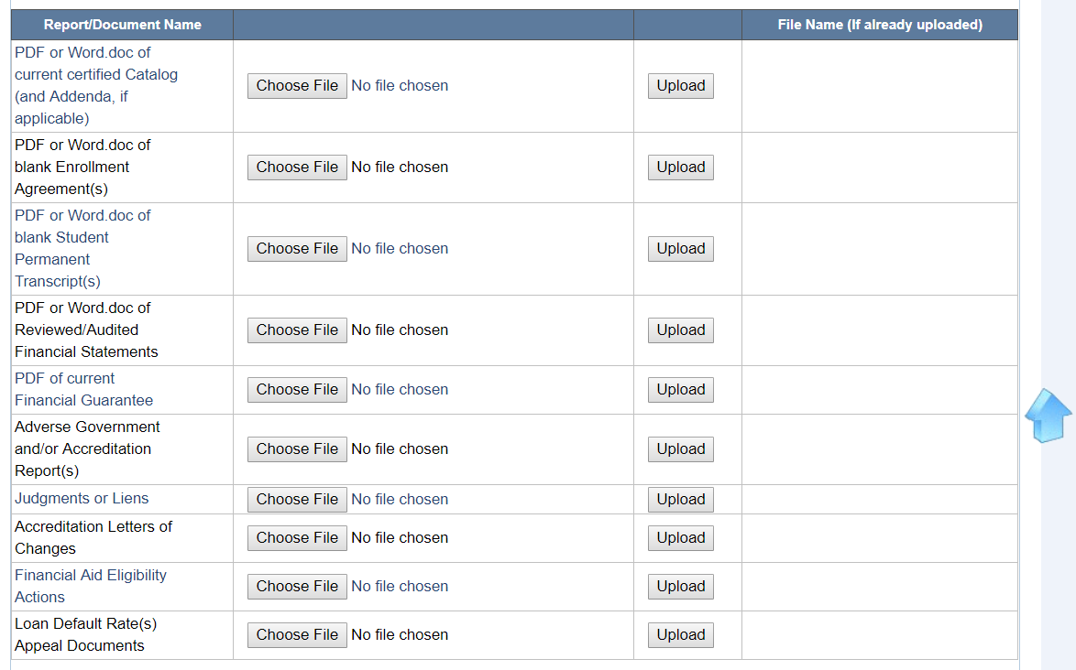
Annual report – “Uploads”
Please provide up-to-date versions!
Step 1
Step 2
If you upload a 2nd file, it will overwrite the 1st.

Slide 29
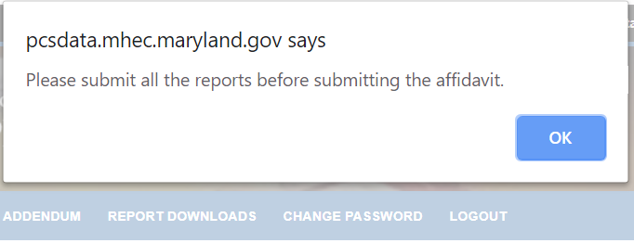
Annual report – “affidavit”
You will be unable to submit the affidavit if parts of your Annual Report are missing.
Instructions:
Sign your name on a blank piece of paper.
Scan and save signature as a “jpeg” file.
Upload the signature.

Slide 30
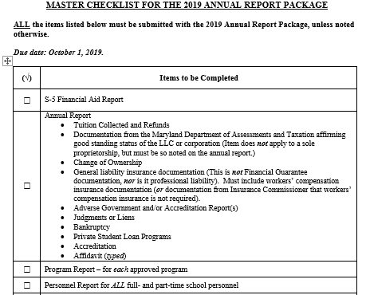
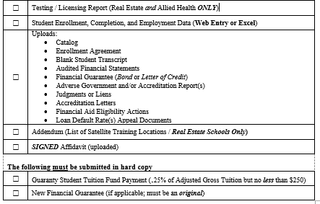
Master checklist
Use the Master Checklist to ensure that everything has been submitted.

Slide 31


Practice
Transcript A
Transcript B
Reaching Dreams Academy
Program: CNA
Student: Ayesha Williams
Reading Rainbow Institute
Program: Cosmetology
Student: Mark Connelly

Slide 32
Thank you!
Division Contact Information:
Ashley Wallace, Ph.D., Associate Director, 410-767-4983 Ashley.Wallace@maryland.gov
Angela Carroll, Education Analyst, 410-767-3305, Angela.Carroll@maryland.gov
Ronda Brown, Administrative Assistant, 410-767-3403, Ronda.Brown@maryland.gov

