Slide 1


FY’27 Operating and Capital Budget Presentation
MARYLAND HIGHER EDUCATION COMMISSION
Dr. David K. Wilson l PRESIDENT
September 17, 2025

Slide 2
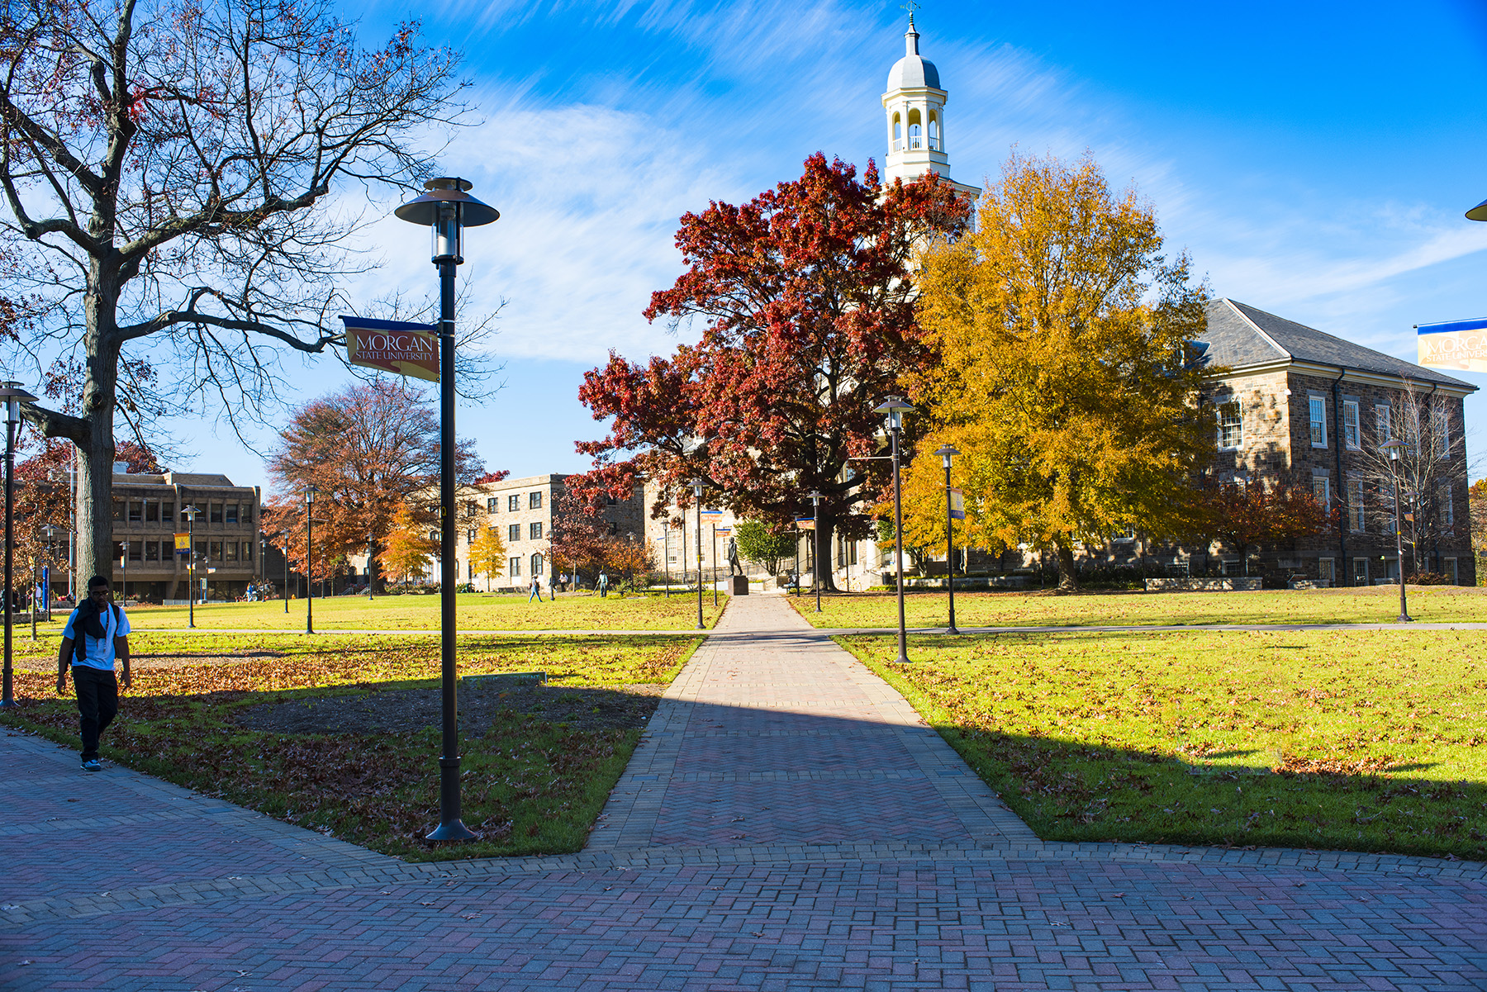
OVERVIEW
Presentation Highlights
Morgan State University at a Glance
Leaning Forward: Transformation Morgan 2030
Academic Investments
Enrollment Management and Student Success
Research and Development
FY 2027 Operating and Capital Budget Requests

Slide 3


MORGAN STATE UNIVERSITY
AT A GLANCE

Slide 4
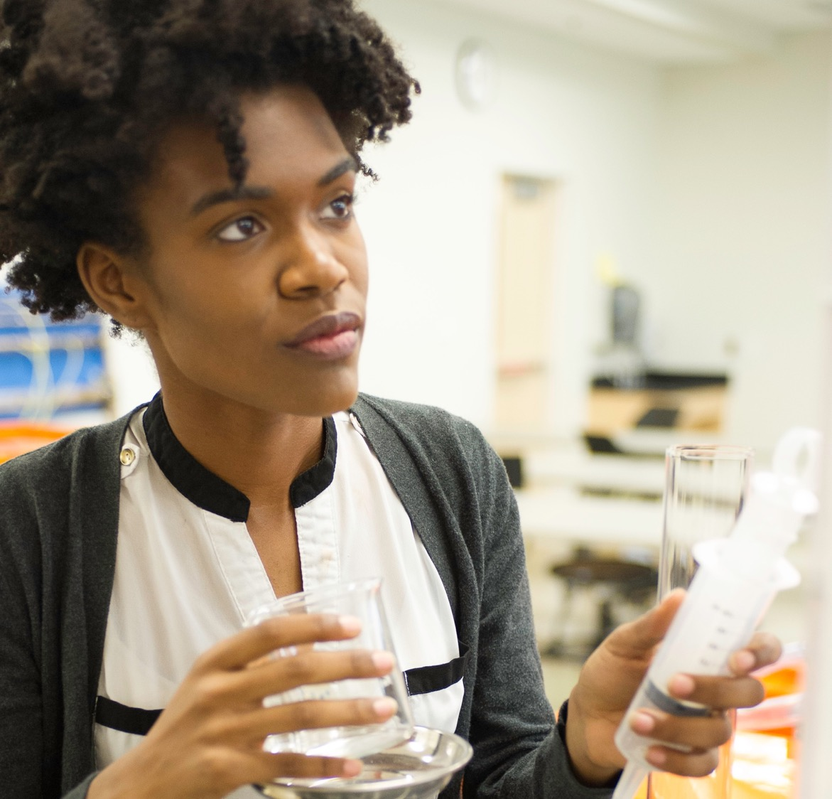

Our
Core Values
VISION STATEMENT
Morgan State University is the premier public urban research university in Maryland, known for excellence in teaching, intensive research, effective public service and community engagement. Morgan prepares diverse and competitive graduates for success in a global, interdependent society.
Leadership
Innovation
Integrity
Diversity
Excellence
Respect
L I I D E R

Slide 5
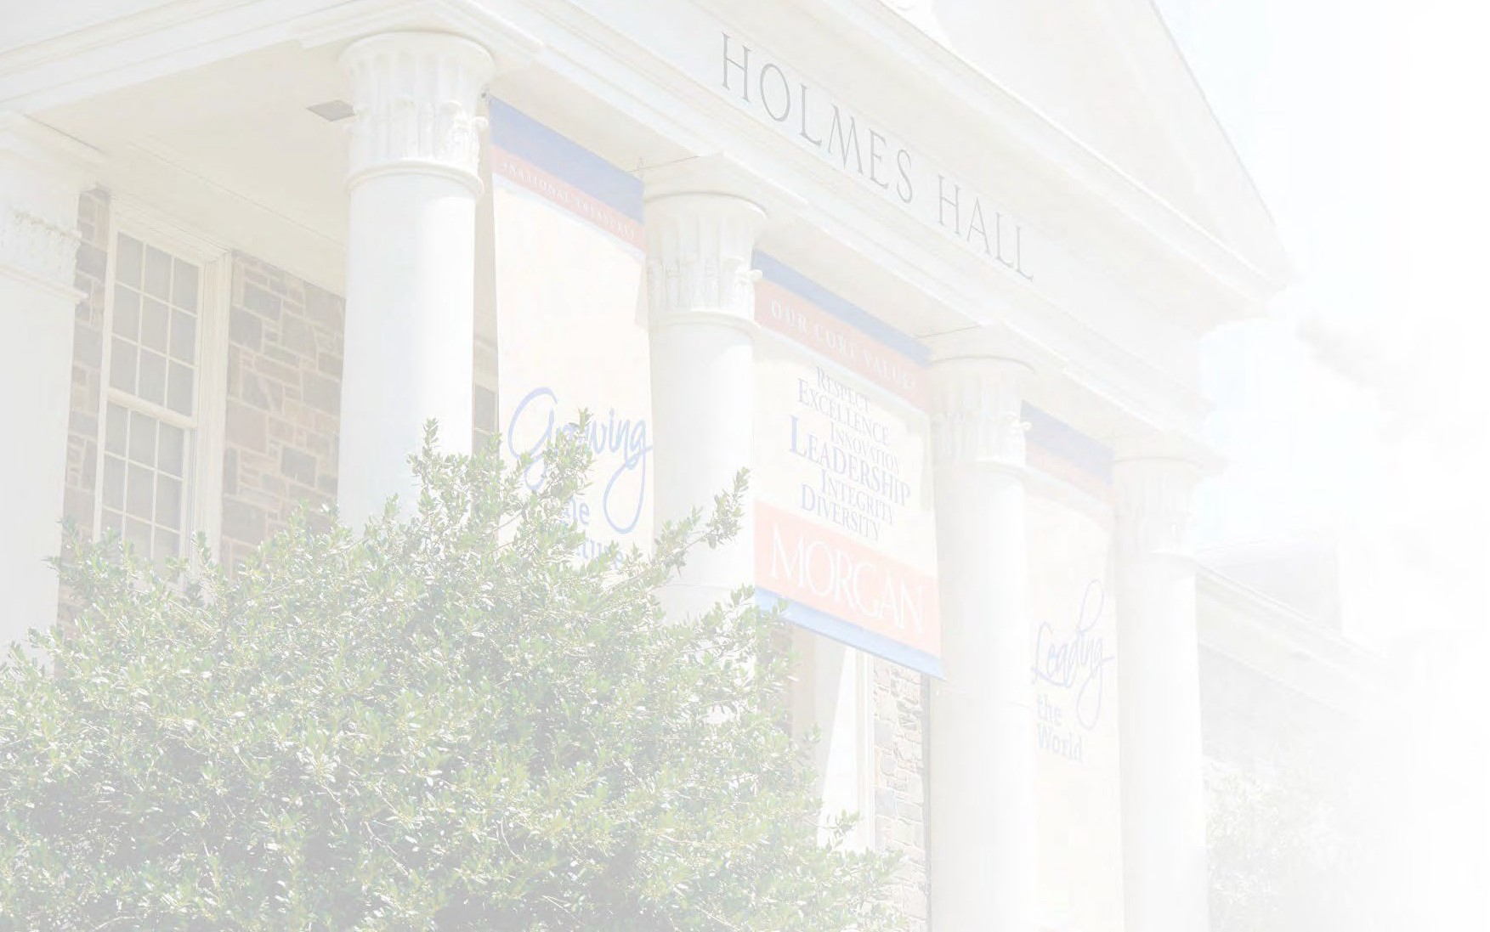


Rigorous academic curricula and challenging co-curricula opportunities to promote the development of and to facilitate the exercise of leadership.
Leadership
Integrity
Honest communications, ethical behavior, and accountability for words and deeds.
CORE
Innovation
Faculty, staff, and students are encouraged and supported in scholarship and in the discovery and application of knowledge.
VALUES
Diversity
A broad diversity of people and ideas are welcomed and supported as essential to quality education.
Excellence
In teaching, research, scholarship, creative endeavors, student services, and in all aspects of the University’s operations.
Respect
Each person is to be treated with respect and dignity and is to be treated equitably .
LIIDER

Slide 6
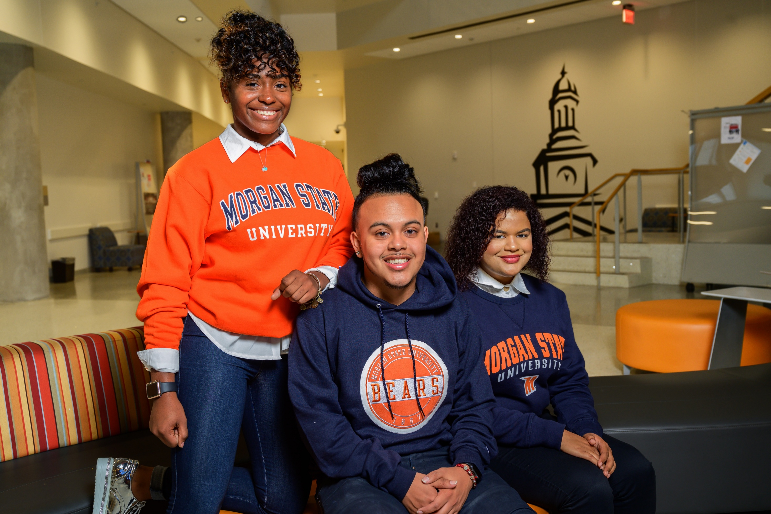
Student Population:
Fall 2024-10,739;
Fall 2025 Estimate - 11,400
Workforce (Fall 2024):
Faculty-818; Staff-2,108
Academic Degree Programs
62 Bachelor’s
54 Master’s
32 Doctoral
13 Certificate Programs
Students
Best prepared
35% First-Generation College Students
Majority have significant financial need
Campus Master Plan
2015-2025
Strategic Housing Plan
2017-2025

Slide 7
LEANING FORWARD:
Transformation Morgan 2030

Slide 8
Positioning Morgan for the Next Decade
Strategic Plan
Update
2021-2030
GOAL 1 | Enhance Student Success and Wellbeing Provide students with a comprehensive educational and transformative experience that actualizes their full potential and empowers them to emerge as confident and competent global citizens and dynamic leaders in their selected careers and communities.
GOAL 2 | Implement Faculty Ascendency and Staff Development Initiatives The University will implement a broad range of human resource development initiatives for the benefit of faculty and staff.
GOAL 3 | Elevate Morgan’s Status to R1 Very High Doctoral Research University Over the next ten years, Morgan will emerge as a R1 doctoral research university fully engaged in basic and applied research and creative interdisciplinary inquiries undergirded and sustained through increased research grants and contracts.
GOAL 4 | Expand and Improve a Campus-Wide Infrastructure to Support Operational Excellence and Increase Overall Institutional Capacity Morgan will advance new construction, capital improvement, deferred maintenance, and campus safety projects in keeping with the University’s evolving master plan.
GOAL 5 | Serve as the Premier Anchor Institution for Baltimore City and Beyond Morgan will expand and deepen its role as a recognized anchor institution with broad social and economic impact.
GOAL 6 | Accelerate Global Education Initiatives and Expand the University’s International Footprint Morgan will enhance its study abroad program and promote global awareness and intercultural competencies through its diverse curricular and co-curricular programs and activities.

Slide 9
ENROLLMENT MANAGEMENT
AND STUDENT SUCCESS

Slide 10
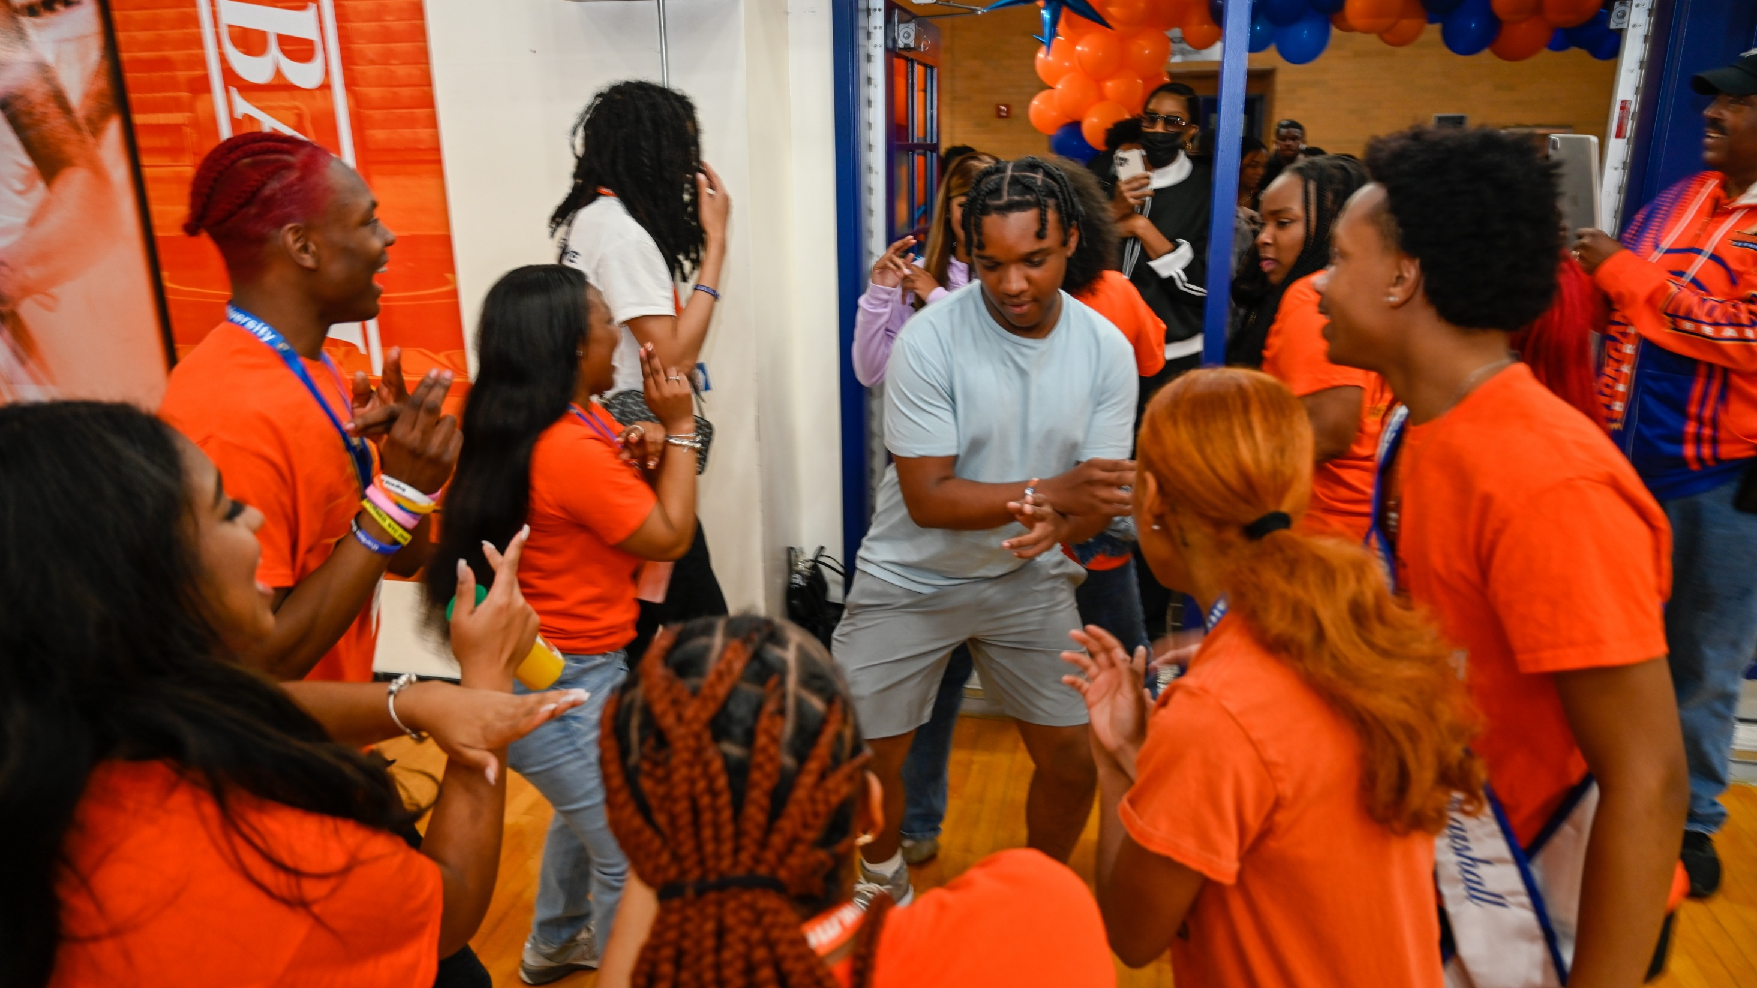
OVER 25,000 FRESHMAN APPLICATIONS!

Slide 11
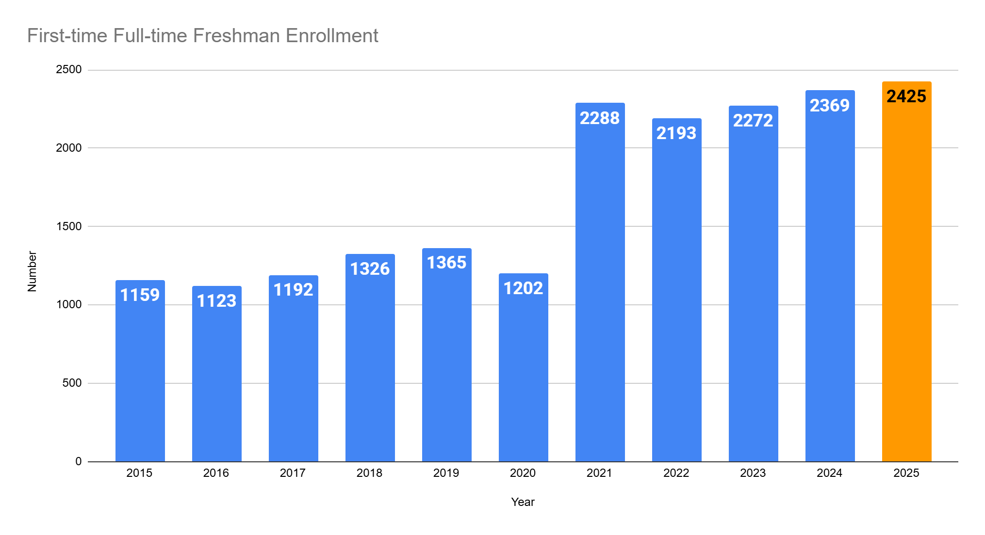
RECORD FRESHMAN ENROLLMENT TRENDS CONTINUE
Projected

Slide 12
GRADUATE STUDENT ENROLLMENT GROWTH
Projected

Slide 13
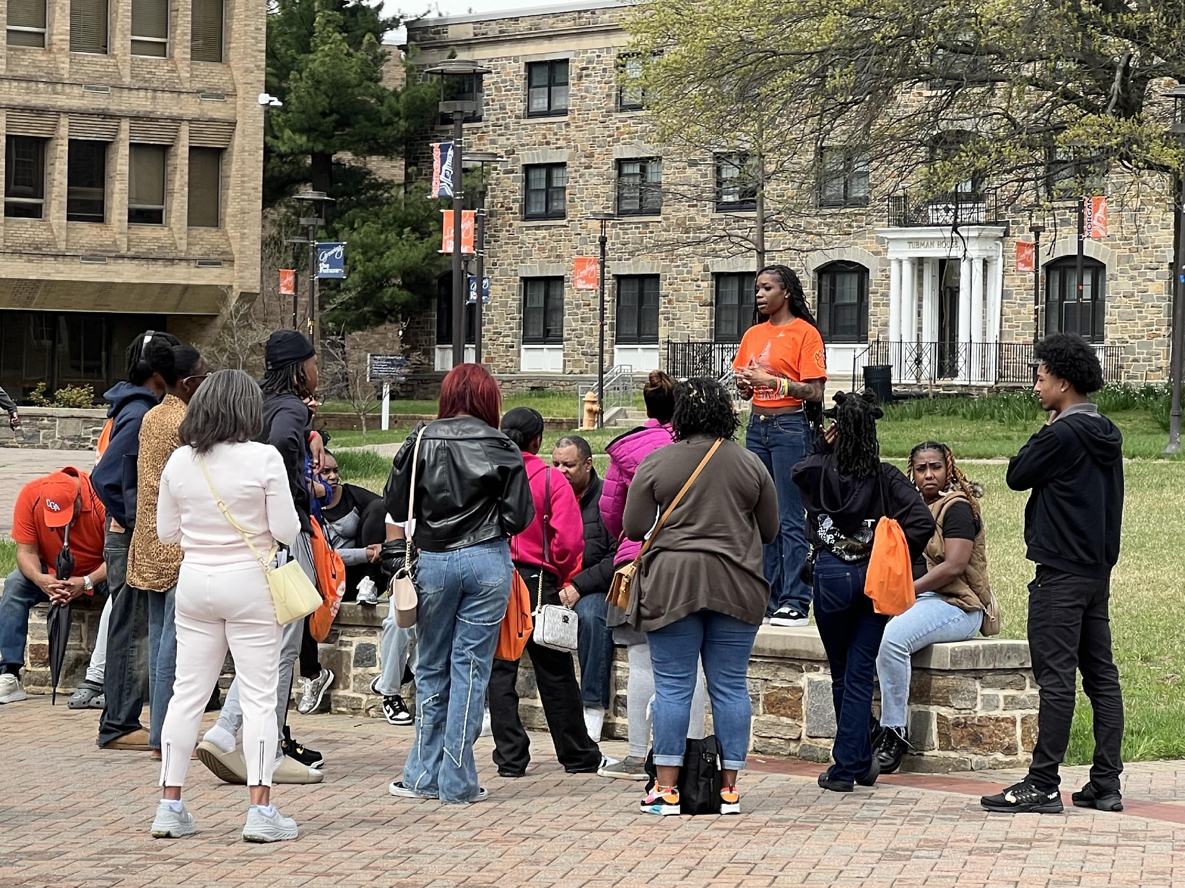
RECORD ENROLLMENT PROJECTED
Conservative-11,000 (Last fall 10,739)
Likely-11,200
Possible-
11,500+

Slide 14
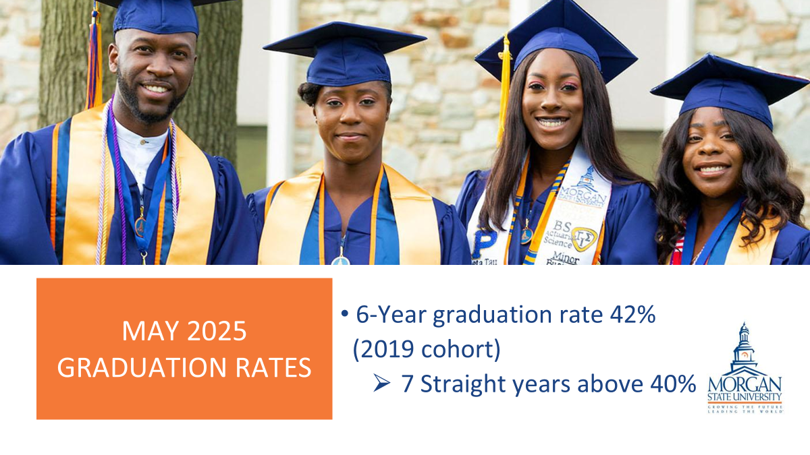
IPEDS TREND IN 2ND YEAR RETENTION RATES • FULL-TIME COHORTS

Slide 15
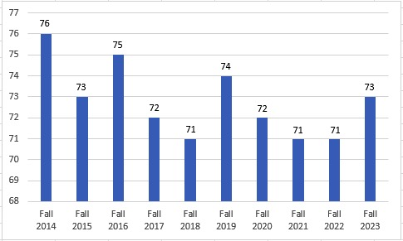
IPEDS TREND IN 2ND YEAR RETENTION RATES • FULL-TIME COHORTS

Slide 16
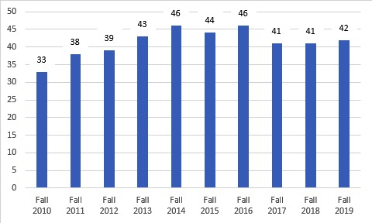
SIX YEAR GRADUATION RATES • FULL-TIME COHORTS

Slide 17
STUDENT DEBT – MONITORING MEASURES
Approximately 64% of our student population is receiving Federal Loans.
To better understand and monitor the loan burden of our students, we perform the following:
Exit Counseling:
Loan exit interviews are mandatory for our upcoming graduates and other students who will not continue with the University and have Federal loans.
Student borrowers are provided with info on understanding repayment options and managing debt, their rights and responsibilities, and most importantly, how to avoid loan default.
Partner with ECMC, a student loan guarantor; who reaches out to our students regarding loan payment counseling, and default prevention.
ECMC helps students recognize and realize their potential by investing in, creating, and providing innovative education solutions that support schools and improve student educational outcomes.

Slide 18
STUDENT DEBT – MINIMIZING THE LOAN BURDEN
Morgan hired a Financial Wellness Coordinator to proactively work with our students to provide financial wellness education and support the holistic success of our students, who represent first-generation college students. This position helps Morgan to meet the diverse financial needs of our student body.
Our financial wellness programs are designed to provide comprehensive financial guidance and coaching:
Financial Wellness Workshops: These workshops touch on various topics such as budgeting, financial planning, and managing student loans, including keeping our community informed as to the latest changes happening with the US Department of Education.
Individual Coaching: Personalized financial counseling sessions to help students understand their financial situations, create budgets, and develop plans to manage their finances effectively. For example, helping graduating seniors to create debt repayment plans and helping incoming students to enhance life planning and earning expectations around choosing majors, and helping students in between to manage their day-to-day budgeting so they can stay in school and graduate.

Slide 19
STUDENT DEBT – AVERAGE SIZE OF DEBT VS. INCOME
https://collegescorecard.ed.gov/school/?163453-Morgan-State-University

Slide 20
RESEARCH AND ECONOMIC DEVELOPMENT

Slide 21
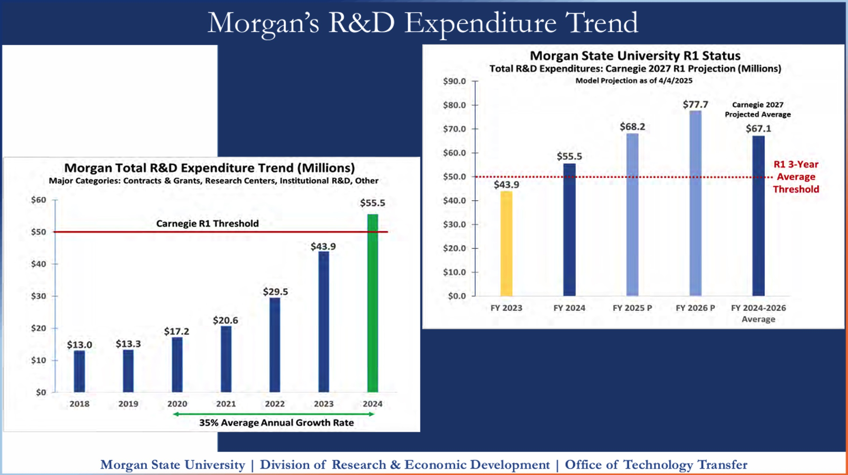

Slide 22
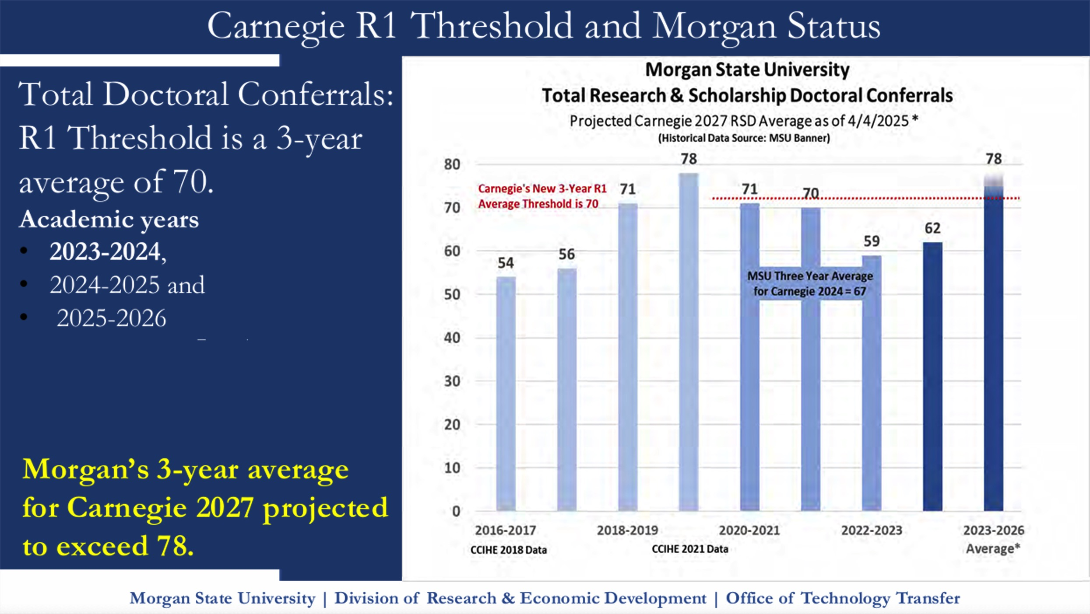

Slide 23
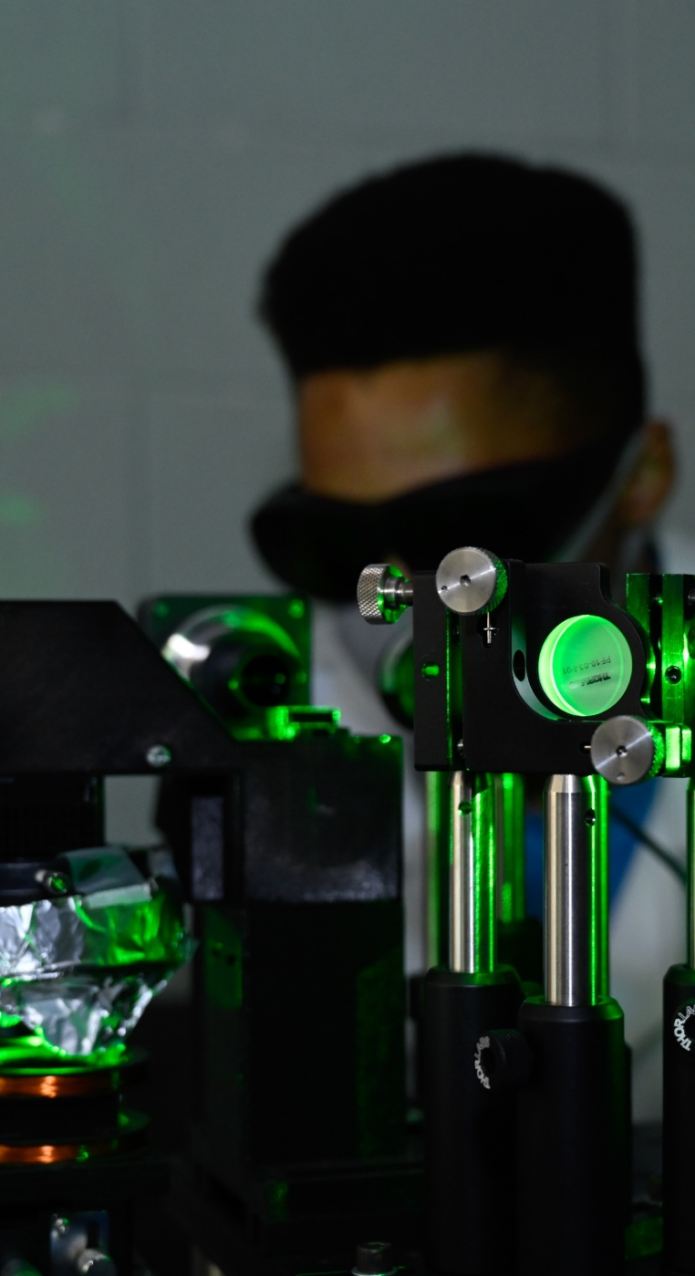
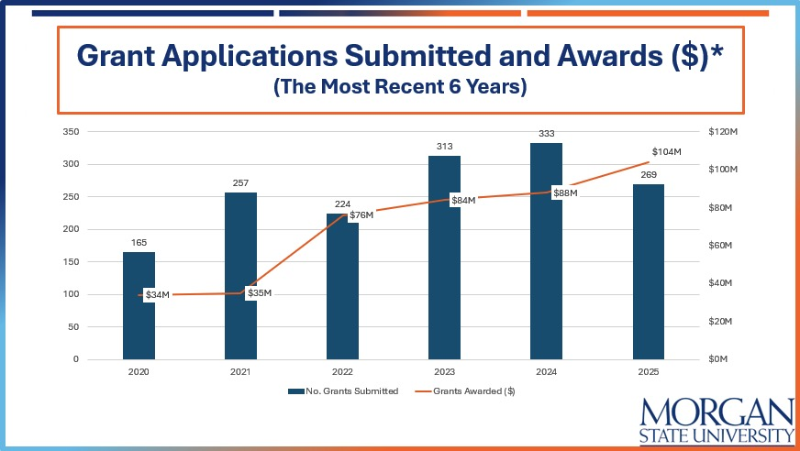
RESEARCH AT MORGAN ACHIEVING NEW HEIGHTS

Slide 24

ECONOMIC IMPACT OF MORGAN
Morgan State University continues to prove that its value extends well beyond the classroom as a major economic engine for the city and state annually producing $1.5 billion in statewide economic impact, supporting 8,200 jobs and generating $71 million in state tax revenues. Approximately 60 percent of that economic and employment impact occurs in Baltimore.

Slide 25
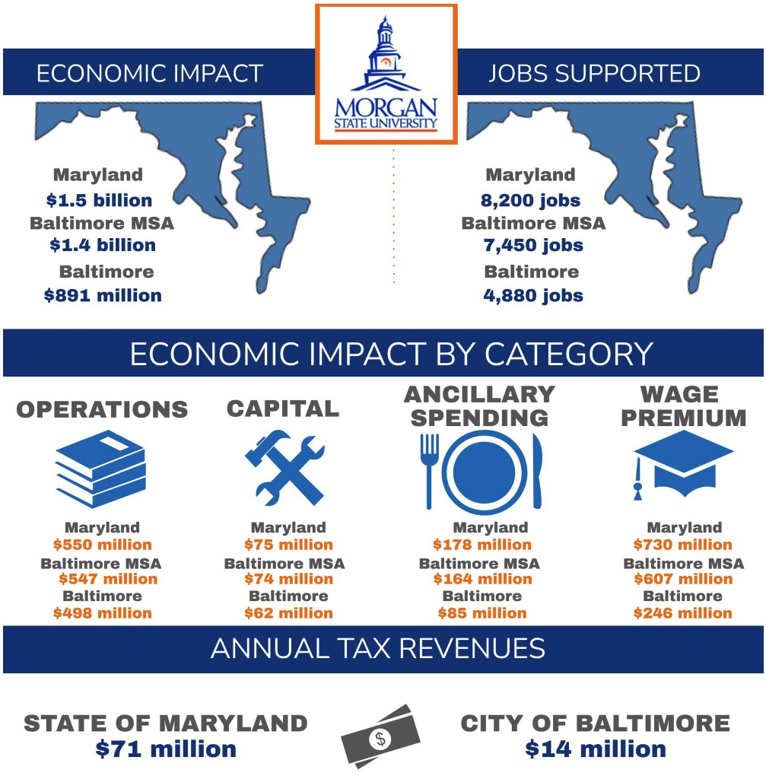
Morgan is a major economic engine for the city and state

Slide 26
RECORD NUMBER OF PATENTS ISSUED
Snapshot of the 90th - 100th Ranked U.S. University Patent Awardees in 2023

Slide 27
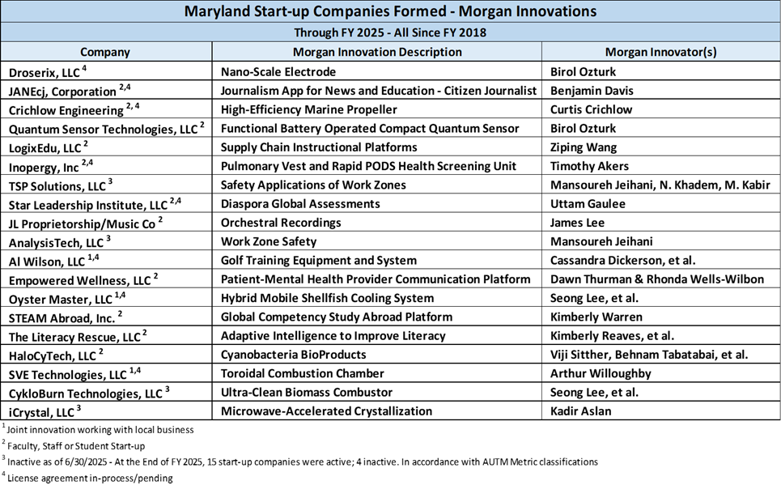
MORGAN’S MARYLAND START-UP COMPANIES

Slide 28
OPERATING AND CAPITAL BUDGETS

Slide 29
OPERATING BUDGET REQUEST
Priority | University Initiative | Amount
1 | Center for Brain Science | $3.5M
2 | The Urban Future Laboratory | $5.0M
3 | Next-Era tech- and AI-enabled Transportation Safety Research Center (NEATS) | $3.0M
 | Total for FY 2027 | $11.5M
Developing innovative research centers to find solutions to the state’s greatest challenges.

Slide 30
OPERATING BUDGET REQUEST
Priority | Operational Shortfall – Security Technology | Amount
1a | Security Technology Maintenance Monitoring | $2.5M
1b | Security Related Subscriptions | $1.0M
1c | Security Technology Upgrades | $1.0M
1 | Total for FY 2027 | $4.5M
Additional recurring operational needs to support critical security technology enhancements.

Slide 31
DETAILS ON MORGAN’S OPERATING BUDGET
Budget information is prepared by the MSU central budget/planning office
Marvin Hick, Budget Director; marvin.hicks@morgan.edu
Cynthia Wilder, University Planner; cynthia.wilder@morgan.edu
Jazzmine Carter, Sr. Financial Analyst; jazzmine.carter@morgan.edu
Morgans budget consists of state and self-supporting operations in the current fund and grant related activities in the restricted fund. The FY27 budget request is $351M for state support, $76M for auxiliary, and $126M for restricted funds for a combine FY27 budget request of $553M.
Morgan expends substantially all of its budget either directly during the year or via budget encumbrances for expenditures that have been obligated.

Slide 32
DETAILS ON MORGAN’S OPERATING BUDGET
Percent of annual budget expended , based on financial statement data, per NACUBO operating categories is as follows:
Instruction: 21%
Research: 17%
Academic Support: 11%
Student Services: 4%
Institutional Support: 17%
The percentages noted above are in line with ‘same size’ and peer R-1 or aspiring R-1 institutions
Total vacancies as of 6/30/25 total 177 – 44 faculty, 84 exempt, and 49 non-exempt – at a vacancy rate of 10%.

Slide 33
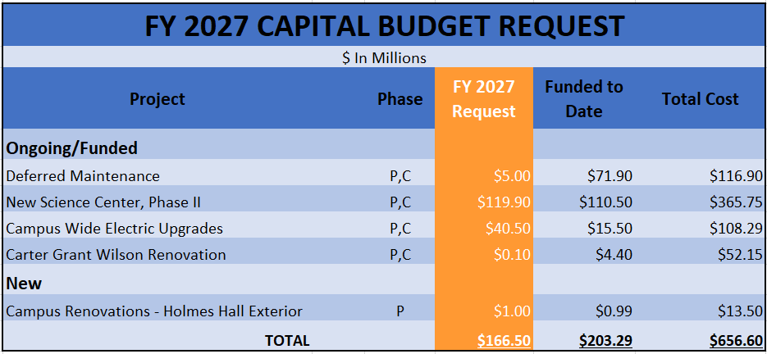
CAPITAL BUDGET REQUEST

Slide 34
FY’27 Operating and Capital Budget Presentation
MARYLAND HIGHER EDUCATION COMMISSION
Dr. David K. Wilson l PRESIDENT
September 17, 2025

