Slide 1
St. Mary’s College of Maryland
Operating and Capital Budget
Presented to the
Maryland Higher Education Commission
September 17, 2025

Rhonda G. Phillips, Ph.D.
President
Katherine L. Gantz, Ph.D.
Provost and Dean of Faculty
Eileen E. Petula, CPA MBA
Vice President for Business
and Chief Financial Officer

Slide 2
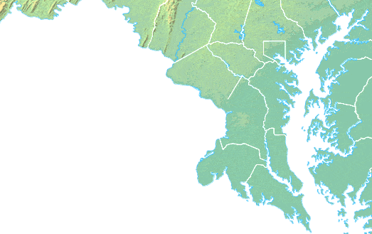
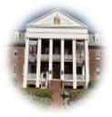
We are…
Liberal Arts
Honors
Accessible
Affordable

Slide 3
By The Numbers

Slide 4
By The Numbers
Tuition Rankings
Public Four-Year
6th
54th
2012-2013
2023-2024
ON
OFF
USDE’s “Highest Tuition” List

Slide 5
Access

Slide 6
Affordable Access
Comparisons use the most recently available data.

Slide 7
Affordable Value
Comparisons use the most recently available data.

Slide 8
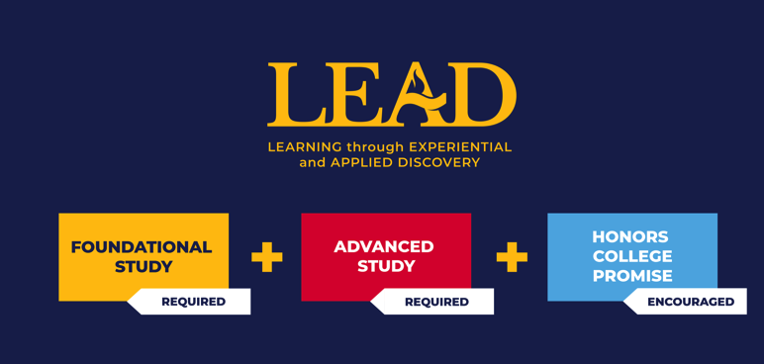

Slide 9
Quality
Class of 2024 – St. Mary’s College of Maryland
Five-year average – National Baccalaureate Arts & Sciences

Slide 10
Equitable Quality
All SMCM Students
SMCM Students of Color
SMCM Pell Students

Slide 11
Success
Comparisons use the most recently available data.

Slide 12
Equitable Success
All SMCM Students
SMCM Students of Color
SMCM Pell Students
Five-year averages.
Notes:
All are five-year averages

Slide 13
Current State Funding
12

Slide 14
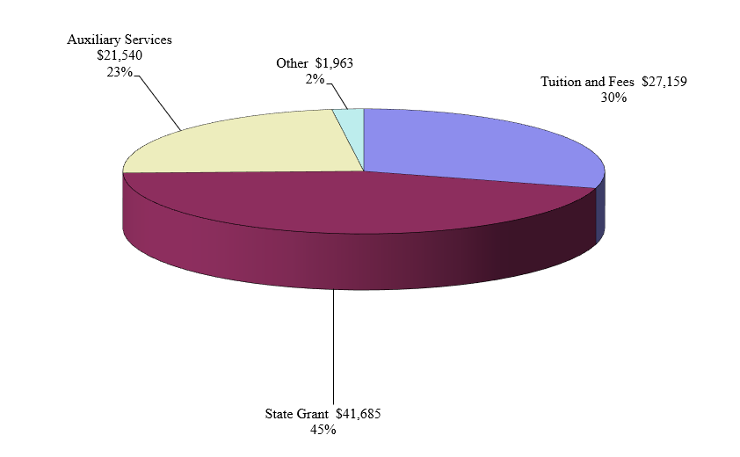
Current Funds Unrestricted Revenues by Source

Slide 15
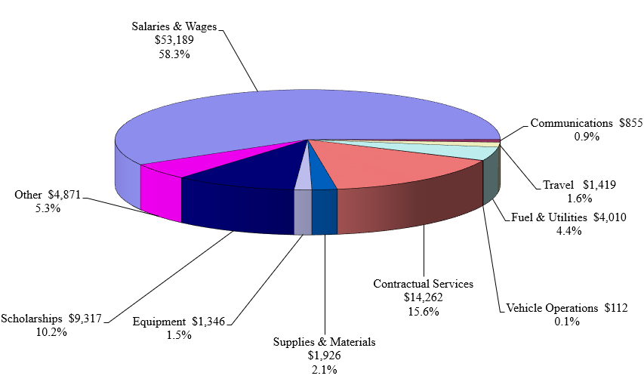
Expenditures by Object

Slide 16
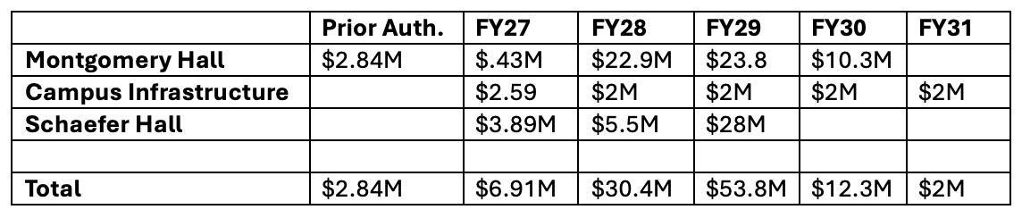
Capital Initiatives Summary

Slide 17
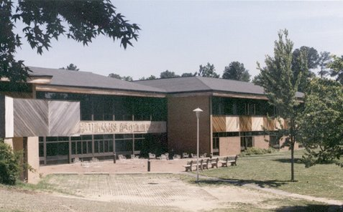
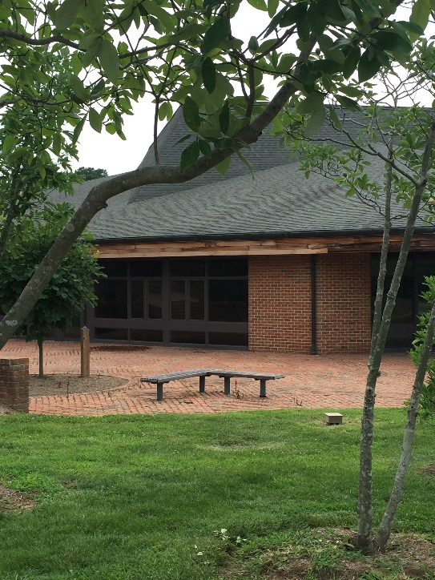
Montgomery Hall

Slide 18
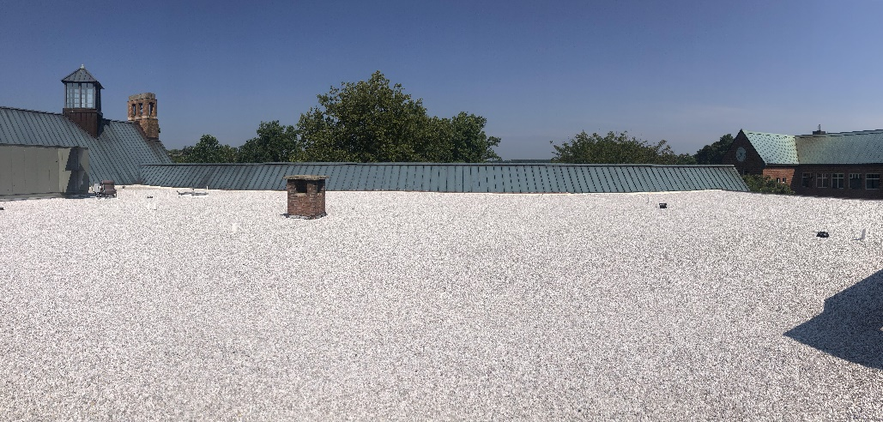
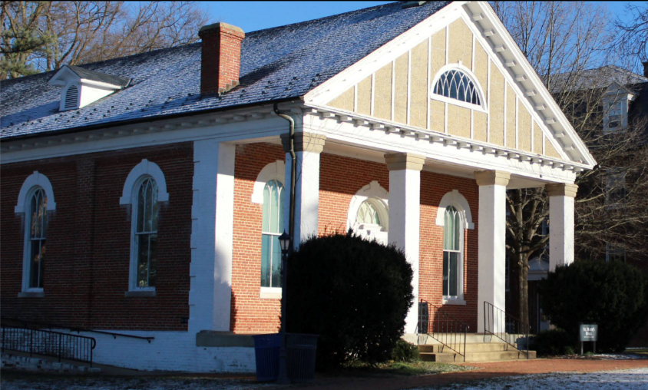
Campus Infrastructure
Historic St. Mary’s Hall Revitalization
(FY27 initiative)
Campus Center Roof Replacement
(completed FY24)

Slide 19
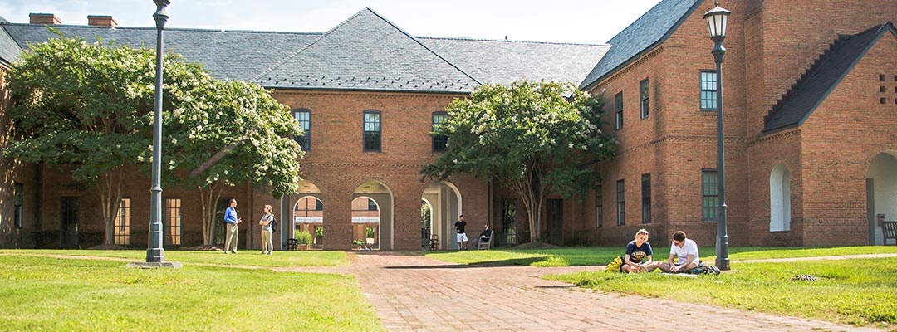
Schaefer Hall

Slide 20



Thank you!
Questions?

