Slide 1








MARYLAND ASSOCIATION OF COMMUNITY COLLEGES
Operating and Capital Budget Presentation
September 2025
Dr. Brad Phillips, Executive Director

Slide 2

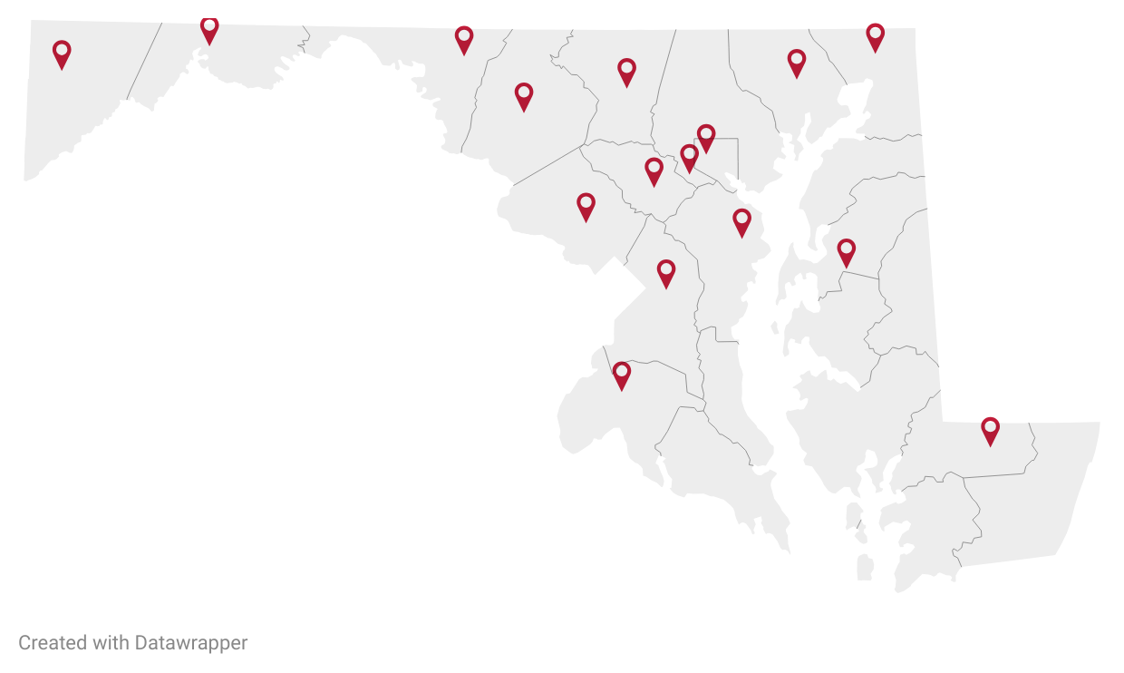



We’re #1: Again
Maryland’s community colleges are the best in the U.S.
Fall 2024 Enrollment:
244,000 Students
16 Community Colleges
23 Campuses
1,000+ Sites
24/7 Virtual Learning
Blended Locations
Weighted Summation
Ranking
College’s Priority
Source: Wallethub Report, 2024 and 2025
Notes:
Fall 2024 Enrollment: 244,000 total including 104,000 credit and over 139,654 enrolled in workforce training courses (not for credit).

Slide 3
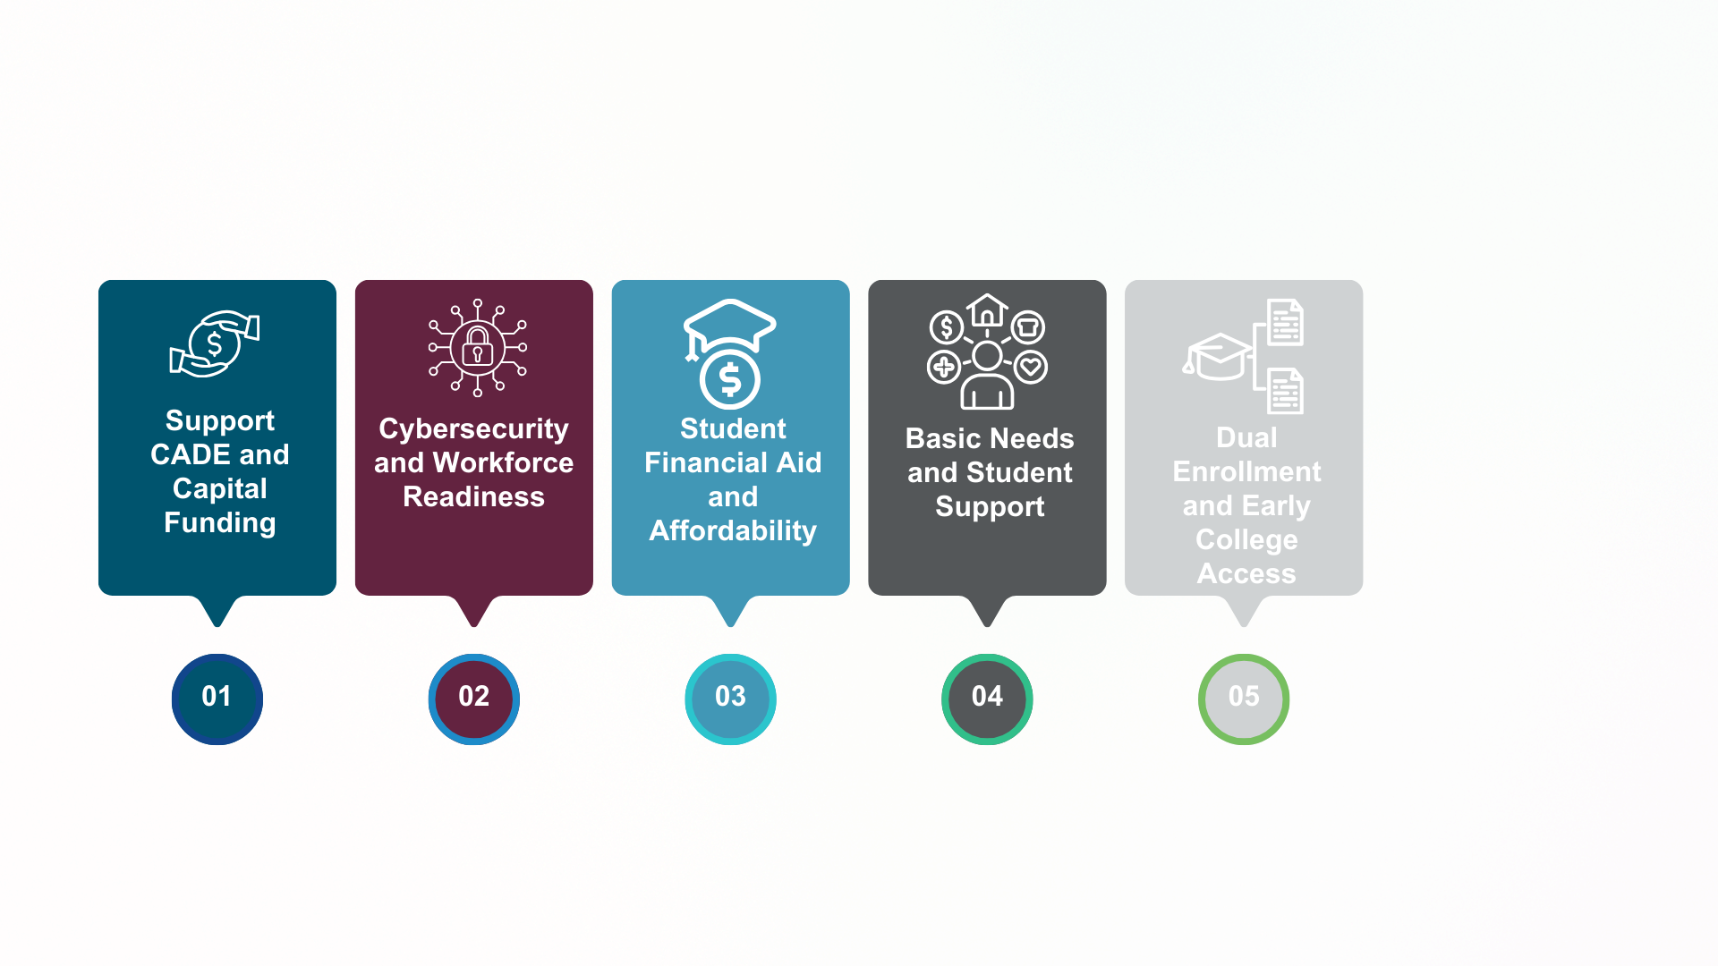
2026 Legislative Priorities
Weighted Summation
Ranking
Notes:
Support full funding of the CADE formula
Support capital project requests
Cybersecurity and Workforce Readiness
Student Financial Aid and Affordability
Basic needs and student support
Dual enrollment and Early College Access

Slide 4
RESPONSE TO QUESTIONS:HIGHLIGHTS
Ranking
College’s Priority

Slide 5
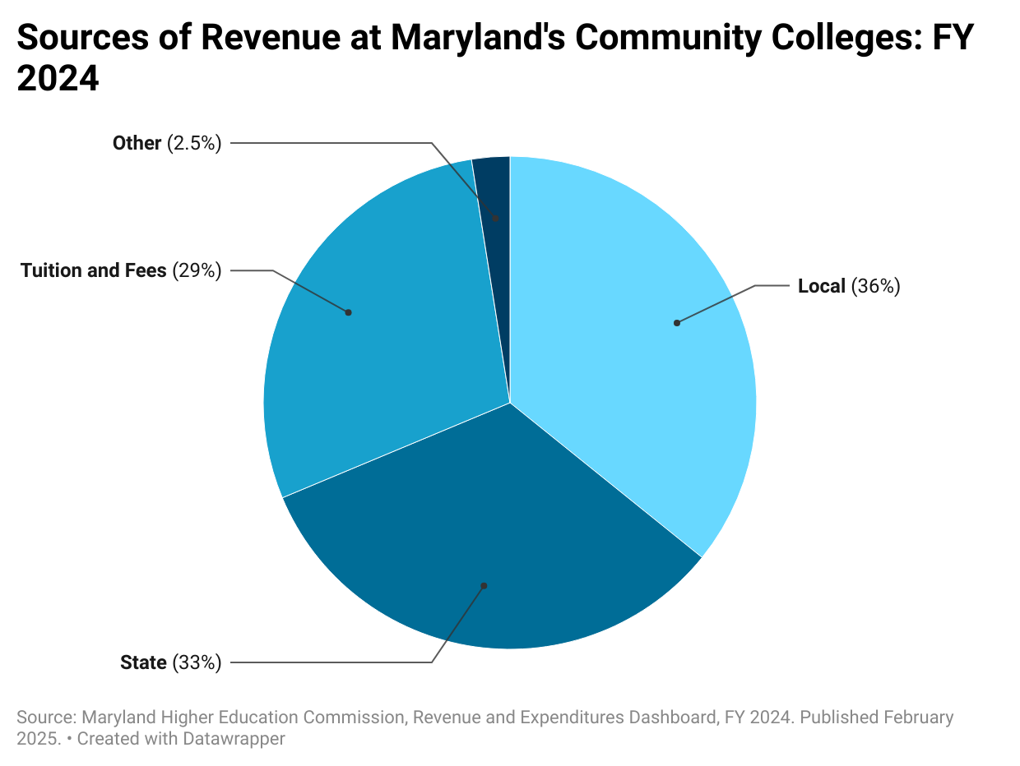
Revenue
Weighted Summation
Ranking
College’s Priority
Notes:
“Our colleges rely on a diverse mix of funding. State and local support are critical, but tuition and federal grants also play key roles.”

Slide 6
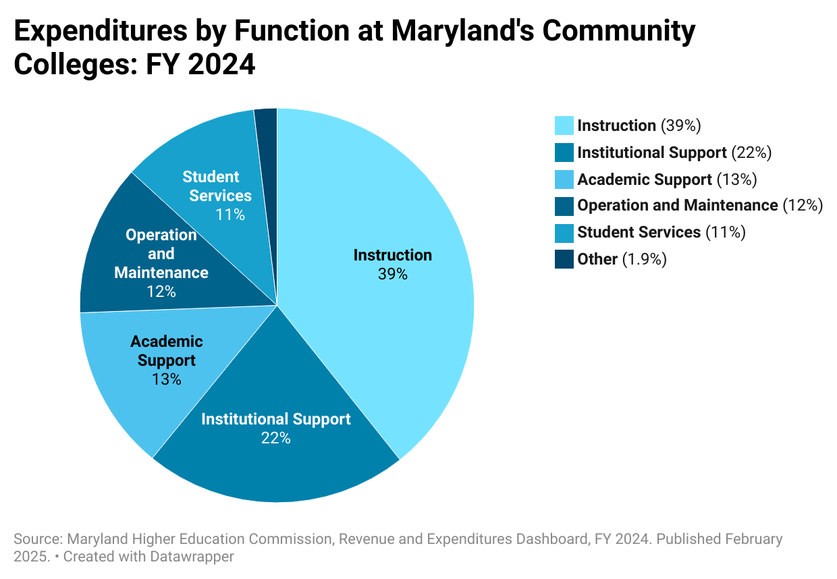
Expenditures By Function
Weighted Summation
Ranking
College’s Priority

Slide 7
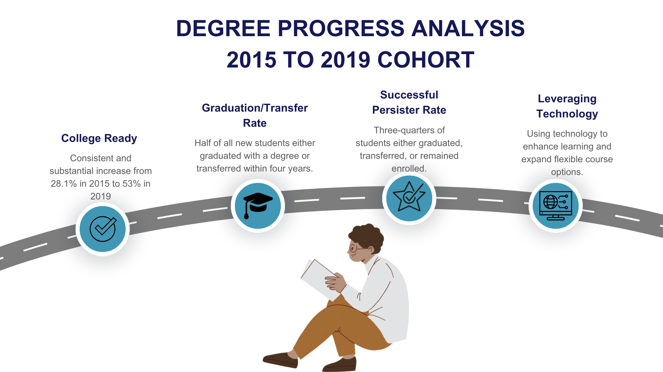
Ranking
College’s Priority
Source: Maryland Higher Education Commission, Degree Progress Analysis: Community Colleges, December 2024

Slide 8
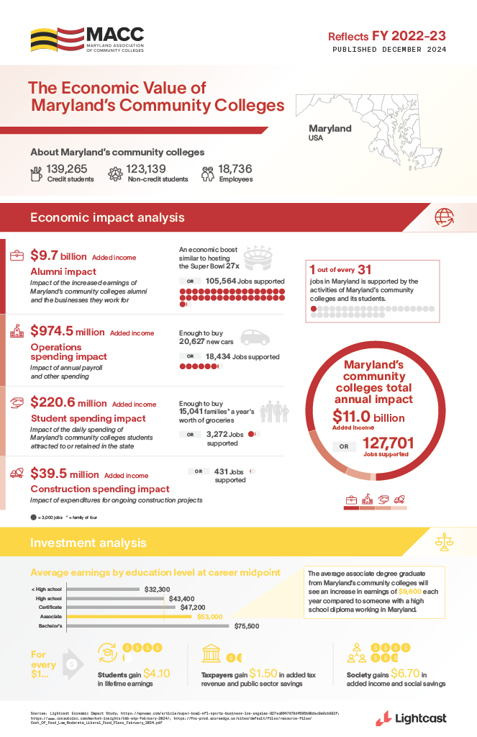
Weighted Summation
Ranking
College’s Priority

Slide 9






15 CYBER RANGES FUNDED
Senator Edwards Fund
MD Commerce + Earmark
TEDCO EGF Grant
HAGERSTOWN CC
ALLEGANY CC
GARRETT CC
FY26 MD Budget
BCR SERIES 3000 CYBER RANGES
BCR SERIES 3000 CYBER RANGES
AACC
BCCC
CARROLL
CECIL
CHESAPEAKE
CSM
FREDERICK
HARFORD
HOWARD
MONTGOMERY
PGCC
CCBC
Wor-Wic

Slide 10
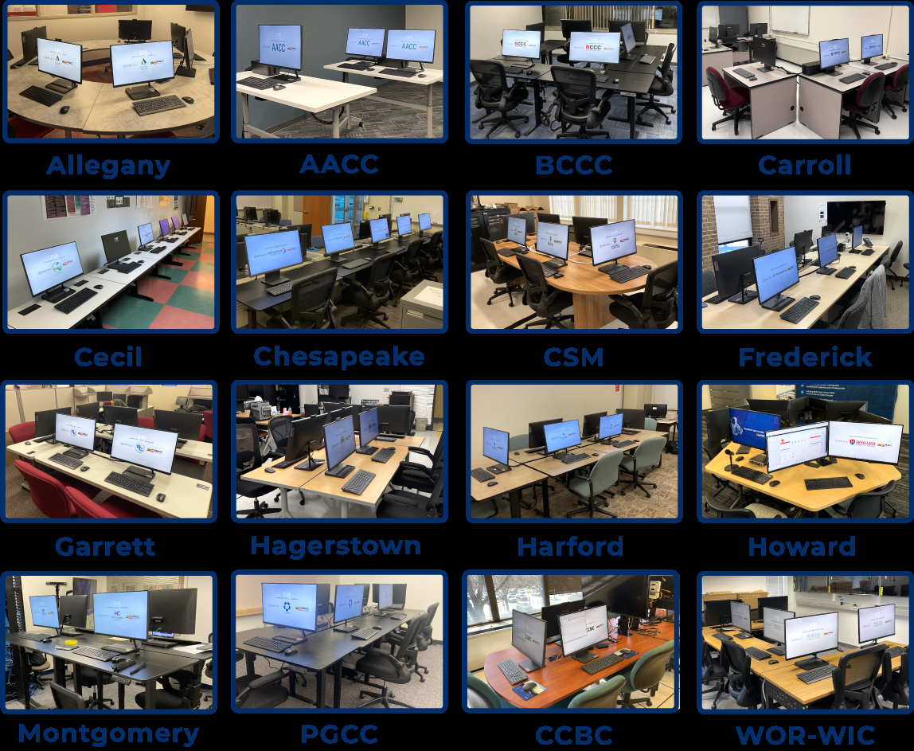
Workforce Innovation
Goal: Train 1,100 | 80% Job Placement
As of September 1, 2025 (Cohort #5)
275 Learners Enrolled
62 Completed Training
42 Certifications

Slide 11
THANK YOU!
Weighted Summation
Ranking
College’s Priority

