Slide 1





Regional Higher Education Centers
Maryland Higher Education Commission
September 17, 2025

Slide 2
Maryland’s Regional Higher Education Centers Definition: “Higher education facility that is operated by a public institution of higher education in the State or a nonpublic institution of higher education operating under a charter granted by the General Assembly and includes participation by two or more institutions of higher education in the State, consists of an array of program offerings from institutions of higher education approved to operate in the State by the Commission or by an act of the General Assembly that specifically satisfies the criteria set forth in § 10-212(b) of this title, offers multiple degree levels; and is either approved by the Commission to operate in the State or is established by statute.” §10-101(k) Education Article, Annotated Code of Maryland.

Slide 3
Maryland’s Regional Higher Education Centers
Duties and Goals:
Regional Higher Education Centers shall, “Provide access to affordable higher education programs to citizens in unserved or underserved areas of the State, respond to the needs of businesses and industries in the areas in which they serve and encourage participation by institutions of higher education for the benefit of students and serve the needs of, and provide programs to, elementary and secondary schools, business and industry, and governmental agencies.” §10-212(b) Education Article, Annotated Code of Maryland

Slide 4
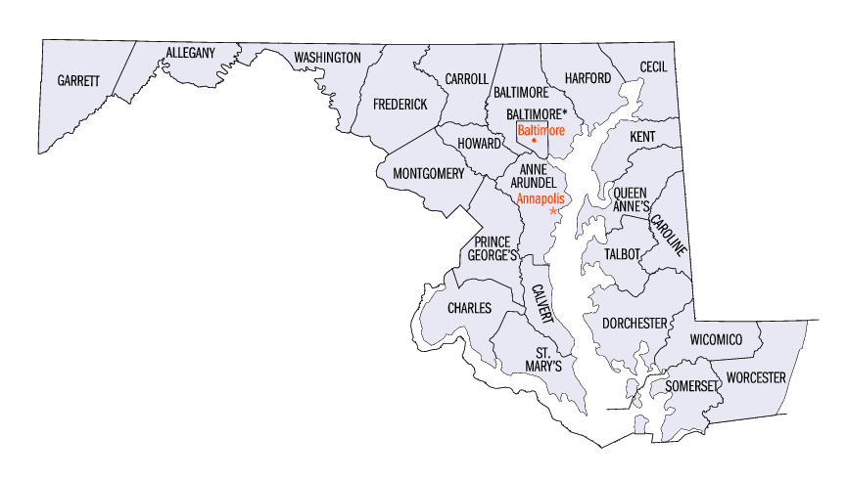
Regional higher education center locations Serving underserved areas of the State
University System of Maryland
at Hagerstown
(USM)
Anne Arundel Community College at Arundel Mills
Eastern Shore Regional Higher Education Center
The Universities
at Shady Grove (USM)
Laurel College Center
The Universities at LaPlata
University System of Maryland at Southern Maryland
(USM)

Slide 5
Differing RHEC governance and organizational structures
Four centers with State fund oversight by MHEC
Anne Arundel Community College (AACC) at Arundel Mills University Consortium
Eastern Shore Higher Education Center
Laurel College Center
The Universities at LaPlata
Three centers governed by the University System of Maryland (USM) Board of Regents
The Universities at Shady Grove
University of Maryland at Hagerstown
Southern Maryland Higher Education Center

Slide 6
Funding strategy for regional education centers under MHEC oversight
The funding strategy includes:
Base allocation for each center ($200,000)
Incentive funding for Target FTES (2+2 lower division, upper division and graduate enrollment)
Lease funding for centers with leased space that have not received State capital funding support
Special funding for one-time projects or start-up costs

Slide 7
FY 2026 Allocation

Slide 8


mhec.maryland.gov

