Slide 1
Marcus Wright
Director of Transfer, Articulation & Career Alignment
Anne Arundel Community College
mwright22@aacc.edu

Slide 2
AACC at Arundel Mills Regional Higher Education Center provides access to affordable, high quality associate, baccalaureate and graduate degree programs that meet the needs of learners historically underserved; the necessary career education and skills to successfully compete in the workplace and global economy, with a focus on areas of worker shortages; lifelong learning and life skills opportunities; and a full array of instructional and student support services to ensure completion and student success.

Slide 3
15 DEGREE PROGRAMS | 4 INSTITUTIONS | 1 CONVENIENT LOCATION

Slide 4
ACADEMIC PROGRAMS
Associate
Bachelor
Business Administration
Cybersecurity Management & Policy
Master
Leadership in Teaching
Engineering (Electrical)
Information Systems Management
Liberal Studies/Elementary Education
Management Studies
Homeland Security
Teaching
Nursing
Leadership in Nursing Administration (Concentration)
Leadership in Nursing Education (Concentration)
Business Administration Transfer
Elementary Education
Electrical Engineering
Homeland Security Management
Information Assurance and Cybersecurity

Slide 5
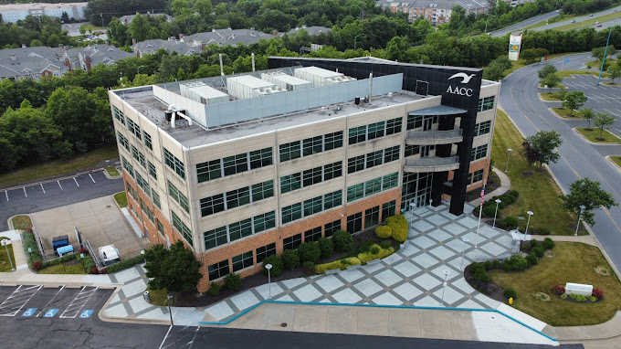
BY THE NUMBERS
80,272 gross square foot facility
1,000 steps away from Live! Casino & Hotel
449 steps away from Arundel Mills Mall
135-seat lecture hall
27 general-purpose classrooms
27 miles from AACC (Arnold campus)
25 miles from PGCC (Largo campus)
16 laboratories (science, computer, engineering)
14 miles from Howard Community College
9 miles from CCBC-Catonsville campus
1 3D printer
1 Lactation room
1 Engineering Fabrication Shop
1 distance learning classroom

Slide 6
FULL-TIME ENROLLMENT (FTE)

