Slide 1
Maryland Higher Education Commission
Maryland Association of Community Colleges
Operating and Capital Budget Presentation
September 22, 2021

Slide 2
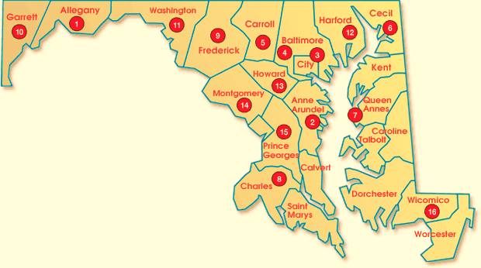
Maryland’s Community Colleges
16 Colleges
23 Campuses
1,000+ Sites
24/7 Virtual Learning
Blended Locations

Slide 3

Adults
Entry-level workers
Early retirees
Career changers
Underemployed adults
The Blueprint for Maryland’s Present – Building an Inclusive Workforce Postpandemic
Adults
Lifelong Learning
K-12
Certification/Recertification
Licensure
Post-baccalaureate Programs
Acquire new skills
Middle College
Early College Access
PTECH
Transition Courses
Community
College
Students
Disenfranchised
4Yr Institutions
HS dropouts (GED)
Immigrants (ESL, ABE)
Illiterate (ESL, ABE, GED)
Unemployed adults
Incarcerated
Students with disabilities
Transfer students
Associates completers
Traditional students
Workforce
Customized training
Incumbent workers
Short-term credentials

Slide 4

Maryland Community College Student Demographics
Female – 57 Percent | Male – 43 Percent
Average Age – 24 Years old
Full-Time – 31 Percent and Part-Time 69 Percent
46 Percent of full-time students work while taking classes.
76 Percent of part-time students work while taking classes.
Race/Ethnicity
Hispanic/Latino – 10 Percent
Black/African American – 27 Percent
American Indian/Alaskan Native – 0.2 Percent
Native Hawaiian/Pacific Islander – 0.1 Percent
Asian – 6 Percent
White – 47 Percent
Multiple Races – 4 Percent
Foreign/Non-Resident – 4 Percent
Unknown/Not Report – 2 Percent

Slide 5
The Enduring Mission of Maryland’s Community Colleges
Protect the Value of the Associate Degree, Increase Affordable Access to the Baccalaureate, and Assure Seamless Transfer,
Building Maryland’s New Workforce,
Protect Affordability for the State’s Well-Being, and
Bridging the Digital Divide, Digital Equity, Digital Accessibility Through Strategic and Innovative Technology Solutions.
Community College’s New Strategic Plan 2022-2025

Slide 6
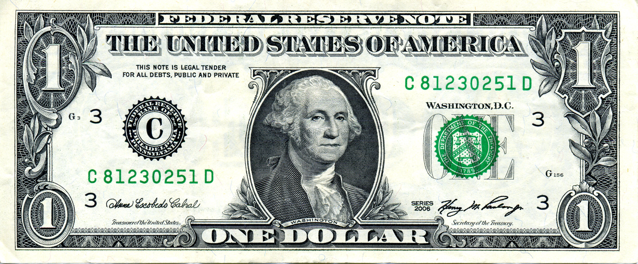
Senator John A. Cade Funded Community Colleges by Source
36% Tuition
40% Local
23% State
Note: Baltimore City Community College is not funded through the Cade Funding Formula

Slide 7
Senator John A. Cade Funding Formula FY 2007 to 2025
Full Cade Funding is 29%
We are Finally Here!

Slide 9

MD Community Colleges Facilities Renewal: FY23
Community College | Project Name | Project Cost
Baltimore City Community College | Fire Alarm System Replacement | $ 150,000
Carroll Community College | HVAC Renovation | 50,000
Chesapeake College | Manufacturing Training Center Roof Replacement | 500,000
Frederick Community College | Roof Replacement & Gutter Replacement | 488,000
Garrett College | Replace 300 Building R22 Units | 105,000
Hagerstown Community College | Multi-Roof Replacement of the Kepler Theater & Student Center | 500,000
Harford Community College | Boiler Replacement | 550,000
Howard Community College | Duncan Hall Roof Replacement | 795,000
Total |  | $ 3,138,000
482 deferred maintenance/facility renewal projects totaling over $115 million

Slide 10

Transfer with Success - Act II - $1 Million
As Maryland begins implementation of the Blueprint for Maryland’s Future, more students will:
Earn college credit at one of Maryland’s community colleges.
Will enroll into a postsecondary institution after high school graduation with college credit, blurring the line as to what it means to be a first-time full-time degree seeking student.
Need a rigorous transfer system so students who earn credit can be assured that credit will be accepted at a Maryland institution.
Maryland’s community colleges need state funding for maintaining transfer platform:
Community colleges have agreed to implement the new Transfer Equivalency Enterprise Platform known as Quottly, which will strengthen ARTSYS and help students navigate the transfer process.
For fiscal year 2024 and each fiscal year thereafter, MACC request the Governor to include in the annual budget bill a general fund appropriation of at least $1 million to fund a statewide, student-centered transfer & articulation system for all of Maryland’s higher education institutions.

Slide 11

Workforce Readiness Grant Program Deficiency
SB 515 – Workforce Readiness Grant passed the 2019 General Assembly and was signed into law by Governor Hogan.
Based on highly popular programs such as the IPT and PDIP, this legislation allowed Maryland’s community college campuses to accept donations that the Governor has the authority to match in supplemental funding for the purposes of improving each campuses technology.
In Fiscal Year 2022 and Fiscal Year 2024, the Governor may include in the State budget for each community college supplemental funding in an amount up to $250,000.
MACC requests a deficiency appropriation equal to the amount raised as a result of the legislation.

Slide 12

Questions?
Brad Phillips, Ed.D.
Executive Director
Maryland Association of Community Colleges
60 West Street, Suite 200
Annapolis, MD 21401
Phone: (410) 974-8117
Email: bphillips@mdacc.org

