Slide 1

Regional Higher Education Centers
Maryland Higher Education Commission
September 23, 2020

Slide 3
Maryland’s Regional Higher Education Centers
Definition:
“Higher education facility that is operated by a public institution of higher education in the State or a nonpublic institution of higher education operating under a charter granted by the General Assembly and includes participation by two or more institutions of higher education in the State, consists of an array of program offerings from institutions of higher education approved to operate in the State by the Commission or by an act of the General Assembly that specifically satisfies the criteria set forth in § 10-212(b) of this title, offers multiple degree levels; and is either approved by the Commission to operate in the State or is established by statute.” §10-101(k) Education Article, Annotated Code of Maryland.

Slide 4
Maryland’s Regional Higher Education Centers
Duties and Goals:
Regional Higher Education Centers shall, “Provide access to affordable higher education programs to citizens in unserved or underserved areas of the State, respond to the needs of businesses and industries in the areas in which they serve and encourage participation by institutions of higher education for the benefit of students and serve the needs of, and provide programs to, elementary and secondary schools, business and industry, and governmental agencies.” §10-212(b) Education Article, Annotated Code of Maryland

Slide 5
Regional higher education center locations
Serving underserved areas of the State

Slide 6
Differing RHEC governance and organizational structures
Fur centers with State fund oversight by MHEC
  Anne Arundel Community College (AACC) at Arundel Mills University Consortium
  Eastern Shore Higher Education Center
  Laurel College Center
  Waldorf Center for Higher Education
Three centers governed by the University System of Maryland (USM) Board of Regents
  The Universities at Shady Grove
  University of Maryland at Hagerstown
  Southern Maryland Higher Education Center

Slide 7
Funding strategy for regional education centers under MHEC oversight
  The funding strategy includes:
  Base allocation for each center ($200,000)
  Incentive funding for Target FTES (2+2 lower division, upper division and graduate enrollment)
  Lease funding for centers with leased space that have not received State capital funding support
  Special funding for one-time projects or start-up costs

Slide 8
Regional Higher Education Center State Eligible FTE Enrollment

Slide 9
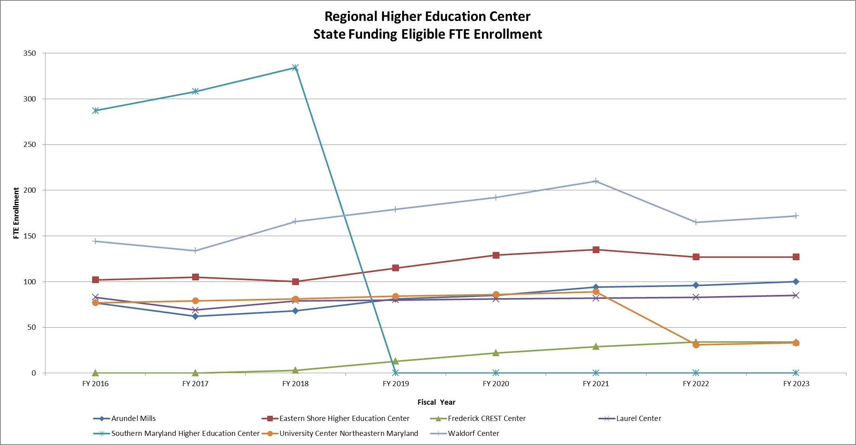

Slide 10
FY 2021 Allocation

