Slide 1
The Maryland Higher Education Commission
_______________________________________
Office of Student Financial Assistance
MHEC Independent Auditor Training

Slide 2
Agenda
Purpose of the Audit
Sampling Size Determination
MDCAPS Accessibility
Overview of Howard P. Rawlings Educational Excellence Awards Programs
Auditing Requirements
Overview: Calculating Campus-Based Educational Assistance Grant
Reporting Procedures
Independent Audit Review Resources

Slide 3
Purpose of the Audit
The Maryland Higher Education Commission (MHEC) Office of Student Financial Assistance (OSFA) is responsible for maintaining the integrity of state grant/scholarship awarding and distribution at Maryland colleges and universities to students. Institutions are required to certify eligibility of state grant recipients prior to making awards.
To ensure the accuracy of this process, an annual independent audit known as the MHEC Independent Audit is to be conducted annually at each institution on awards granted to students who participate in the Howard P. Rawlings Educational Excellence Awards (EEA) Program which includes the Educational Assistance (EA) Grant, Guaranteed Access (GA) Grant, and Campus Based Educational Assistance Grant (CBEAG).

Slide 4
Role of MHEC-OSFA
OSFA identifies eligible initial and renewal EA and GA applicants who have completed their FAFSA annually by the Maryland state deadline of March 1;
OSFA performs verification of all initial GA applicants and 25% of GA renewal applicants who have submitted all required documentation by April 1;
OSFA makes awards to students who are eligible for the EA and GA program; and
CBEAG funds are allocated to the institution, and the institution selects and awards eligible students.

Slide 5
Role of MHEC-OSFA
The institution is required to perform certain processes in MDCAPS which include but are not limited to:
Reporting Institutional Student Information Record (ISIR) based on federal verification performed on selected EA recipients;
Certify the eligibility of EA and GA recipients per semester in MDCAPS based on program eligibility requirements which include but are not limited to full-time enrollment, Maryland residency demonstrated by the student and parent (if dependent), degree-seeking status, and compliance of Satisfactory Academic Progress (SAP); and
Updating MDCAPS of all CBEAG recipients awarded by the institution in a given year.

Slide 6
Role of the Institution
The institution’s Financial Aid Office is responsible for enforcing both the General Policies and the individual program requirements in accordance with Title 18 of the Education Article, Annotated Code of Maryland, and each program’s guidelines and or regulations; and
All institutions must follow the procedures outlined in the Financial Aid Officer’s manual provided by MHEC on an annual basis as well as the Maryland College Aid Processing System (MDCAPS) Financial Aid Officer’s User Manual, which is available from the “Help” link in MDCAPS.

Slide 7
Role of the Auditor
The institution’s designated auditor(s) must gain access to the Maryland College Aid Processing System (MDCAPS);
The institution’s designated auditor(s) must gain access to the institution’s records for each student being reviewed; and
The institution’s designated auditor(s) must compare institutional records to the actual certification of each awarded student’s eligibility in MDCAPS.

Slide 8
Role of the Auditor
The institution’s designated auditor(s) must gain access to the Maryland College Aid Processing System (MDCAPS);
The institution’s designated auditor(s) must gain access to the institution’s records for each student being reviewed; and
The institution’s designated auditor(s) must compare institutional records to the actual certification of each awarded student’s eligibility in MDCAPS.

Slide 9
What is MDCAPS?
The Maryland College Aid Processing System (MDCAPS) is the financial aid system that allows OSFA to process State scholarship applications and allocate funds to eligible applicants; and
MDCAPS is utilized by students, institutions, legislators, and OSFA to determine and verify the final eligibility of state aid recipients.

Slide 10
Access to Maryland College Aid Processing System (MDCAPS)
To utilize MDCAPS, the Auditor must obtain MDCAPS login information from OSFA;
To obtain access, the Auditor must first complete the MDCAPS User Agreement and Contact Information Form;
MHEC will notify the auditor(s) within 2 business days that access to MDCAPS has been granted; and
MDCAPS access will be view only for the auditor reviewing each institution and access to MDCAPS will be limited to the duration of each specific audit.

Slide 11
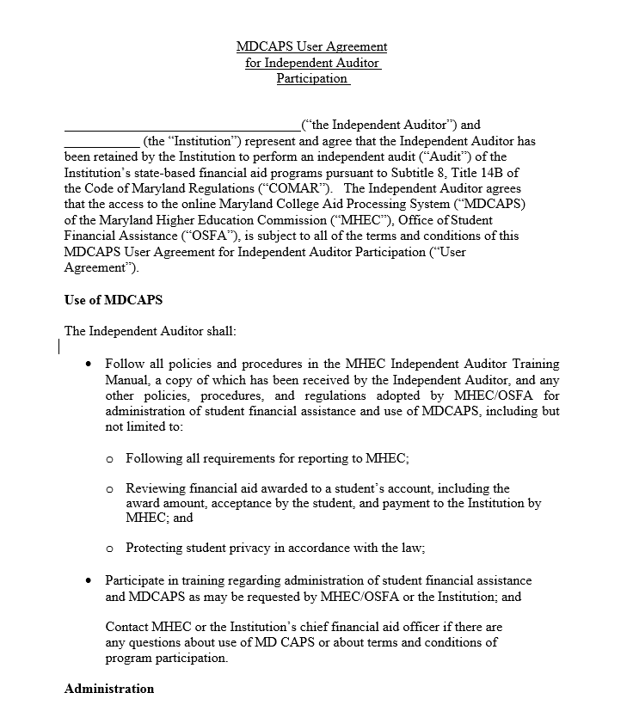
Sample MDCAPS User Agreement
Complete and submit the below MDCAPS User Agreement form.

Slide 12
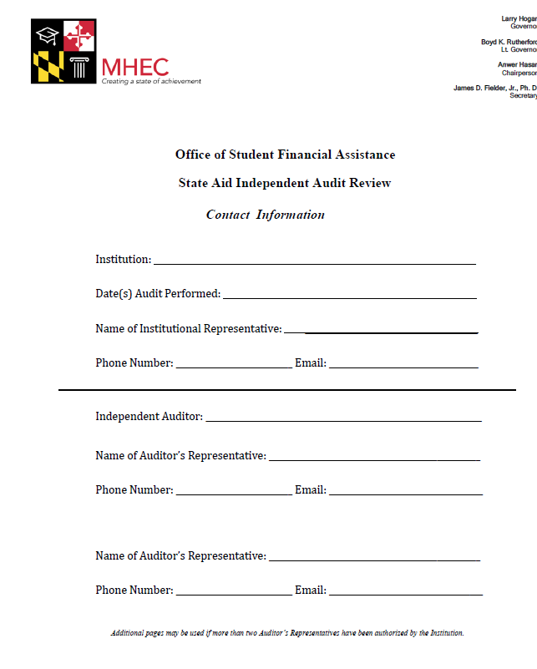
Contact Information Form
In addition to the MDCAPS User Agreement, each institution must complete the Contact Information form indicating the contact information of the Auditor(s) designated to perform the institutional audit.

Slide 13
Howard P. Rawlings Educational Excellence Awards Program: An Overview

Slide 14
Howard P. Rawlings Educational Excellence Awards (EEA) Program
The Howard P. Rawlings Educational Excellence Awards (EEA) programs include the following need-based grants:
Educational Assistance Grant;
Guaranteed Access Grant; and
Campus Based Educational Assistance Grant (CBEAG).

Slide 15
Educational Assistance Grant
Program Requirements
The Howard P. Rawlings Educational Assistance (EA) Grant provides postsecondary financial assistance to eligible in-state students who are current high school seniors and/or students who will enroll as full-time, degree-seeking undergraduates at a Maryland college or university.
FAFSA must be filed annually by March 1;
All initial applicants are ranked by Expected Family Contribution (EFC); and
An EA Grant is determined by student need as determined by OSFA.

Slide 16
Guaranteed Access Grant
Program Requirements
The Howard P. Rawlings Guaranteed Access (GA) Grant provides postsecondary financial assistance to eligible in-state students currently enrolled as high school seniors who:
Have filed the FAFSA by March 1;
Will complete a college preparatory program;
Maintain High School GPA of 2.5;
Meet annual income requirements determined by MHEC; and
Submit all required GA documentation requested by MHEC by April 1 of each year.
Note: The amount of the GA Grant equals 100 percent of the student’s financial need.

Slide 17
Campus Based Educational Assistance Grant
Program Requirements:
The Howard P. Rawlings Campus Based Educational Assistance Grant (CBEAG) provides postsecondary financial assistance to eligible in-state students who are:
Current high school seniors and full-time, degree-seeking undergraduates;
FAFSA must be filed after March 1 each year; and
A CBEAG award is determined by the institution.

Slide 18
Sampling Size Determination: The Process
Upon receiving access to MDCAPS the MHEC Compliance Officer will provide the Auditor with the following reports for the respective aid year applicable to the institution being audited:
The Sampling Size template;
A standard report of the total number of Guaranteed Access (GA) Grant recipients awarded/paid;
A standard report of the total number of Educational Assistance (EA) Grant recipients selected for verification by MHEC who were awarded/paid;
A standard report of the total number of Educational Assistance (EA) Grant recipients not selected for verification awarded/paid; and
A standard report of the total number of Campus Based Educational Assistance Grant (CBEAG) awarded.

Slide 19
Sampling Size Determination (cont’d)
How to Determine the Sample Sizes:
If population > 100, use HYPGEOM.DIST formula
If population > 10 but < 100, select 10% of total
If population < or = 10, select all records

Slide 20
Sampling Size Determination Worksheet Below is the sample size worksheet that will be provided by MHEC to the Independent Auditors once they have obtained access to MDCAPS.

Slide 21
Sampling Size Determination Worksheet cont’d
Enter the population sizes for each EEA Program noted on the report(s) provided by MHEC to the Auditor.

Slide 22
Sampling Size Determination Worksheet cont’d
Enter an estimate of the sample size for the EA Program.

Slide 23
Sampling Size Determination Worksheet cont’d
Adjust the EA Program Sample Size to yield a Formula Result value that is less than or equal to 0.25; and
The total Sample Size (the number of record to be reviewed) result will be displayed in the next cell to the right.

Slide 24
Sampling Size Determination Worksheet cont’d
Detailed results will be displayed in the next cells to the right.

Slide 25
Auditing Requirements
Institutional Policies
The review of student records by the auditor should be performed with a view toward ensuring that the institution has complied with its own stated policies regarding the following policy areas:
RESIDENCY
VERIFICATION
SATISFACTORY ACADEMIC PROGRESS (SAP)
STUDENT HOUSING

Slide 26
Auditing Requirements (cont’d)
The following areas of review and corresponding documents noted below (as applicable) must be reviewed by the independent auditor for each student record to ensure the institution properly confirmed the students’ eligibility for the award:
RESIDENCY (i.e. Admissions documentation, state license, or other documents used by the institution to determine Maryland residency)
DEGREE PROGRAM (i.e. Academic transcript, class schedule, etc.)
ENROLLMENT STATUS (Academic transcript, class schedule, add/drop slips, etc.)
SAP STATUS (Academic transcript, SAP forms/appeals collected from the student by the institution)
VERIFICATION (Documentation required for each V-group as outlined in Title IV regulation)

Slide 27
Auditing Requirements (cont’d)
HOUSING STATUS (billing/housing statements, student leases, documentation from institution’s Housing Office, etc.)
ISIR or STUDENT AID REPORT (SAR) (Copy of ISIR or SAR upon which the student was paid the state award
CAMPUS BASED EAG CALCULATIONS (if institution awarded funds for that program)
Any other documents relating to each student's enrollment including the school enrollment contract, records of disciplinary action, drop slips, etc.

Slide 28
Auditing Requirements (cont’d)
For more information on acceptable documentation that may be collected from the institution for auditing purposes, please reference the Independent Audit Review Manual.
The below chart provides the page numbers which you may reference in the IAR manual:
Acceptable Documentation | IAR Manual Page Number
Residency | 25-28
Degree Program | 34
Enrollment Status | 29-30
SAP Status | 31
Verification | 38-41
Housing | 36-37
ISIR or SAR Reporting | 41

Slide 29
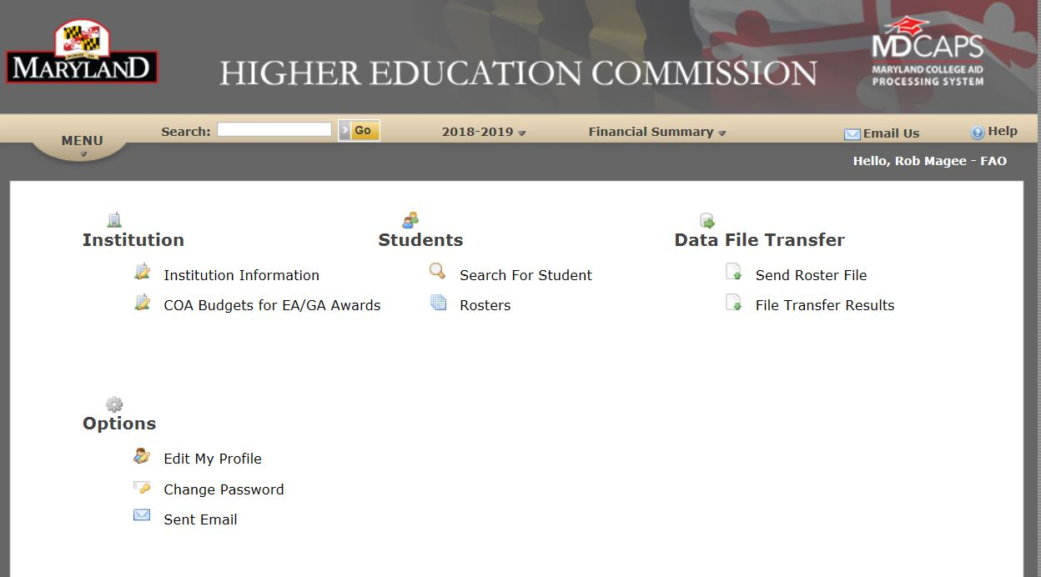
Auditing Requirements (cont’d)
Below is a screenshot of the MDCAPS home screen once logged in:

Slide 30
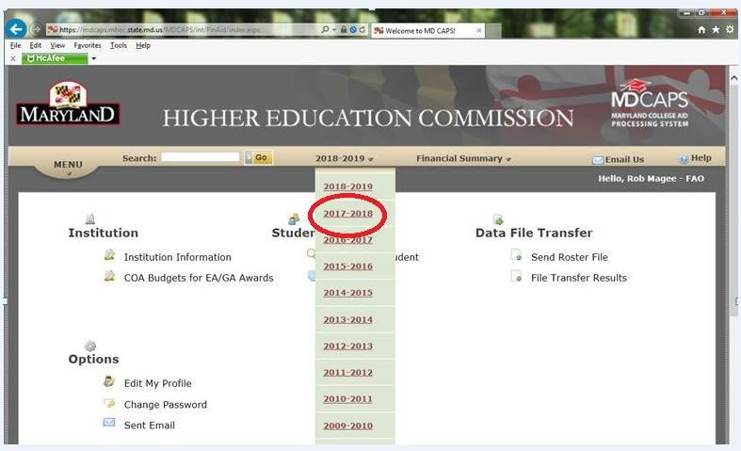
Auditing Requirements (cont’d)
Click on the 2018-2019 year down arrow and select the 2017-2018 year to ensure you are reviewing records from the correct year.

Slide 31
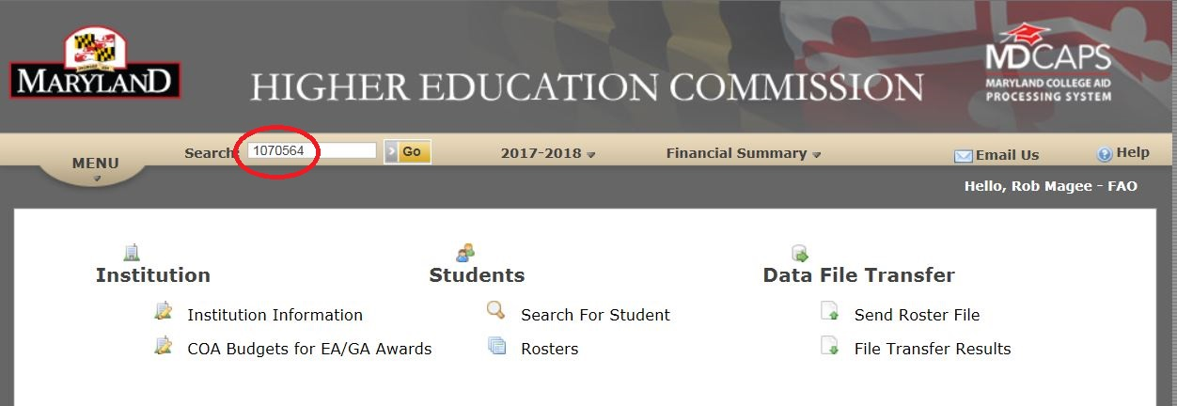
Auditing Requirements (cont’d)
After selecting the correct academic year, enter the student’s MHEC ID number as noted on the spreadsheet, and hit the GO button or the Enter key on your keyboard.

Slide 32
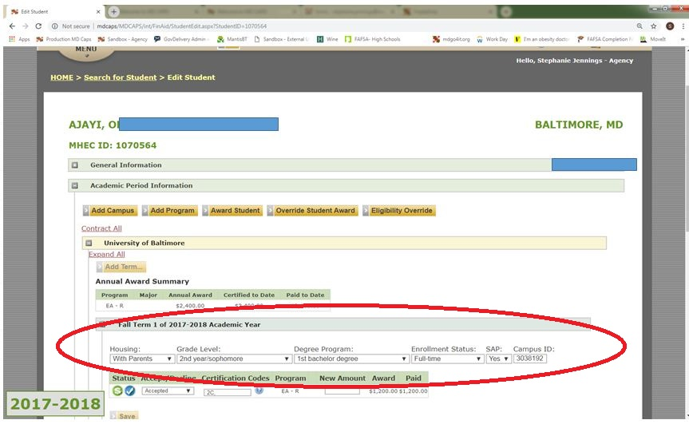
Auditing Requirements (cont’d)
Next, go to the Academic Period Information section and review the certification information for each term (Fall & Spring).

Slide 33
Auditing Requirements (cont’d)
Housing Certification Requirements:
The housing status for students must be updated in MDCAPS to reflect the student’s housing as determined by the institution’s policy
MHEC defines a student’s housing in one of the following ways:
On Campus- residing in on campus housing where charges are directly applied by the institution;
Off Campus- residing in off campus housing, not with a parent; and
With Parent- residing off campus with a parent.
Schools are required to certify the housing status for each student receiving a State award(s). For more information on acceptable documentation that may be collected to verify the housing status of each student, refer to page 36-37 of the IAR manual.

Slide 34
Auditing Requirements (cont’d)
Degree Program Certification Requirements:
The degree program should be certified based on the degree status of the student at the time of certification.

Slide 35
Auditing Requirements (cont’d)
Enrollment Status Certification Requirements:
Note: MHEC awards and disburses scholarships on a semester basis. Therefore, if an institution follows a trimester/quarter calendar it must determine the appropriate distribution of awards according to the established Billing Roster cycles.

Slide 36
Auditing Requirements (cont’d)
Enrollment Status Certification Requirements:
The enrollment status should be certified at the time that the student’s eligibility can be confirmed.
MHEC defines a student’s enrollment in one of the following ways:
 | Undergraduate Students | Graduate Students
Full-time | 12+ | 9
Three-quarter time | 9-11 | N/A
Half-time | 6-8 | 6-8
Less than half-time | <6 | <6

Slide 37
Auditing Requirements (cont’d)
Enrollment Status Certification Requirements:
A student may appeal for less than Full-time enrollment and qualify for a prorated award under certain circumstances;
If enrolled in a qualifying program which requires clinical training, as documented by the institution (e.g. Nursing); or
Other special circumstances, (e.g. documented disability), as approved by OSFA.

Slide 38
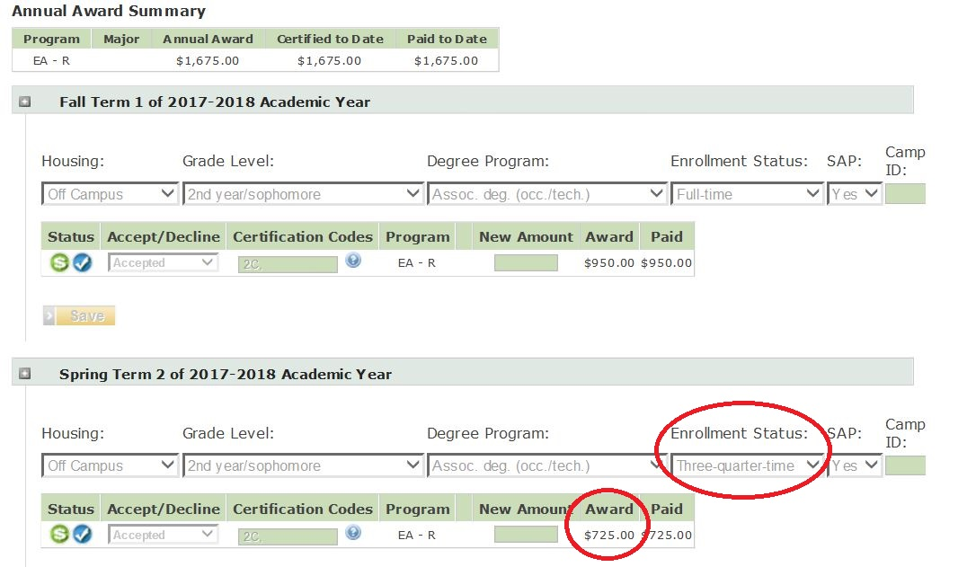
Auditing Requirements (cont’d)
Enrollment Status Certification Requirements for less than 12 credits (if appeal was approved by OSFA):
Note: Confirm that prorated award amount is displayed as Award.

Slide 39
Auditing Requirements (cont’d)
SAP Certification Requirements:
SAP should be certified as determined by federal regulations in accordance with the institution’s policy.

Slide 40
Auditing Requirements (cont’d)
Proper Usage of Certification Codes
Institutions are required to report the appropriate certification codes in MDCAPS in each student record.
System Assigned cancellation codes are automatically applied to the student’s record once the institution has properly updated the student’s Housing, Degree Program, Enrollment Status and SAP.
To certify or cancel an award for any other reason, the institution must enter the appropriate code(s) into the certification box or click the for a full listing of all cancellation codes.

Slide 41
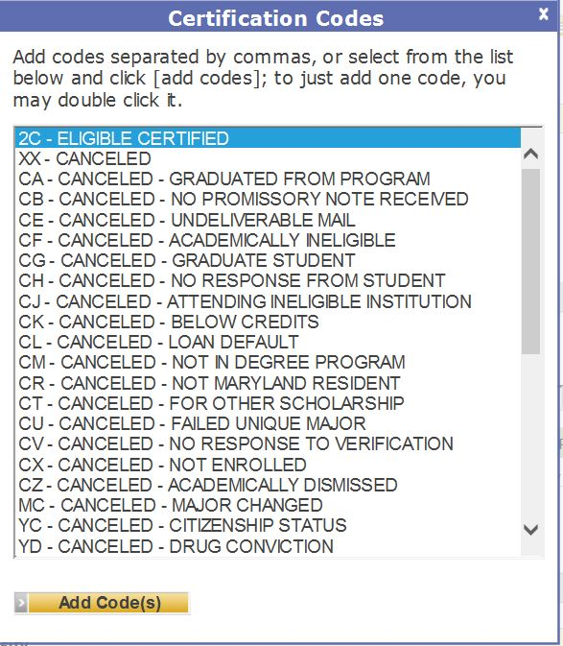
Auditing Requirements (cont’d)
Examples of Certification Codes

Slide 42
Audit Review Requirements (cont’d)
Institutions are required to report ISIR information in MDCAPS for EA recipients under the following circumstances:
If a student was an on-time applicant and selected for verification;
OR
If a student was not selected for verification and was an on-time applicant and there is an increase or decrease in the student’s EFC (Estimated Family Contribution).
* Note all institutions must update the Institutional line in MDCAPS for students selected for verification regardless if the EFC changes.

Slide 43
Auditing Requirements (cont’d)
ISIR (FAFSA) information:
The ISIR data should be reviewed as follows:

Slide 44
Overview: Calculating Campus-Based Educational Assistance Grant

Slide 45
Campus Based Educational Assistance Grant
The CBEAG program is a decentralized program, whereby institutions are allocated funds by MHEC and institutions then make award determinations at the campus level; and
Auditors are required to review and determine the institution’s accuracy in calculating CBEAG award amounts.

Slide 46
Campus Based Educational Assistance Grant
Since the CBEAG program is decentralized, the institutions make the awards to eligible students.
Auditors are required to review and determine the institution’s accuracy in calculating CB-EAG award amounts.
When determining award eligibility of the Campus Based Educational Assistance Grant program (CBEAG), institutions must use the following formula:
OSFA Cost of Attendance
- EFC
+/- COLA adjustment
- Pell Grant Award
- Other awards (if listed below)
__________________________________
= OSFA Adjusted Need

Slide 47
Campus Based EAG (cont’d)
The Cost of Attendance (COA) is the cost of attendance reported by institutions into MDCAPS for the given academic year; and
The COA to be used when calculating a Campus Based EAG award should not be adjusted to reflect recent adjustments in tuition and fees. The COA budgets can be found in MDCAPS under the INSTITUTION menu.
EFC: The student’s expected family contribution, as determined by the FAFSA.

Slide 48
Campus Based EAG (cont’d)
The Cost of Living Adjustment (COLA) is used for the CBEAG program to adjust for variable costs associated with the student’s area of residence, as described below:
COLA adjustment derived by: EFC x adjustment factor = COLA. The result is added to the calculation, as listed above. However, when/if the adjustment factor percent is below 1.00 (e.g.: 0.96), then the auditor would subtract the COLA from the calculation. For the 2017-2018 academic year, all adjustment factors are above 1.00.
when the first three digits of the zip code is greater than 209 but less than 217, the
Baltimore adjustment is used: 1.05
when the first three digits of the zip code is greater than 199 but less than 210, the Washington adjustment is used: 1.17
all other zip codes use the "other" adjustment: 1.03
Multiply EFC x adjustment factor. The EFC should then be subtracted from the result. That is the COLA figure that will be used in the calculation of need. For example, an EFC of 4,000 x 1.05 factor would result in a figure of 4200. The difference between the new figure and the EFC is 200. This is your COLA figure.

Slide 49
Campus Based EAG (cont’d)
Pell: The Pell Award that the student is receiving.
The student MUST BE RECEIVING a Pell Grant award in order to be considered for a Campus Based EAG award.
Other Awards are: The Maryland Workforce Shortage Student Assistance Grant. When calculating a Campus Based EAG award, this award must be deducted from the student’s COA when determining the student’s adjusted need. You only need to subtract this award for the 2017-2018 academic year. You would not deduct SEOG, FWS, Perkins, or other State funds when determining a student’s eligibility for Campus-Based EAG.
OSFA Adjusted Need: This is the amount of need that you will use when determining a student’s Campus Based EAG award.
Percent of Need: 2017-2018 academic year: the type of institution the student attends will determine the percent of need. The percent of need for 2- and 4-year independent and 4-year public institutions is 40%. The percent of need for 2-year public institutions (community colleges) is 60%.

Slide 50
Campus Based EAG (cont’d)
Percent of Need: 2017-2018 academic year:
The type of institution the student attends will determine the percent of need; and
The percent of need for 2- and 4-year independent and 4-year public institutions is 40%. The percent of need for 2-year public institutions (community colleges) is 60%.

Slide 51
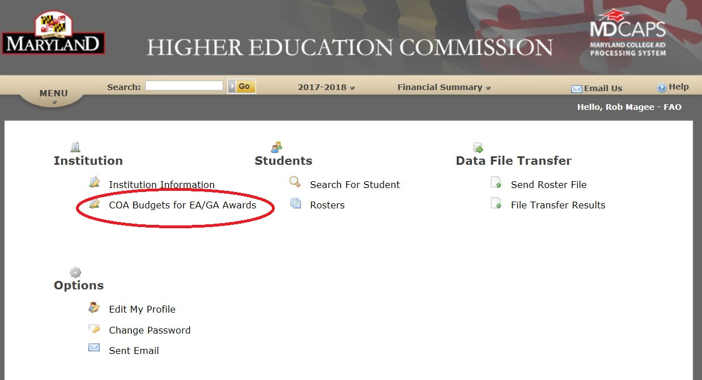
OSFA Cost of Attendance
The institution’s OSFA Cost of Attendance is to be used as the basis for determining a student’s need and CBEAG award eligibility.

Slide 52
Example for a 2-Year Community College OSFA Cost of Attendance (cont’d) The Auditor should access the COA Budgets for EA/GA Awards screen to view the results for the specific institution (example below); and The Auditor must calculate the student’s CBEAG eligibility using the Cost of Attendance associated with the student’s housing status.

Slide 53
Campus Based EAG (cont’d)
Numerical example:
COA 10,218
- EFC - 4,000
+ COLA Adjustment Figure + 200
- Pell Grant - 1970
Other Scholarships (i.e. WSSAG) - 3,000
= OSFA Adjusted Need 1,448
Multiply 1,448 by 60% (if a 2-Year institution), and the student would get an award of $900 (rounded up from 868).
Note: The award amount is rounded to the nearest $100

Slide 54
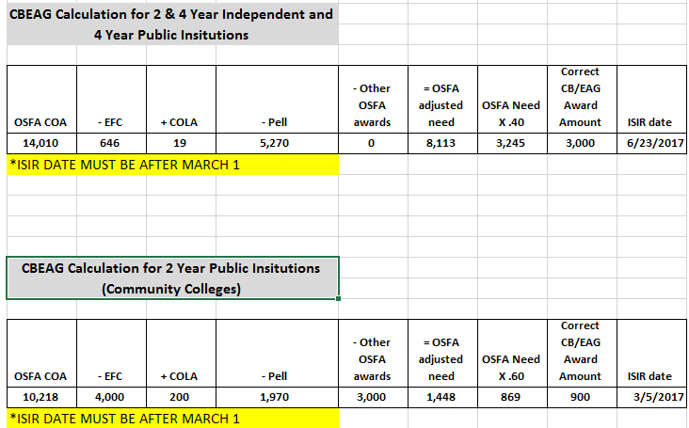
Campus Based EAG Calculator
Below is a sample spreadsheet that may be used to calculate CBEAG eligibility:

Slide 55
Campus Based EAG Calculator (cont’d)
Remember…
The OSFA need is rounded to the nearest $100 to obtain the “Correct CBEAG award amount”;
The “Correct CBEAG award amount” may not exceed $3,000 or be less than $400; and
The ISIR date must be after March 1.

Slide 56
CBEAG Last Dollar Award
If the Institution’s CBEAG allocation was at “last dollar”, then the award amount made to the student may be less than their calculated amount of eligibility;
“Last dollar” means that the institution’s allocation had been exhausted to the extent that an eligible student could not be awarded the full amount for which they would otherwise have been eligible; and
With the exception of the award being “last dollar” there should be no other circumstance in which a student is not awarded their full eligibility in CBEAG.

Slide 57
Completion of the Independent Audit Review
The Auditor shall send a final audit report to MHEC, to include:
Itemization of any findings;
The institution’s responses to any findings; and
The institution’s corrective plans for any findings.

Slide 58
Audit Reporting Procedures

Slide 59
Audit Reporting
Upon completion of the audit review, the Auditor will send a final audit report to MHEC of all areas reviewed;
The Auditor will utilize data provided during each Audit to generate the formal audit report;
This report is to be sent to MHEC for final review by June 1 each year to ensure accuracy of reporting; and
Reports should be sent to the attention of:
Robert Magee, OSFA Compliance Officer
6 N. Liberty St.
Baltimore, MD 21201
Note: Additional information regarding reporting requirements may be found on page 10 of the Independent Audit Review Manual.

Slide 60
Reporting Procedures
Within 45 days of receipt of the final audit report, MHEC will send a memo to the institution verifying whether financial reimbursements (return of funds) are due back to MHEC as a result of findings identified during the audit. MHEC will notify the institution should no return of funds be assessed;
Institutions that must remit payment based upon findings cited will be notified by MHEC of the procedures and deadlines associated with the payment process; and
FAOs will be responsible for adjusting all student records in MDCAPS that have been assessed as a finding and resulted in payment remittance. MHEC will notify each institution as to the time and date that the adjustments are to occur.

Slide 61
Independent Audit Review Resources
As of June 11, 2018 the EEA Audit Regulations were approved by the Commission for Publication and are accessible online through COMAR at http://www.dsd.state.md.us/COMAR/ComarHome.html;
The Independent Audit Review Manual has been distributed to all applicable institutions; and
Any inquiries regarding the Independent Audit process may be sent to osfacompliance.mhec@maryland.gov.

Slide 62
Questions

