Slide 1
Maryland’s Blueprint and MHEC’s Implementation Plan
Maryland Higher Education Commission
November 15, 2023
Emily A. A. Dow, Ph.D., Assistant Secretary of Academic Affairs

Slide 2
Commission on Innovation and Excellence in Education (Kirwan Commission)
Created in 2016 (Chapters 701 and 702)
made policy recommendations to enable Maryland’s education system to perform at the level of the world’s best systems
reviewed and recommended updated funding formulas
2018 Preliminary Report and Technical Supplement ​describes the research and gap analysis
January 2019 Interim Report
2020 Final Report
Notes:
The Kirwan Commission was created by the Governor and General Assembly in 2016 (Chapters 701 and 702) to make policy recommendations to enable Maryland’s education system to perform at the level of the world’s best systems and to review and recommend updated funding formulas. The Kirwan Commission made a sweeping set of recommendations addressing ​education policy from early childhood through secondary and postsecondary education and training that, if implemented, will enable Maryland’s public schools and students to perform at the levels of the world’s best and, ultimately, enable current and future generations of Maryland’s children to be successful in the 21st century workforce that requires more skills and knowledge than ever before.
Focused on education policy from early childhood through secondary and postsecondary education and training

Slide 3
Legislation
Legislation passed annually in 2018 through 2021 based on the Kirwan Commission’s recommendations
House Bill 1415 (Chapter 361 of 2018)
Senate Bill 1030 (Chapter 771 of 2019)
House Bill 1300 (Chapter 36 of 2021)
House Bill 1372 (Chapter 55 of 2021)
House Bill 1450 (Chapter 33 of 2022)
House Bill 1300 contains the majority of the policies and funding increases
Notes:
The Maryland General Assembly passed legislation annually in 2018 through 2021 based on the Kirwan Commission’s recommendations, modifying portions of it and incorporating additional priorities and funding provisions, including dedicated funding to support the Blueprint’s implementation.
The Blueprint for Maryland’s Future is established in State law by several pieces of legislation that were enacted beginning in 2018. The majority of the policies and funding increases are contained in House Bill 1300, which was initially passed by the General Assembly in 2020 and enacted as Chapter 36 of 2021 after the Governor’s veto was overridden during the 2021 legislative session. Also in 2021, House Bill 1372 (enacted as Chapter 55) was passed to revise House Bill 1300 given the delay in its implementation and to address the impact of the COVID-19 pandemic. House Bill 1300 and House Bill 1372 should both be considered and cross-referen​ced to fully understand the policy and funding provisions found in the Blueprint. During the 2022 session, House Bill 1450 (Chapter 33) made several adjustments to the Blueprint including the implementation plan timelines based on the AIB’s recommendations to the Governor and General Assembly. ​Below are links to the enrolled (final) legislation and the Department of Legislative Services Fiscal and Policy Note for each bill.
House Bill 1415 (Chapter 361 of 2018)
Fiscal Notes
Senate Bill 1030 (Chapter 771 of 2019)
Fiscal Notes
House Bill 1300 (Chapter 36 of 2021)
Fiscal Notes
House Bill 1372 (Chapter 55 of 2021)
Fiscal Notes
House Bill 1450 (Chapter 33 of 2022)
Fiscal​ Notes
Overall, the State will invest an additional $3.9 billion (45% increase) in Maryland’s public schools by fiscal 2034 and local governments will invest at least $700 million (8% increase) over pre-Blueprint levels. For more information on the Blueprint for Maryland’s Future law, click HERE.

Slide 4
Accountability Implementation Board (AIB)
The Board is to evaluate the data submitted to it, and assess how well the many components of the Blueprint for Maryland's Future are working to achieve its desired outcome of equal access to a high-quality education.
By January 1 of each year through 2031, the Board is to review the use of school-level expenditures, including poverty grants and special education funding, and monitor school system compliance with the requirements of the Blueprint for Maryland's Future.
Seven member Board; appointed by the Governor; six-year terms.
November 15, 2021: First board meeting
Authorization for the Board ends June 30, 2032

Slide 5
Accountability Implementation Board: Implementation Plan
First task: develop a Comprehensive Implementation Plan for the Blueprint for Maryland's Future.
Every unit of government responsible for implementing any part of the Blueprint for Maryland's Future, including each local school board, is required to submit its own implementation plan to the Accountability and Implementation Board for approval.
The Board may withhold funding to any agency without an approved implementation plan.
Initial Plans due March 15, 2023 (MHEC Plan)

Slide 6
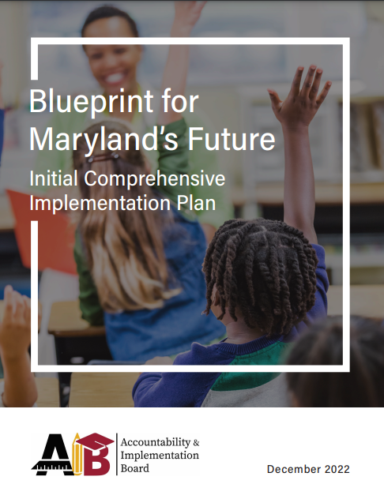
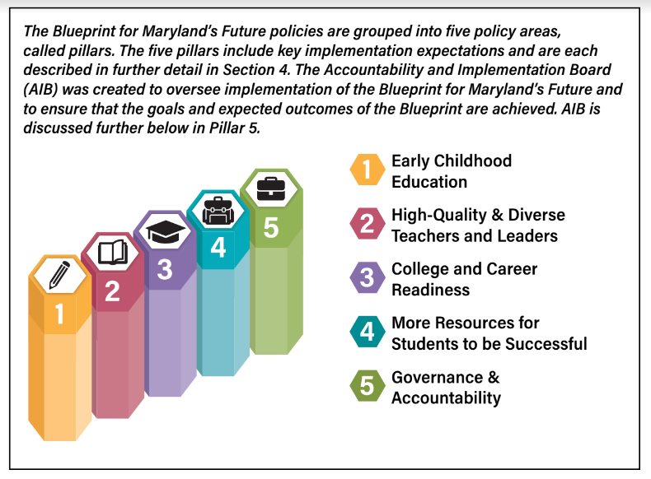
Accountability Implementation Board: Blueprint Comprehensive Plan

Slide 7
MHEC Implementation Plan Highlights
AGENCY SPECIFIC INITIATIVES
Teaching Fellows Scholarship
Funding increase, outreach, diversity, eligibility, criteria
Annual report: Diversity, rejected applications, expenditure explanation
Loan Assistant Repayment Program for public school teachers
Technical assistance to teachers
Teacher Quality Diversity Program
Funding, technical assistance, outreach/awareness, diversity
Annual report (starts 2024)

Slide 8
MHEC Implementation Plan Highlights
COORDINATED INITIATIVES WITH OTHER ENTITIES
Early childhood education: alternative certification pathways
Recruiting high quality and diverse teacher candidates
Alternative teacher pathway: apprenticeship programs, paraprofessional to teacher pathways
College Readiness Standards
Collaborative reports
recruiting teachers (MSDE, LEAs, IHEs, MLDS); annual, July 1 (starts 2024)
Quality and diversity (MLDS, MSDE); annual, July 1

Slide 9
Current Work
Participating in the outcomes workgroup
What are the measures for success and relevant data
Reenergized coordinated effort with MSDE for teacher preparation and career pathways
Renewed discussions with MSDE regarding dual enrollment and transfer of credit
Technical policy support for apprenticeship pathways
Teacher Fellows Scholarship Data
Internship Stipend (2023 Legislation)

Slide 10

Thank you!
Questions?

