Slide 1


Maryland Association of Community Colleges
Operating and Capital Budget Presentation
September 13, 2023

Slide 2
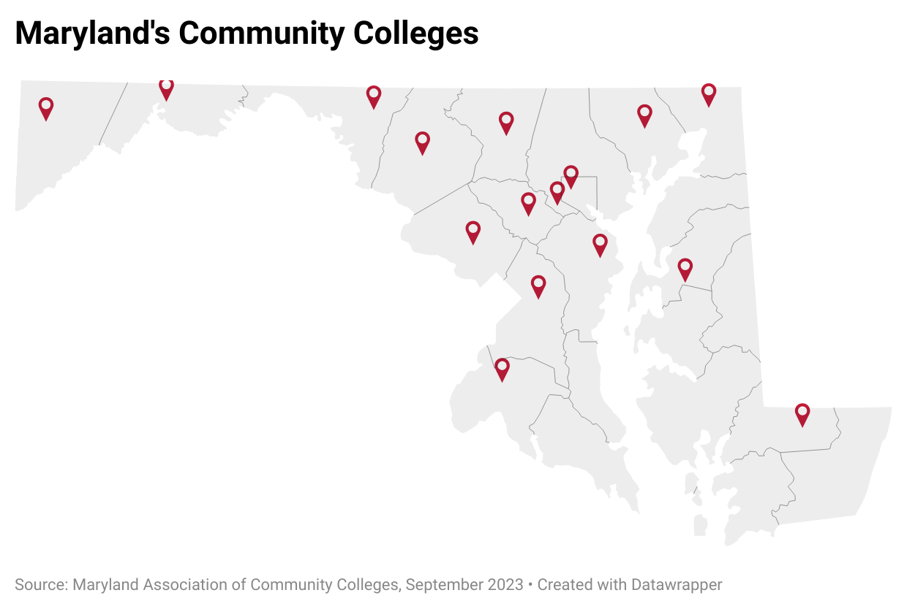

16 Colleges
23 Campuses
1,000+ Sites
24/7 Virtual Learning
Blended Locations

Slide 3
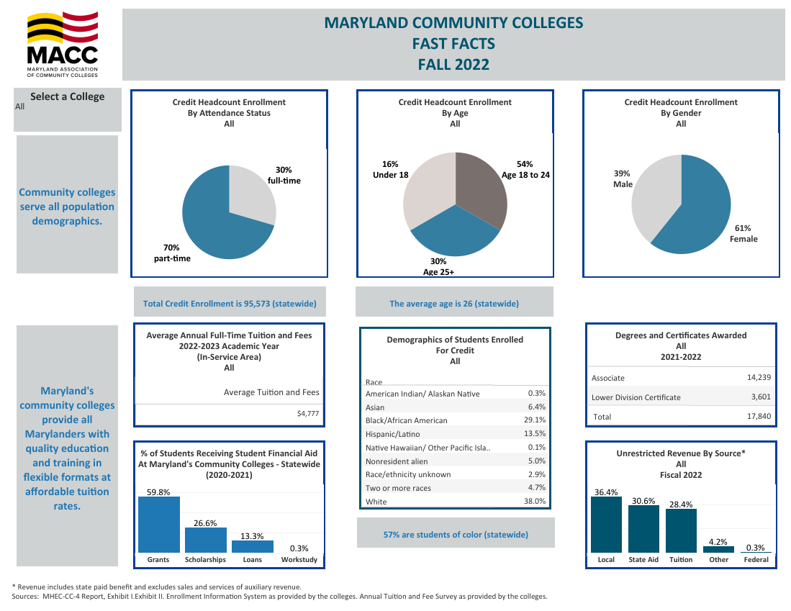
Who We Serve: Credit

Slide 4
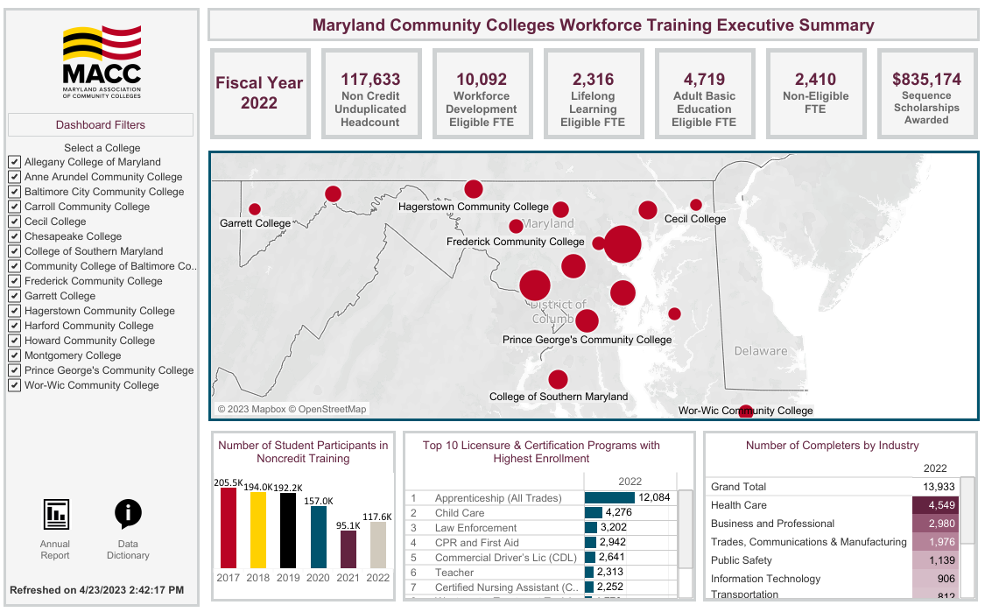
Who We Serve: Non Credit

Slide 5
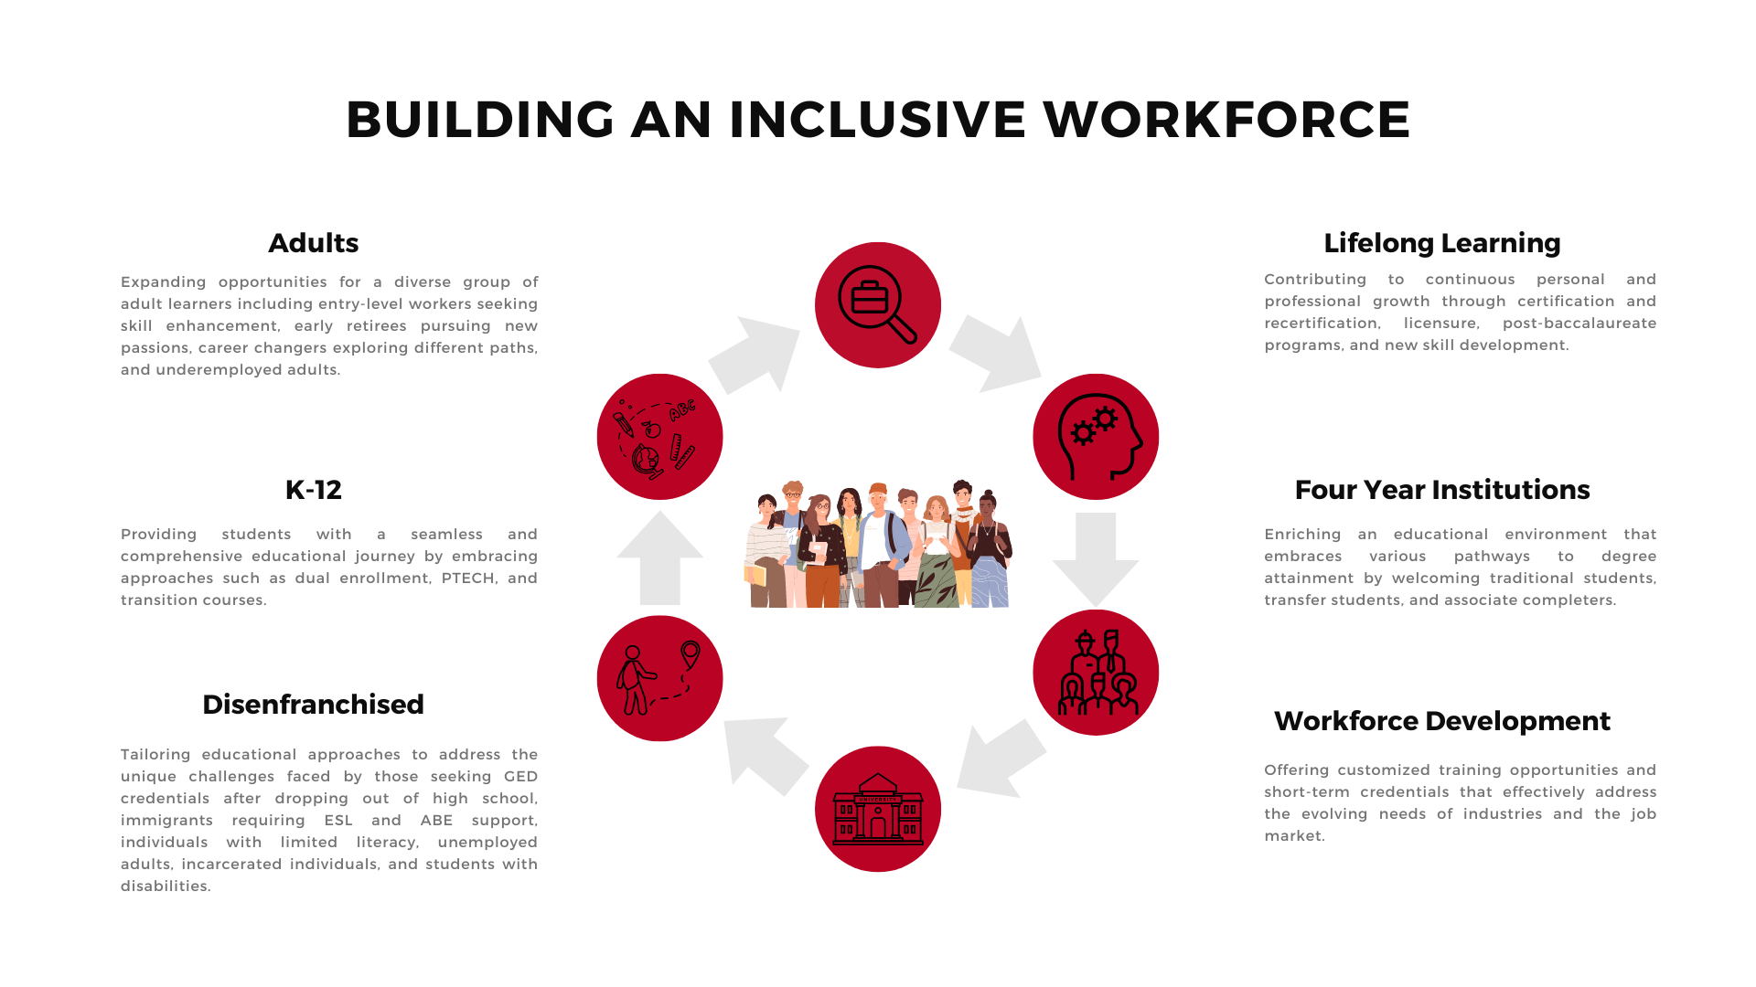

Slide 6
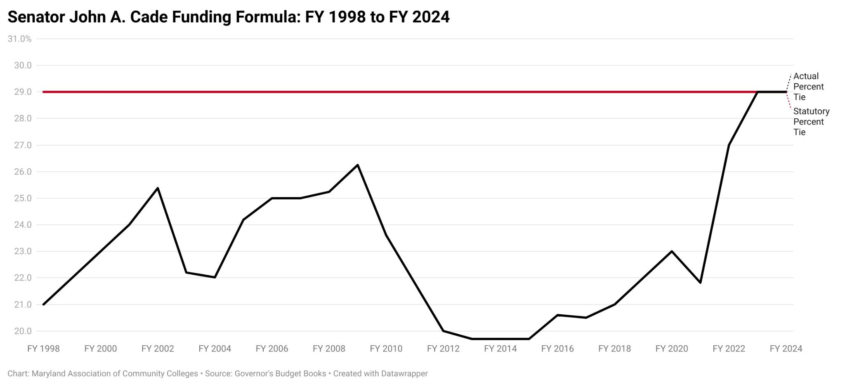

Slide 7
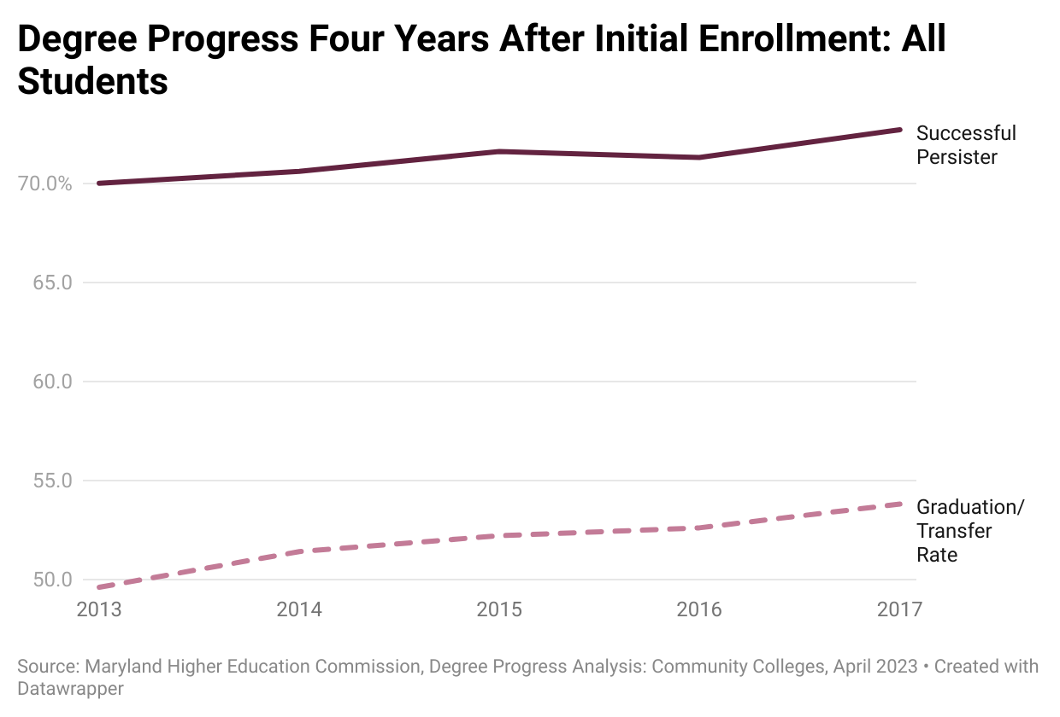

Slide 8
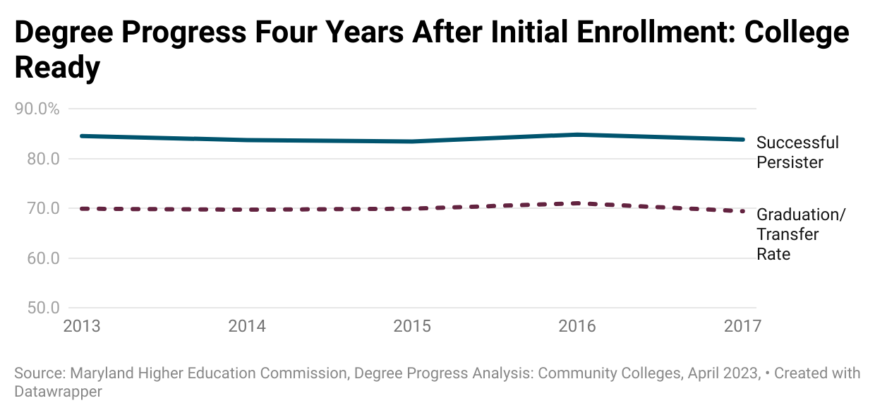

Slide 9
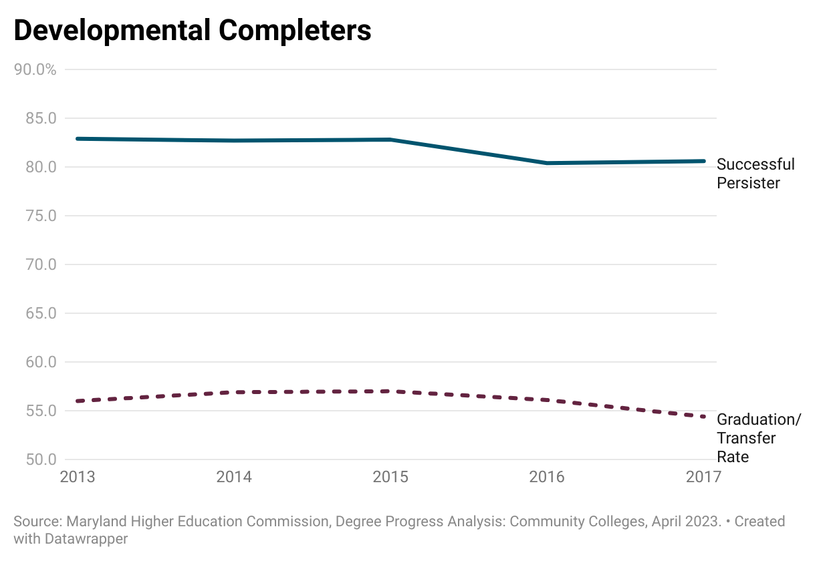
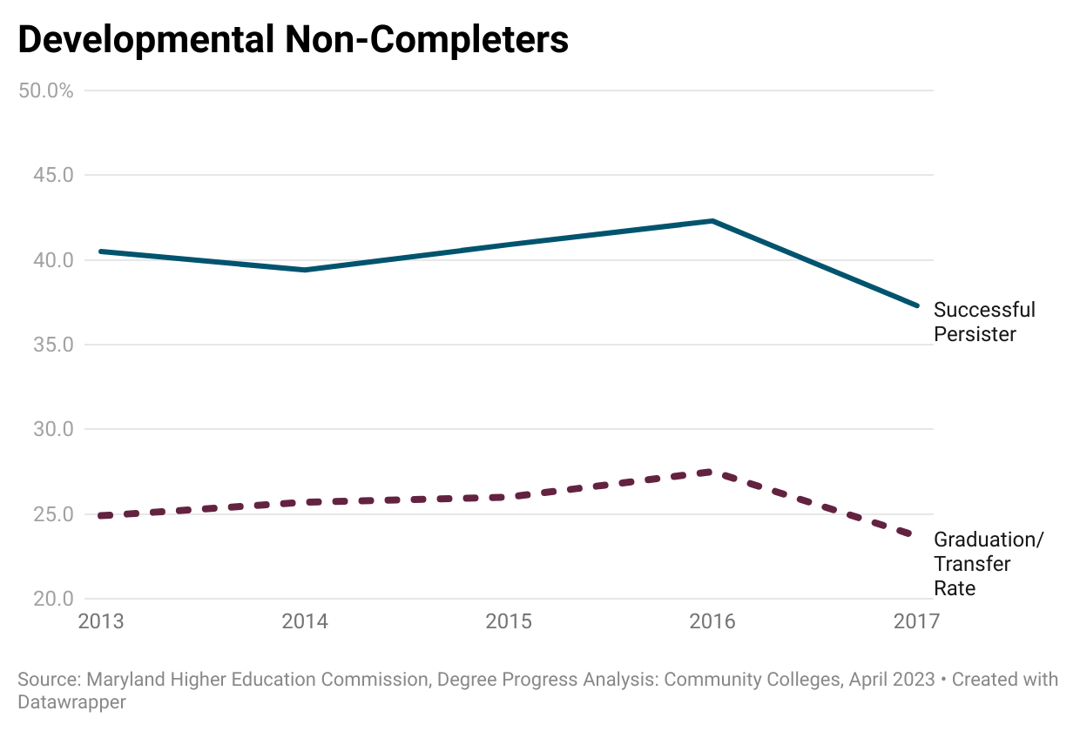
Degree Progress Four Years After Initial Enrollment

Slide 10
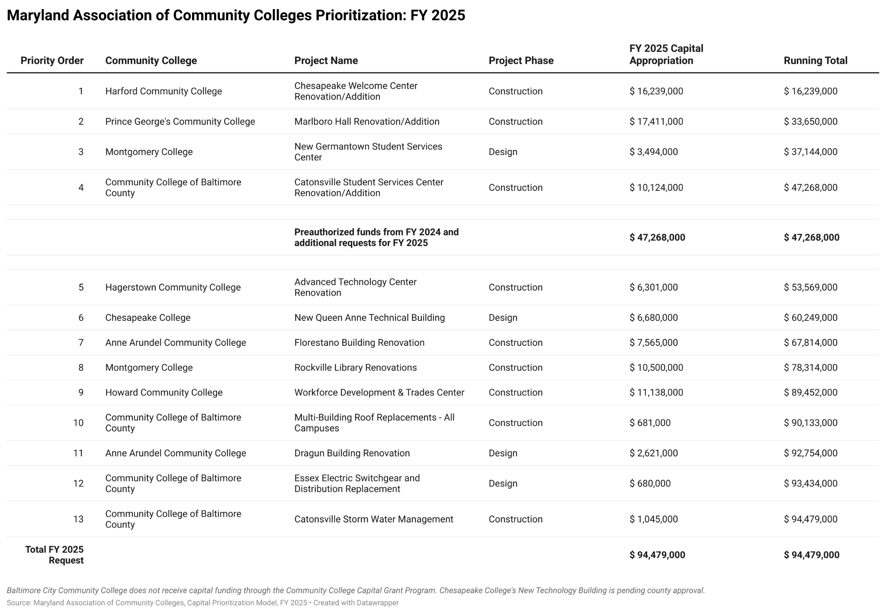

Slide 11
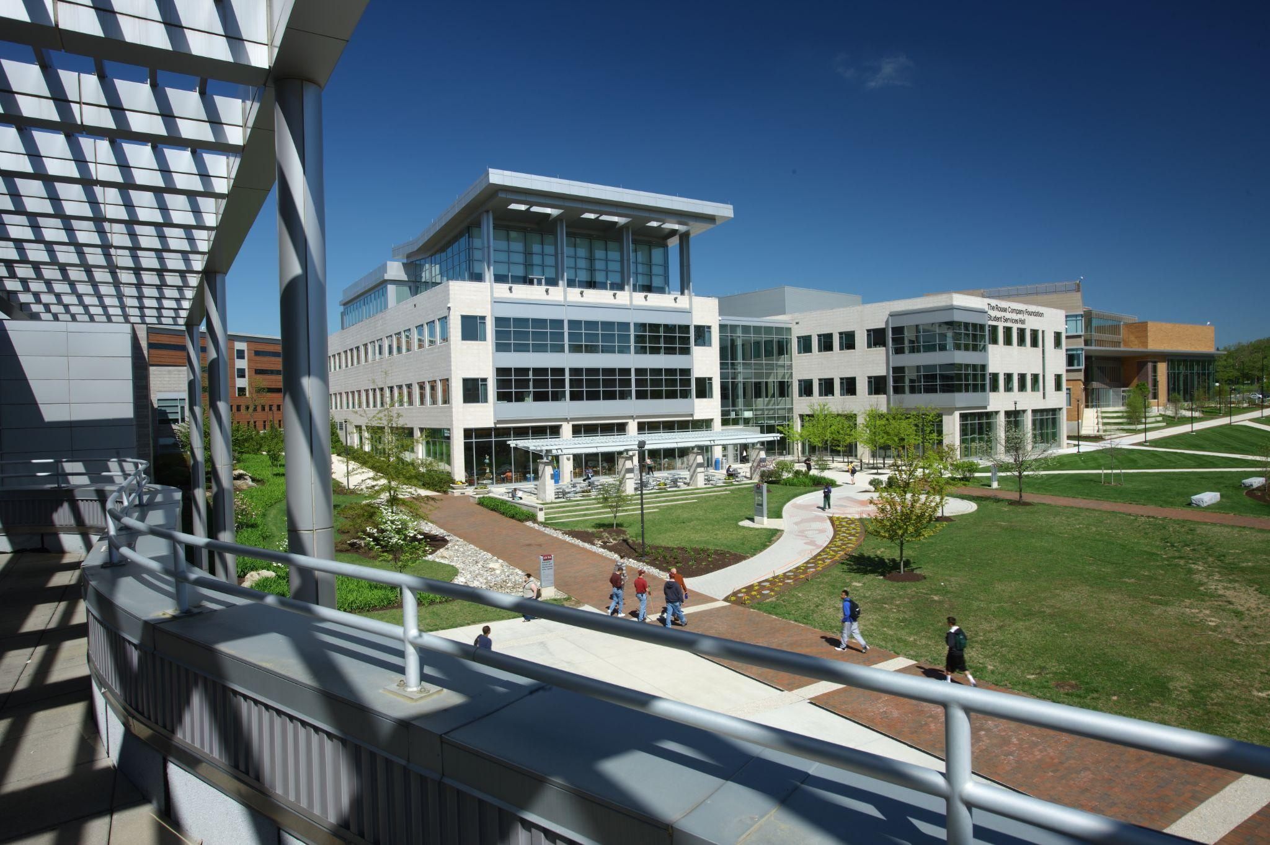
Facilities Renewal Grant Program
Baltimore City Community College
Carroll Community College
Chesapeake College
Frederick Community College
Garrett College
Hagerstown Community College
Harford Community College
Howard Community College

Slide 12
Address Workforce Shortage Areas
Nursing Pathways
Cybersecurity
Maryland healthcare faces a shortage of professionals.
Nursing profession hit hard during the pandemic, resulting in a labor market gap.
Interest in creating a pathway for students to progress from CPN to LPN.
Seeking to join the Advisory Committee in collaboration with Maryland Nurses Association.
Seeking $5 million to expand new cybersecurity training opportunities.
Training and education programs aligned with industry needs.
Equipping graduates with in-demand skills.
Funding to advance resources at Community Colleges to maintain Maryland’s leadership in cybersecurity education.
Notes:
.

Slide 13
Supporting the Blueprint for Maryland’s Future
Transfer with Success
Dual Enrollment
To strengthen ARTSYS, we’ve implemented a new transfer equivalency enterprise platform called Parchment.
Helps students navigate the transfer process.
Students earn college credit while in high school.
This initiative supports the seamless transition to postsecondary education.

Slide 14
QUESTIONS?
Brad Phillips, Ed.D.
Executive Director
Email: bphillips@mdacc.org
Phone: 410.974.8817

