Slide 1
Operating & Capital Budget
Dr. Debra L. McCurdy President
Channa Williams
Associate Vice President – Finance & Budget
Baltimore City Community College
Larry Hogan, Governor State of Maryland
WEDNESDAY | SEPTEMBER 2020
2901 Liberty Heights Avenue | Baltimore, MD 21215 | 410-462-8300 | www.bccc.edu

Slide 2
“Changing Lives, Building Communities”
Operating & Capital Budget
Baltimore City Community College
BCCC is both an old and a young institution. The College was founded in 1947, as Baltimore Junior College, a part of the Baltimore City Public Schools.
Baltimore City Community College is the only community college in Maryland that is a State Agency. It is also the only urban community college in the State.
BCCC’s campus is located in West Baltimore; with several Baltimore City satellite locations. As of fiscal 2020, the College served Over 11,000 credit and non-credit students annually, providing transfers to four-year colleges as well as workforce training.
BCCC buildings are 25+ years old. Buildings located on the Liberty campus date back to 1968. The most recent building on this site is the Life Science Building which was built in the mid-1990s.
Page 2 │

Slide 3
2017 Realignment Legislation
Operating & Capital Budget
Baltimore City Community College
The legislation required various tasks including “to develop or sell all unused or underutilized real estate…”
BCCC is working on the redevelopment proposal for the Inner Harbor-Bard Building site.
BCCC is assessing real estate locations utilized or re-evaluating usage:
Liberty Campus (Main campus) – various buildings
Harbor Park – Workforce Development Classrooms and Administrative
Reisterstown Road Plaza – Workforce Development Classrooms
Reisterstown Road Plaza Radio Station – WBJC-FM
Bio Park – Credit Classrooms and Administrative Offices (second floor)
North Pavilion – Administrative Offices
South Pavilion – Year Up Program Offices & Business Incubator
West Pavilion – Administrative Offices
Bard Building – Proposal Development
Page 3 │

Slide 4
FY 2022 Fiscal Impact
Operating & Capital Budget
Baltimore City Community College
Number of Positions (Budgeted FY2022)
Faculty = 116
Non-faculty Staff = 321
Number of Academic Programs
Undergraduate:
30 degrees
18 certificates
Master’s = n/a
Doctorate = n/a
Other Expectations FY 2022 Budget
Salaries & Benefits = $43.9 million
Financial Aid = $9.80 million (Federal Pell, FSEOG, FWS)
Deferred Maintenance from Operations = $150K
Technology Fee = $195K (new beginning FY2020)
Source: BCCC Budget Office
Page 4 │
Notes:
Number of PIN Positions on Faculty & Staff Fall 2018
Full-Time Faculty = 104
Professors = 24
Associate Professors = 23
Assistant Professors = 57
Full-Time Professional Staff/Administrators = 183
Full-Time Support Staff = 103

Slide 5
Annual Unduplicated Headcount
Operating & Capital Budget
Baltimore City Community College
Source: BCCC Performance Accountability Report for MHEC
Page 5│

Slide 6
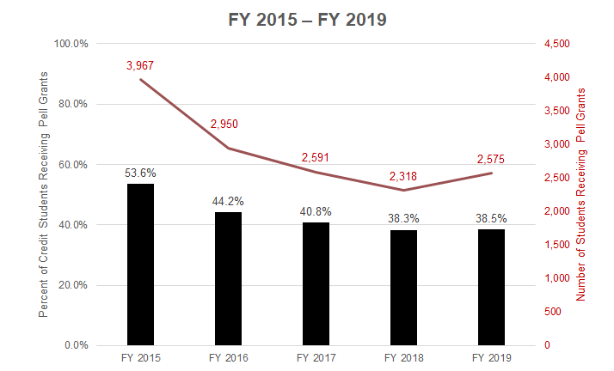
Credit Students Receiving Pell Grants
Operating & Capital Budget
Baltimore City Community College
Source: BCCC Performance Accountability Report for MHEC
Page 6 │

Slide 7
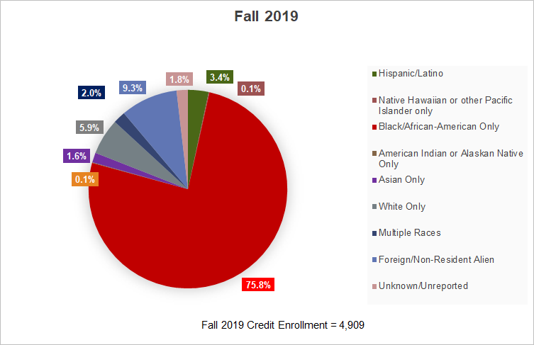
Credit Student Demographics
Operating & Capital Budget
Baltimore City Community College
Source: BCCC Performance Accountability Report for MHEC
Page 7 │

Slide 8
CARES ACT FUNDING – PROGRAMMATIC IMPACT
Operating & Capital Budget
Baltimore City Community College
FY 2020 | Allocation | Spent | Remaining | Use of Funds
CARES - Students | $1.4M | $952K | $486K | Students
CARES – Institutional | $1.4M | 0 | $1.4M | Institutional
GEERS | $754K | $0 | $754K | Career Development
CoVID Expenses – State Aid | $874K | $874K | $0 | Public Safety, Technology & Supplies
Predominately Black Inst. | $192K | $0 | $192K | Student/Institutional
Page 8 │

Slide 9
Operating & Capital Budget
Baltimore City Community College
BCCC Trends in Online Enrollment
Enrollments in online courses | FY 2016 | FY 2017 | FY 2018 | FY 2019
a. Credit | 7,489 | 6,721 | 6,904 | 7,200
b. Continuing education | 374 | 879 | 1,318 | 1,494
MHEC Trends in Community College & 4-Year Undergraduate Online Enrollment
In fall 2019, 39% of BCCC students took one or more online classes.
Enrollment (Credit)
Source: IPEDS Fall Enrollment
Page 9 │

Slide 10
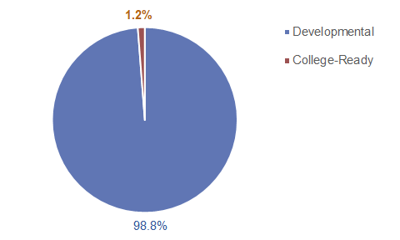
Fall 2019 First-Time Entrants Developmental Status
Operating & Capital Budget
Baltimore City Community College
BCCC Interventions:
RENG and MATH instructors work with the Promise Academy to provide students in the lowest levels with supplemental support including embedded tutoring.
eTutoring, students can receive assistance with the following subjects: Writing, Biology, Statistics, Anatomy & Physiology, Chemistry, Math, and Accounting
Embedded tutoring has been implemented in selected courses.
1,080 Entrants took the placement test.
Source: BCCC Office of Institutional Research & Performance Accountability Report for MHEC.
Page 10 │

Slide 11
Operating & Capital Budget
Baltimore City Community College
Trends in Enrollment Fall 2015 - 2020*
*Fall 2020 As of September 17, 2020
Source: BCCC Office of Institutional Research
Page 11
│

Slide 12
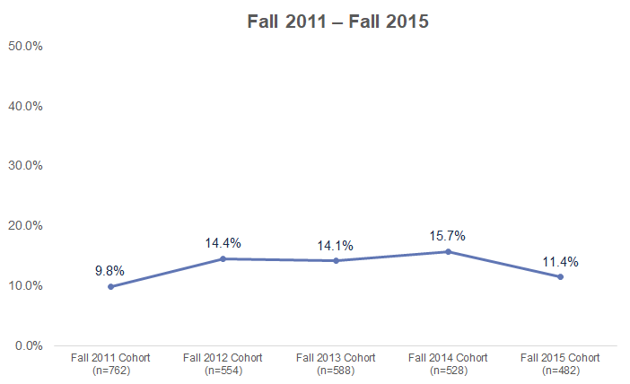
Four-Year Graduation Rates
Operating & Capital Budget
Baltimore City Community College
Source: BCCC Degree Progress Analysis reported for MHEC.
Page 12 │

Slide 13
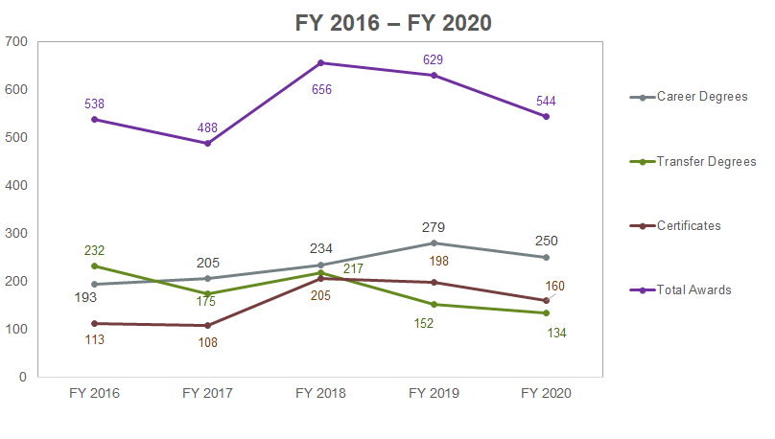
Annual Degrees & Certificates Awarded
Operating & Capital Budget
Baltimore City Community College
Source: BCCC Performance Accountability Report for MHEC.
Page 13│

Slide 14
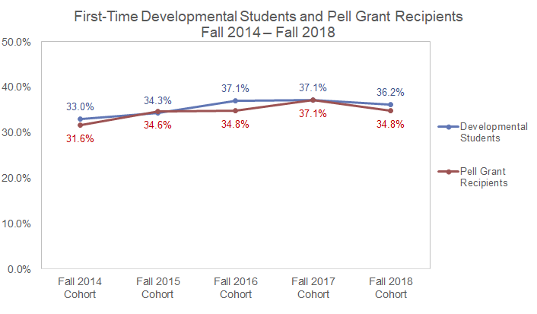
Fall-to-Fall Retention
Operating & Capital Budget
Baltimore City Community College
Developmental Students​ | 287/870​ | 292/851​ | 169/456​ | 206/555​ | 361/997​
Pell Grant Recipients​ | 235/743​ | 197/569​ | 187/538​ | 166/447​ | 243/698
Source: BCCC Performance Accountability Report for MHEC.
Page 14 │

Slide 15
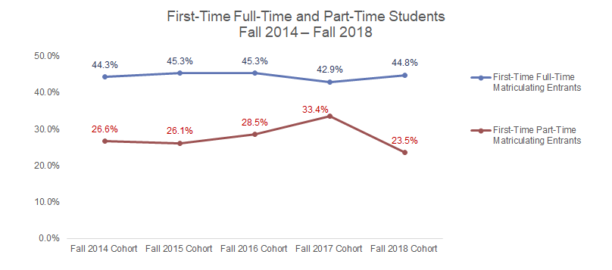
Fall-to-Fall Retention
Operating & Capital Budget
Baltimore City Community College
Full-Time Degree/Certificate-Seeking Students | 180/406 | 178/393 | 145/320 | 137/319 | 267/596
Part-Time Degree/Certificate- Seeking Students | 154/579 | 142/543 | 123/432 | 104/311 | 105/446
Source: BCCC Performance Accountability Report for MHEC.
Page 15 │

Slide 16
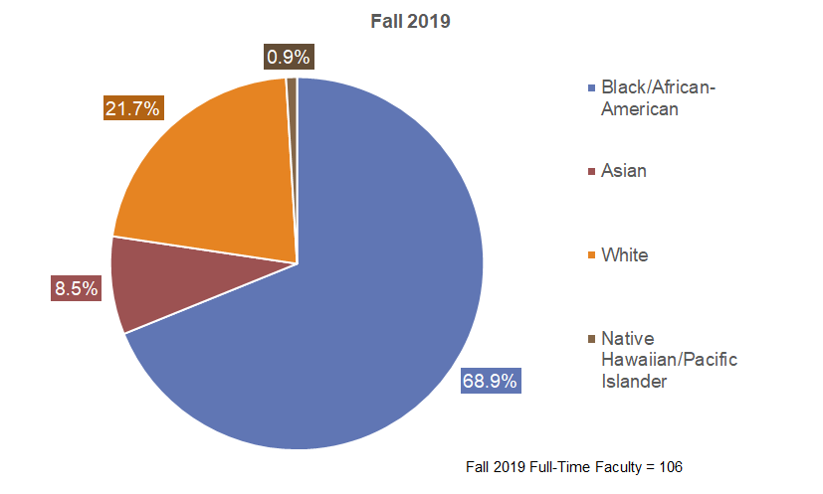
Full-Time Faculty Demographics
Operating & Capital Budget
Baltimore City Community College
Source: BCCC Performance Accountability Report for MHEC.
Page 16│

Slide 17
Operating Budget
Operating & Capital Budget
Baltimore City Community College
For Fiscal Year 2021, BCCC is authorized to receive $40.1 million in State funding, the largest portion of total funding of approximately $83 million.
Fiscal Year 2022 Operating Budget request to Department of Budget and Management (hearing in early November), totaling approximately $85 million.
*BCCC currently has an unrestricted (unallocated) fund balance of less than $1 million.
BCCC is currently evaluating the option to issue academic and/or auxiliary bonds, capital leases or P3 arrangements.
Page 17 │

Slide 18
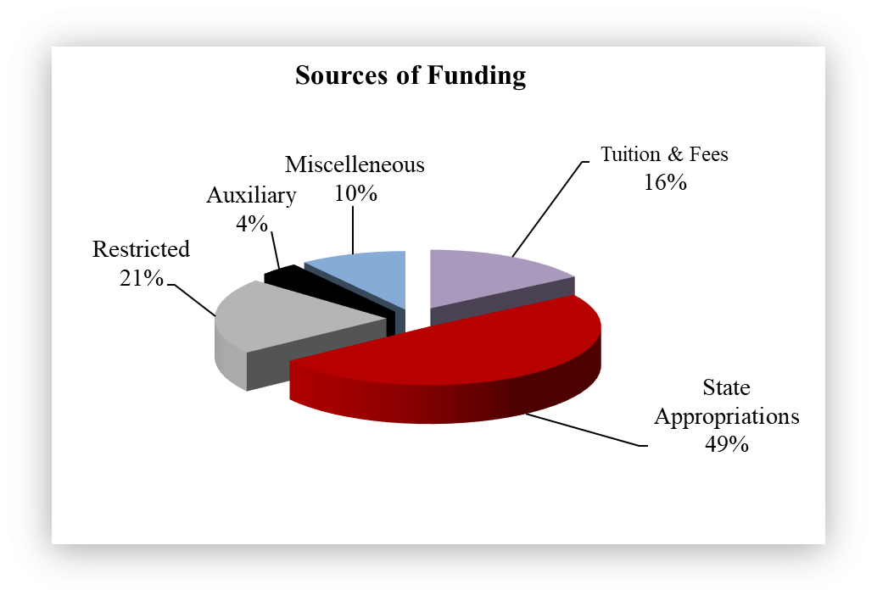
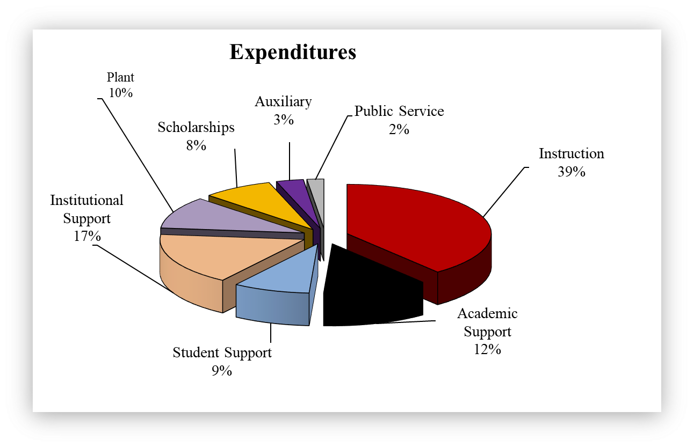
FY 2020 Unaudited Financials
Operating & Capital Budget
Baltimore City Community College
Source: BCCC Budget Office
Page 18 │

Slide 19
Operating Budget Fiscal Year 2022
Operating & Capital Budget
Baltimore City Community College
Salaries, Wages & Benefits |  |  | $43,899
Technical & Special Fees |  |  | $7,407
Other Operating Expenses |  |  | $34,193
TOTAL |  |  | $85,499
(in thousands)
Page 19 │

Slide 20
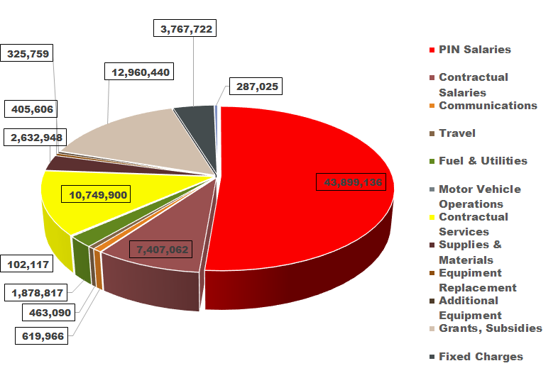
Operating Budget Fiscal Year 2022
Operating & Capital Budget
Baltimore City Community College
Page 20 │

Slide 21
BCCC Capital Debt Profile
Operating & Capital Budget
Baltimore City Community College
Debt Issued in Prior Five Fiscal Years & Amount Authorized but Unissued:
BCCC has not issued debt in the prior five fiscal years
Bonding authority is $65 million for auxiliary and academic facilities
BCCC has no bond debt outstanding - the entire authorization remains unissued as of June 30, 2020.
Current Projections for New Issuances & Rating Agency Update:
BCCC is currently assessing its position to issue debt.
Ten-Year Projection:
Any projected bond issuance has not yet been determined.
Page 21 │

Slide 22
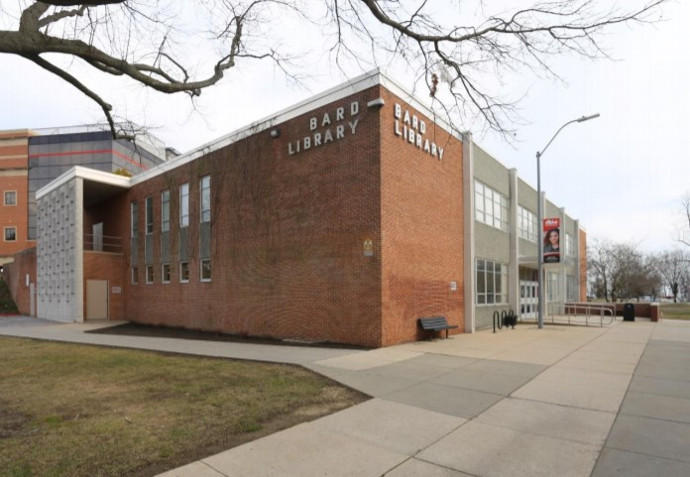
Five-Year Capital Program
Operating & Capital Budget
Baltimore City Community College
The College’s Capital Budget request for fiscal years 2022-2026
Learning Commons Renovation and Addition (Library)
Current FY22 request for $1,560,000 in Planning funding to start the design of the renovation and addition to provide a modern learning commons with needed study space, electronic media space, and additional food service space.
The entire project is estimated to cost $23,202,000 and be completed in FY24.
Page 22 │

Slide 23
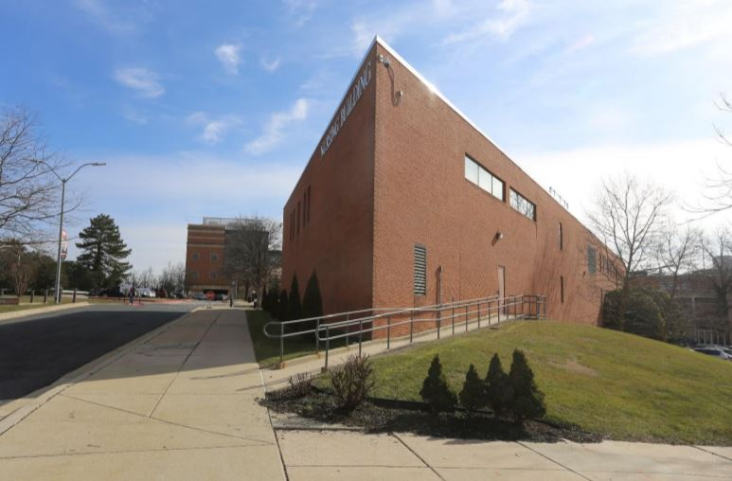
Five-Year Capital Program
Operating & Capital Budget
Baltimore City Community College
The College’s Capital Budget request for fiscal years 2022-2026
Nursing Building Renovation and Addition
Current FY22 request for $2,270,000 in Planning funding to start the design of the renovation and addition to the 1977 Nursing Building with needed office, classroom, and simulation lab space to contribute to the rising need for healthcare workforce in Baltimore.
The entire project is estimated to cost $29,060,000 and be completed in FY24.
Page 23 │

Slide 24
Deferred Maintenance - Five-Year Capital Program
Operating & Capital Budget
Baltimore City Community College
The College is requesting $4.24 Million for deferred maintenance projects in FY 2022 and $19.7M over 5 years. The College has an extensive backlog of facility improvement needs that are long overdue. The aging utility and building systems have exceeded their life expectancy and are constantly being repaired. An engineering assessment was conducted, and deferred maintenance projects are needed to replace major systems and failing equipment throughout the campus, much of which has not been updated since the original construction in the 1960-70's.
The College is requesting funding for the following projects:
Boilers, Chillers, and Cooling Towers
Fire Alarm System Upgrades throughout campus
Campus-wide Elevator Refurbishment
Replacement of HVAC Systems
Restroom upgrades for Main Building
Utility infrastructure campus-wide
Page 24 │

Slide 25
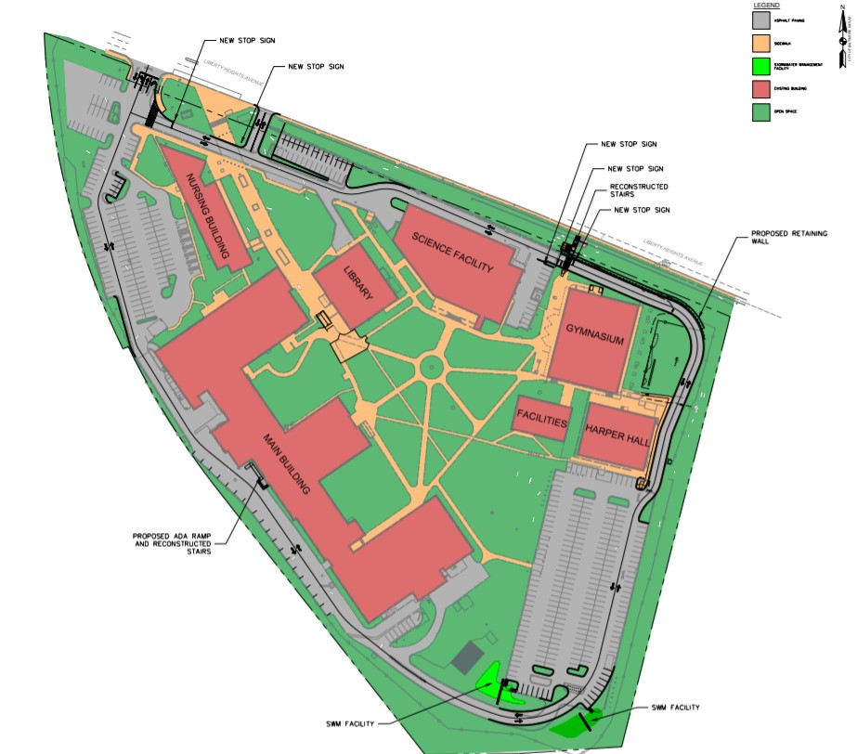
In-Progress Capital Program
Operating & Capital Budget
Baltimore City Community College
Perimeter Loop Road Improvements
Funded at $6,110,000
Bidding Fall 2020 with 12 months of Construction
The Loop Road project involves
the extension of the existing vehicular
access road to surround the entire
Liberty Campus, which will connect all
parking lots on the campus and ease
vehicular circulation through the campus.
This project is the first to be implemented
under the facilities master plan and will improve safety, security, circulation, emergency access, accessibility, and enhance the overall appearance and user experience of the Liberty Campus.
Page 25 │

Slide 26
THANK YOU!
Operating & Capital Budget
Dr. Debra L. McCurdy President
Baltimore City Community College
Larry Hogan, Governor State of Maryland
WEDNESDAY | SEPTEMBER 23, 2020
2901 Liberty Heights Avenue | Baltimore, MD 21215 | 410-462-8300 | www.bccc.edu

