Slide 1
St. Mary’s College of Maryland
Operating and Capital Budget
Presented to the
Maryland Higher Education Commission
September 13, 2023

Tuajuanda C. Jordan, PhD
President
Paul A. Pusecker, III
Vice President for Business and
Chief Financial Officer
Katherine Gantz, PhD
Vice President for Academic Affairs and Dean of Faculty
Paula Collins
Board of Trustees
Vice-Chair

Slide 2
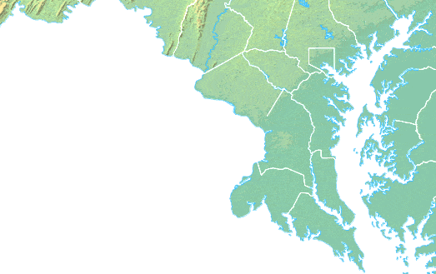
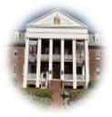
We are…
Honors Liberal Arts
Accessible
Affordable
Mission

Slide 3
By the numbers…

Slide 4
By the numbers…
Tuition Rankings
Public Four-Year
6th
38th
2012-2013
2021-2022
ON
OFF
USDE’s Highest Tuition List

Slide 5
Equitable access to
affordable & quality education…

Slide 6
Access

Slide 7
Access
Comparisons use the most recently available data.

Slide 8
Affordable Access
Comparisons use the most recently available data.

Slide 9
Affordable Access
Comparisons use the most recently available data.

Slide 10

LEARNING through EXPERIENTIAL and APPLIED DISCOVERY
Equitable Access, Success, and Innovation
through
Holistic Curricular Design

Slide 11
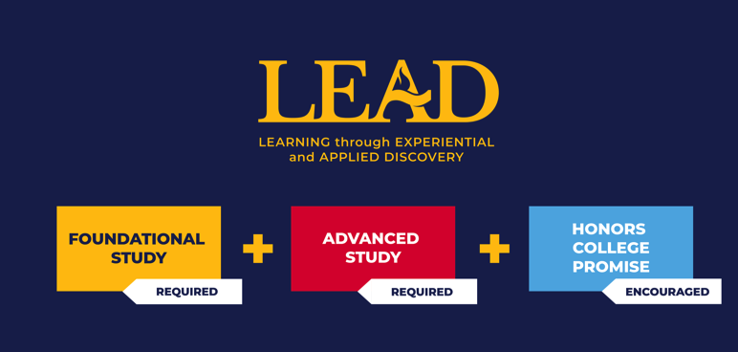

Slide 12
Affordable Access to Quality
SMCM Graduates
National Baccalaureate Arts & Sciences
Comparisons use the most recently available data.

Slide 13
Equitable Affordable Access to Quality
All SMCM Students
SMCM Students of Color
SMCM Pell Students

Slide 14
Student Success
Comparisons use the most recently available data.

Slide 15
Equitable Student Success
All SMCM Students
SMCM Students of Color
SMCM Pell Students
Comparisons use the most recently available data.
Notes:
All are five-year averages

Slide 16
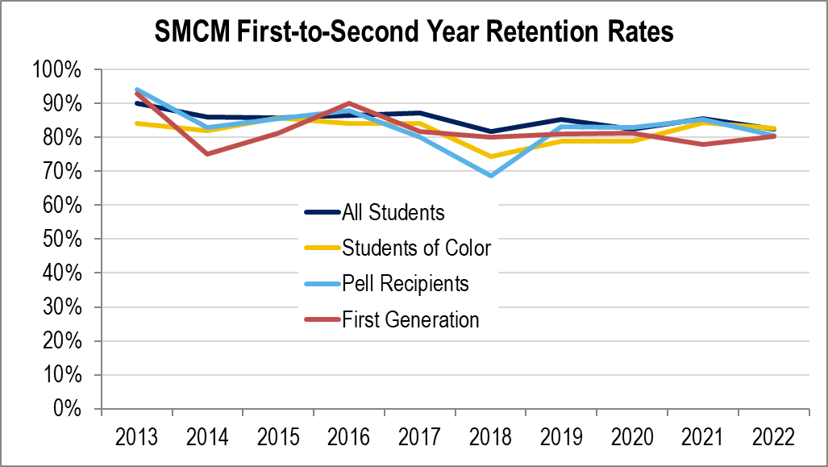
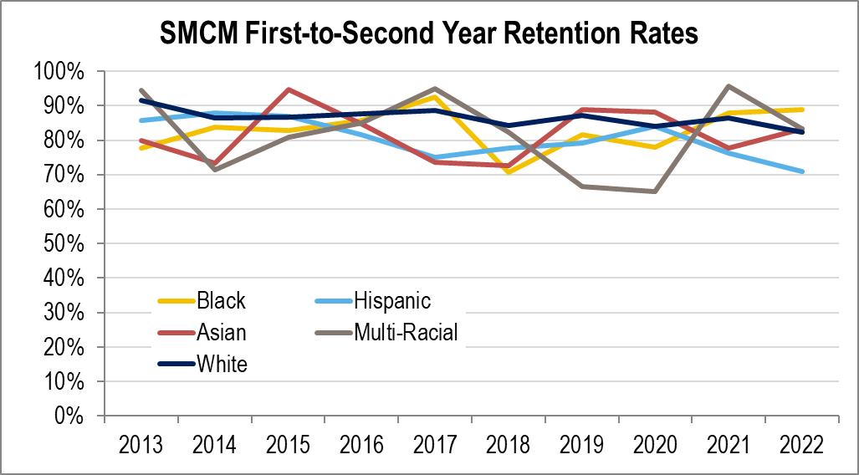
10-year trends

Slide 17
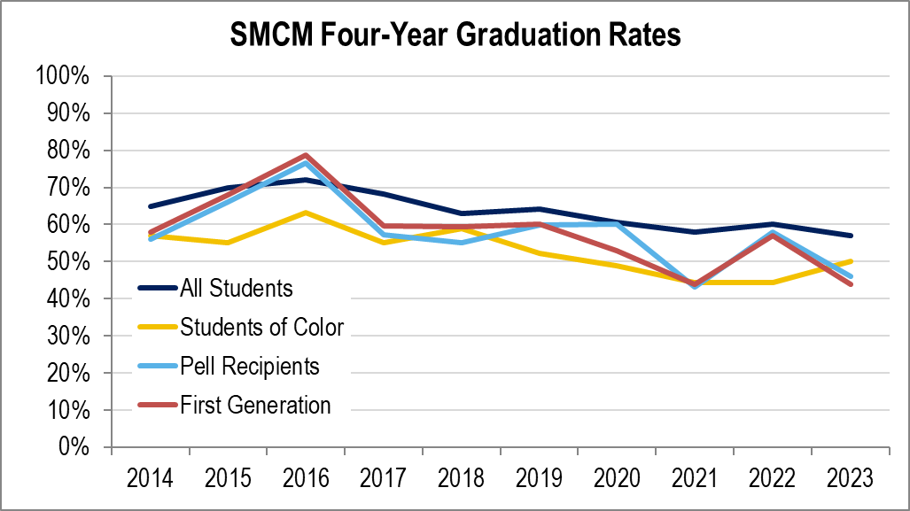
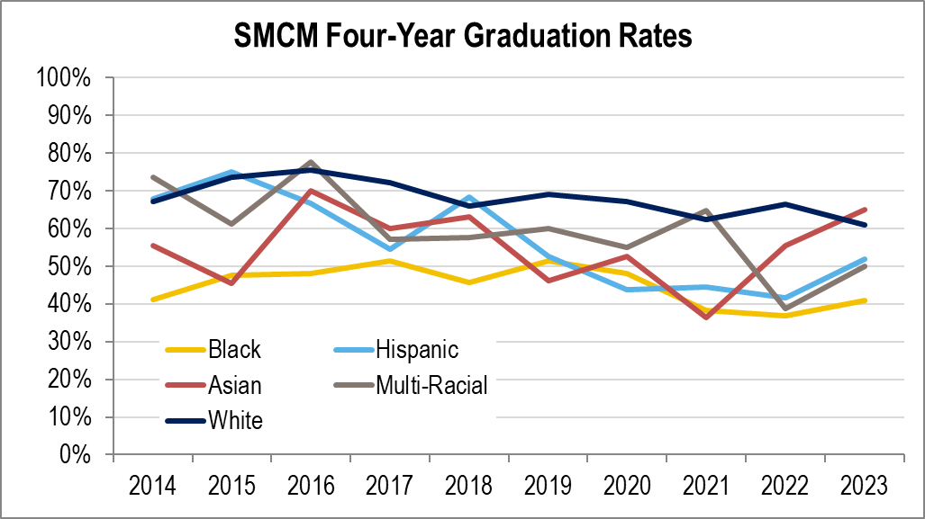
10-year trends

Slide 18
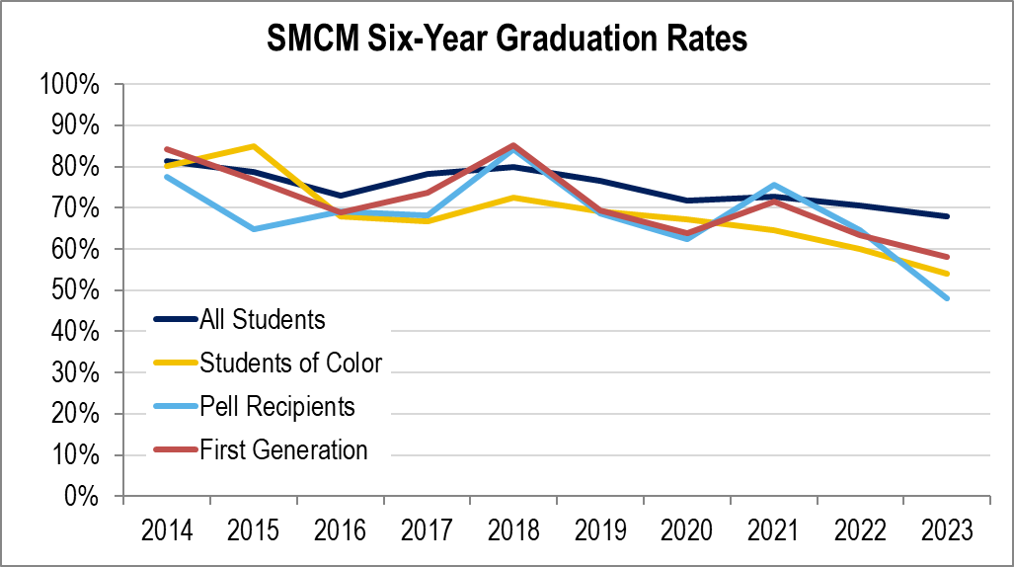
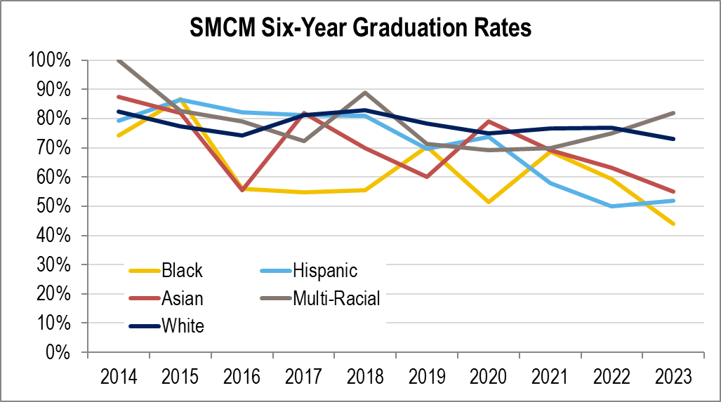
10-year trends

Slide 19
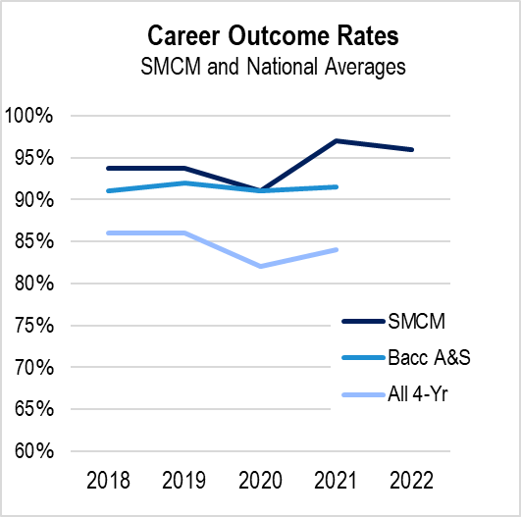
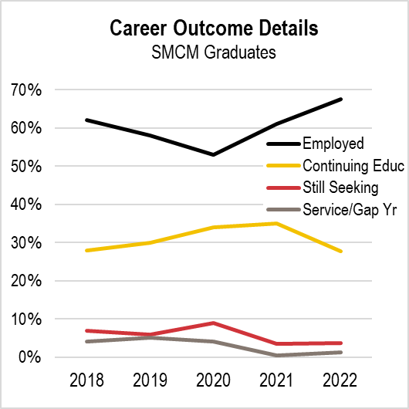

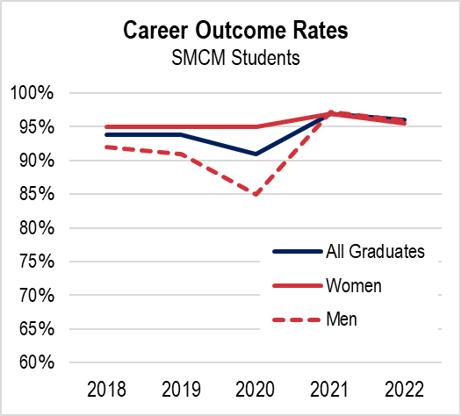
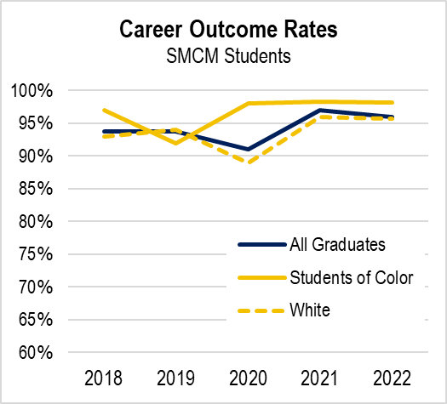
Post-Graduate Success
Comparisons use the most recently available data.

Slide 20
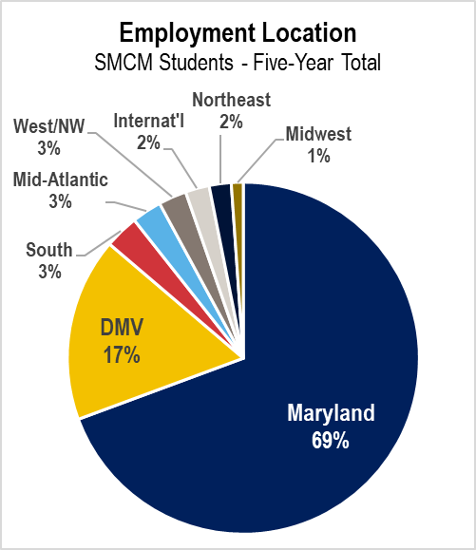
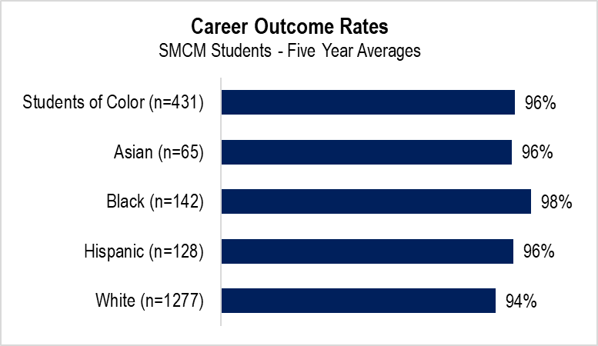
Post-Graduate Success

Slide 21
SMCM Current Operating Budget

Slide 22
SMCM CFU Revenues by Source

Slide 23
SMCM Unrestricted Expenditures by Program

Slide 24
SMCM Expenditures by Category

Slide 25
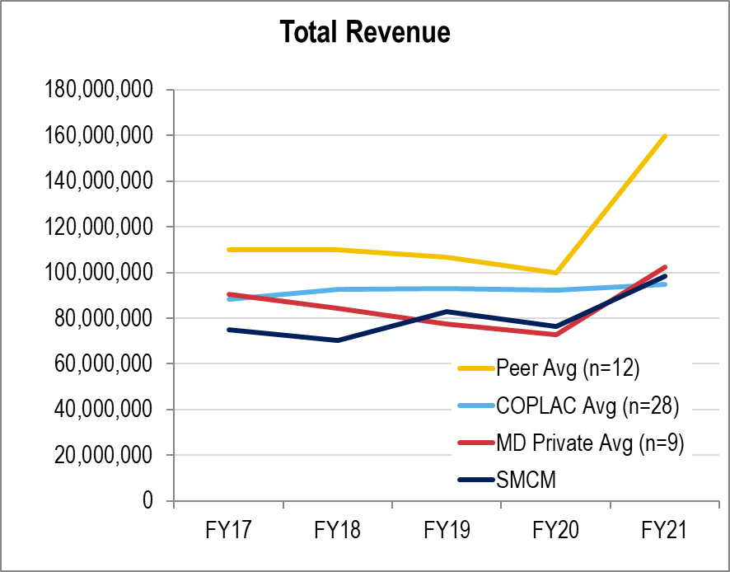
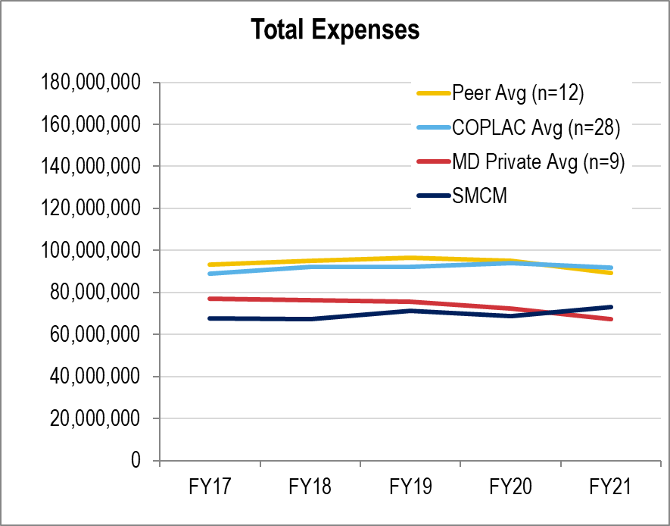
SMCM Revenue and Expenditure Peer Comparison

Slide 26
SMCM Capital Budget Request
Infrastructure Improvement Program |  | FY25 | FY26-29
 | TOTAL (construction/equipment) | $4.21M | $9.55M
Montgomery Hall Renovation
 | Design | $3.06M | 0
 | Construction |  | $34.83M
 | Equipment |  | $3.85M
 | TOTAL | $3.06M | $37.68M
Calvert Hall
 | Design |  | $3.07M
 | Construction |  | 0
 | Equipment |  | 0
 | TOTAL |  | $3.07M
Total CIP Request |  | $7.27M | $50.30M

Slide 27
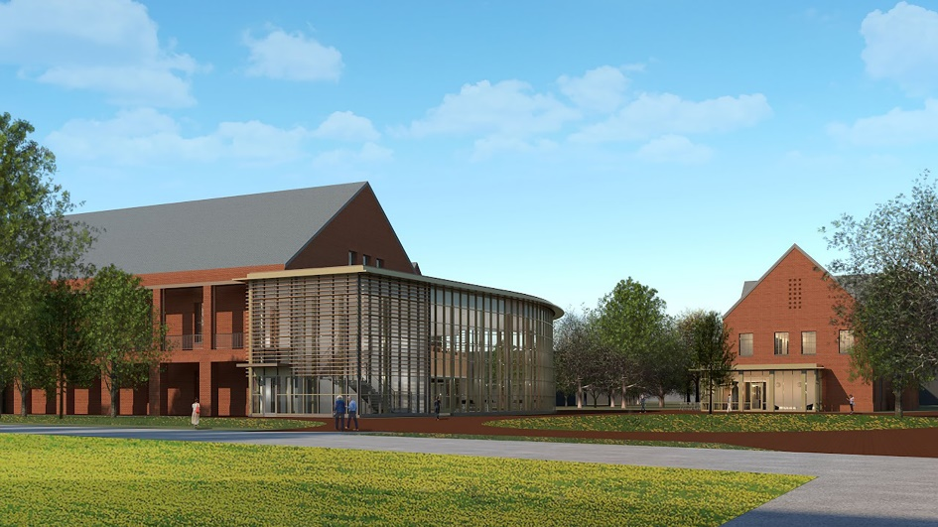
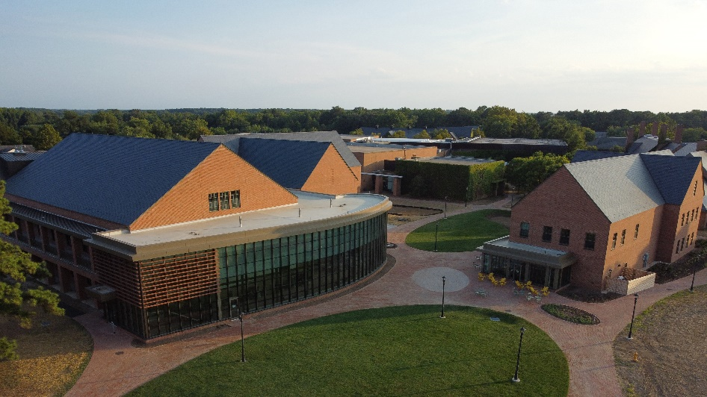
Nancy R. and Norton T. Dodge Performing Arts Center and Learning Commons

Slide 28
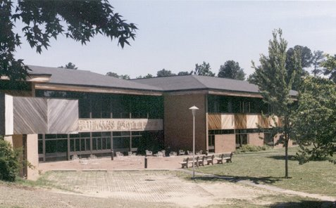
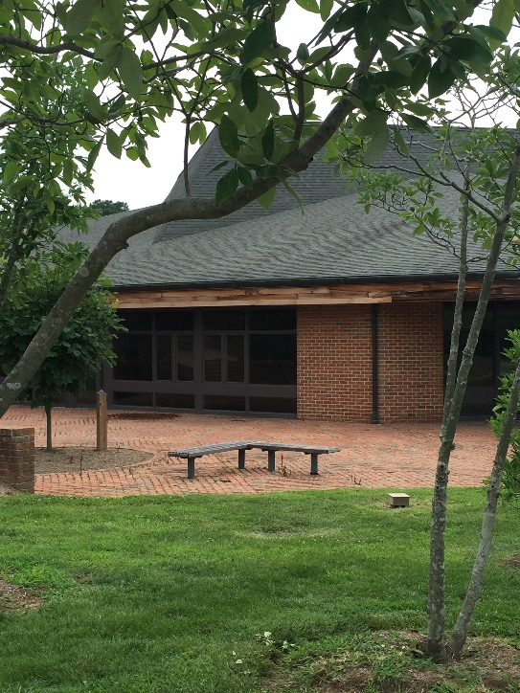
Montgomery Hall

Slide 29
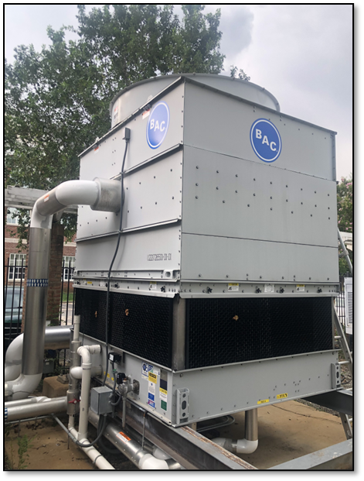
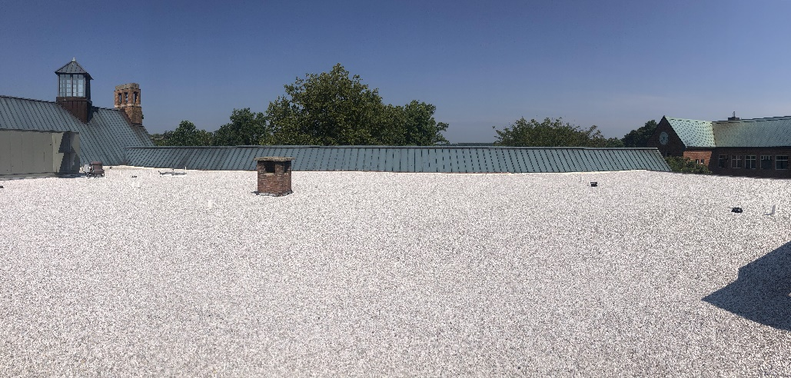
Infrastructure Improvements
Campus Center Roof Replacement
Kent Hall Cooling Tower

Slide 30
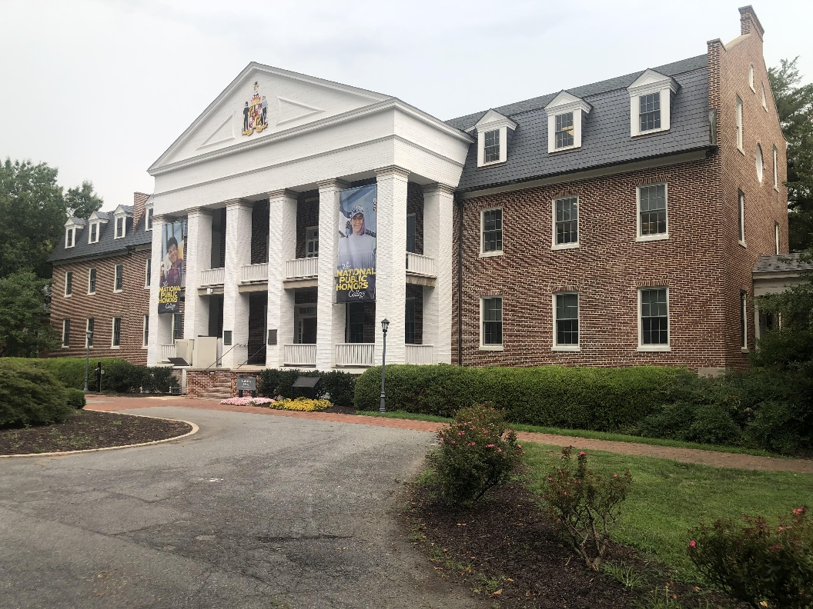
Calvert Hall

Slide 31
Thank You!
Questions?

