Slide 1
FY 2023 Operating
and Capital Budget Request
Presented to the
Maryland Higher Education Commission
September 22, 2021

Tuajuanda C. Jordan, PhD
President
Lawrence E. Leak, PhD
Board of Trustees Government Relations Liaison
Paul A. Pusecker, III
Vice President for Business &
Chief Financial Officer
Jeffrey J. Byrd, PhD
Interim Vice President
for Academic Affairs
Katherine Gantz, PhD
Interim Dean of Faculty

Slide 2
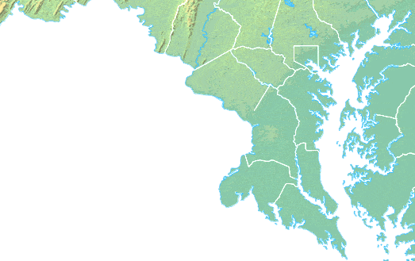
We are…
Mission
Honors Liberal Arts
Accessible
Affordable

Slide 3
By the numbers…

Slide 4
By the numbers…
Tuition Rankings – Public 4-Year
6th
29th
2012-2013
2020-2021

Slide 5
By the accolades…

Slide 6
Equitable access to
affordable & quality education…

Slide 7
Access

Slide 8
Access
Comparisons use the most recently available data.

Slide 9
Affordable Access
Comparisons use the most recently available data.

Slide 10
Affordable Access
Comparisons use the most recently available data.

Slide 11
LEARNING through EXPERIENTIAL and APPLIED DISCOVERY
Equitable Access, Success, and Innovation
through
Holistic Curricular Design

Slide 16
Affordable Access to Quality
SMCM Graduates
National Baccalaureate Arts & Sciences
Comparisons use the most recently available data.

Slide 17
Equitable Affordable Access to Quality
All SMCM Students
SMCM Students of Color
SMCM Pell Students

Slide 18
Student success…

Slide 19
Student Success
Comparisons use the most recently available data.

Slide 20
Equitable Student Success
All SMCM Students
SMCM Students of Color
SMCM Pell Students
Comparisons use the most recently available data.

Slide 21
FY23 Budget Request

Slide 22
FY23 Capital Budget Request
Infrastructure
 | Design | $135,000 | $800,000
 | Construction | $1,365,000 | $7,700,000
 | TOTAL | $1,500,000 | $8,500,000
Goodpaster Hall Renovation
 | Design (College Funds) | $26,000 | 0
 | Construction | $1,588,000 | 0
 | Equipment | $275,000 | 0
 | TOTAL | $1,889,000 | 0
Montgomery Hall Renovation
 | Design |  | $4,932,000
 | Construction |  | $31,653,000
 | Equipment |  | $3,850,000
 | TOTAL |  | $40,435,000
Total CIP Request |  | $3,389,000 | $48,935,000

Slide 23
Thank You!
Questions?

Slide 24
COVID-19 FY21 Impact
FY21 COVID-19 Gross Impact = $7.8M (11%)
State Reduction July 2020 $2.05M
Revenue Loss Estimate $3.50M
COVID-19 Related Expenses $2.20M

