Slide 1


Maryland Higher
Education Commission
Wednesday, September 23, 2020
Sara Fidler
President of MICUA
sfidler@micua.org
Notes:
Photo: McDaniel College

Slide 2

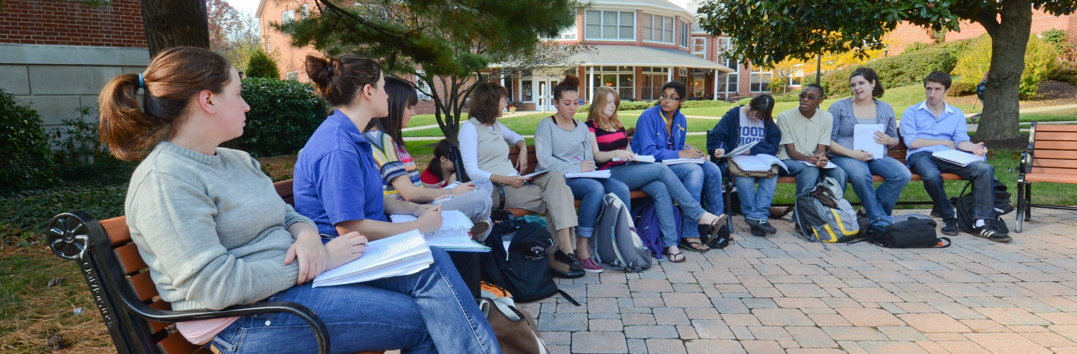
MICUA Members
2
Notes:
Photo: Hood College

Slide 3
Fall 2020 Plans
MICUA institutions offering face-to-face instruction:
MICUA institutions offering virtual instruction only:
Capitol Technology University
Hood College
McDaniel College
Mount St. Mary’s University
Stevenson University
Goucher College
Johns Hopkins University
Loyola University Maryland
Maryland Institute College of Art
Notre Dame of Maryland University
St. John’s College
Washington Adventist University
Washington College

Slide 4
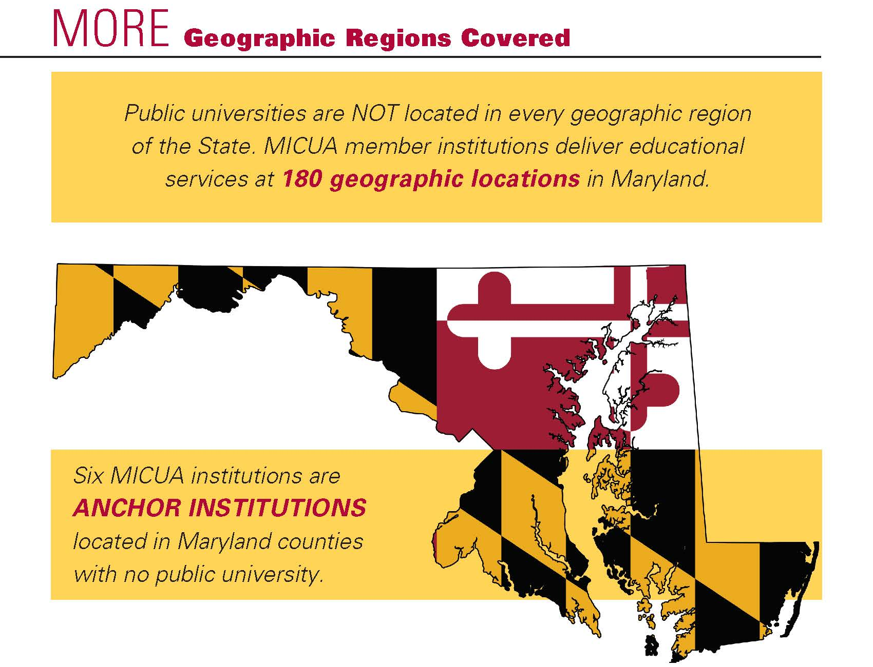
Geographic Regions Covered
Notes:
The six institutions with no public institution in that county: Hood College, McDaniel College, Mount St. Mary’s University, St. John’s College, Washington Adventist University, and Washington College

Slide 5
MICUA Net Tuition
Net Price at Private Non-Profit Institutions
US Median = $21,714
US Average = $22,678
MICUA Average = $28,161 (14th)

Slide 6
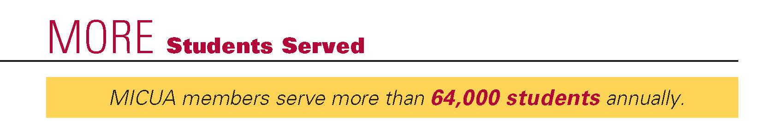
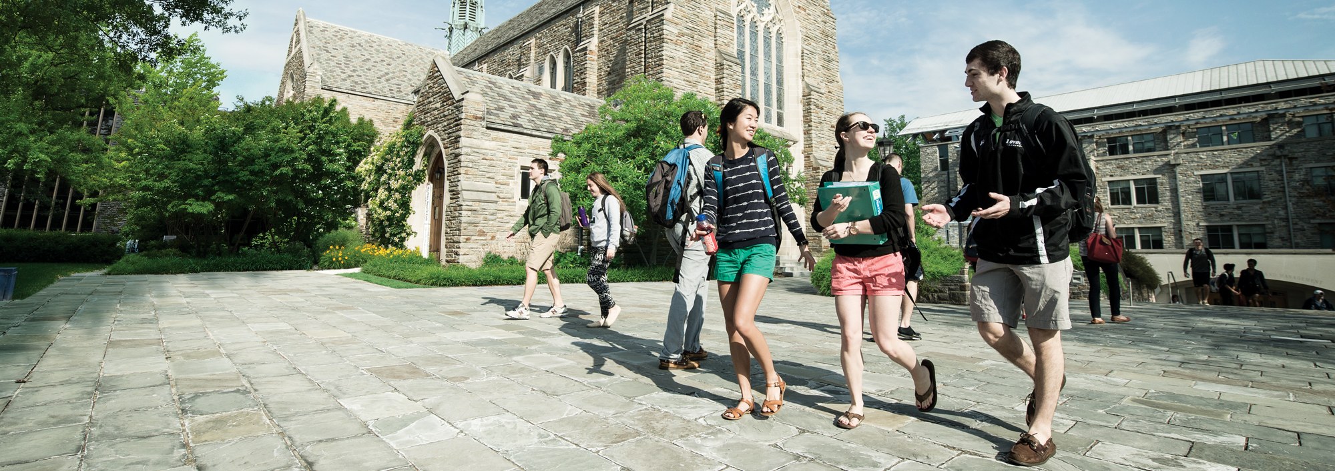
Students Served
MICUA members serve more than 66,000 students annually
^{MICUA Institutions:}
1 in 3 (34%) students is a student of color
1 in 4 (24%) students is a low-income student
1 in 6 (15%) of new undergraduate students are transfer students
An increasing number of students are adult learners
Notes:
Photo: Loyola University Maryland

Slide 7
Trends in Opening Fall Headcount Enrollment MICUA State-Aided Institutions
Actual and Projected

Slide 8
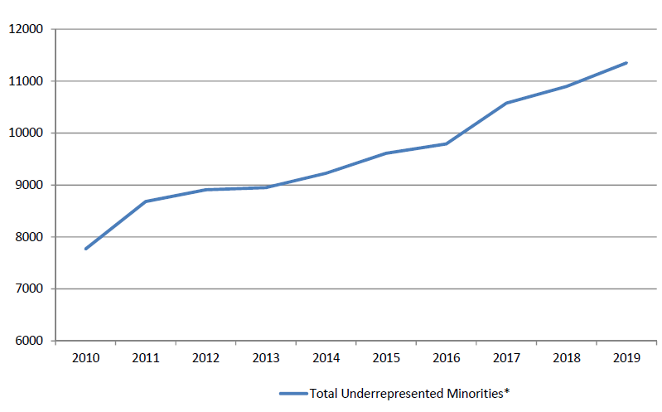
Number of Underrepresented Minority Students Enrolled at MICUA Institutions (Fall Headcount)
Source: IPEDS

Slide 9
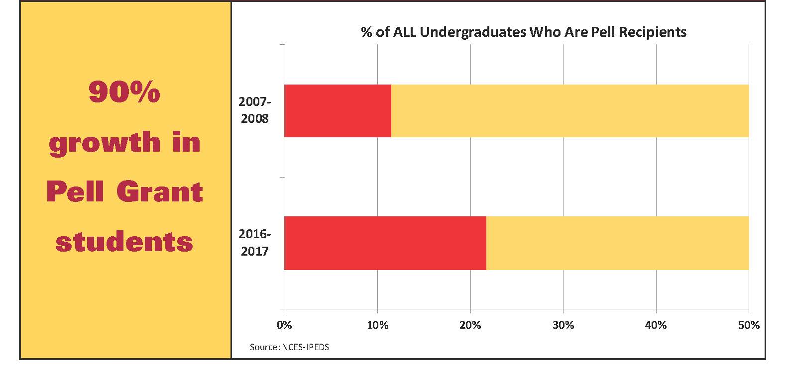
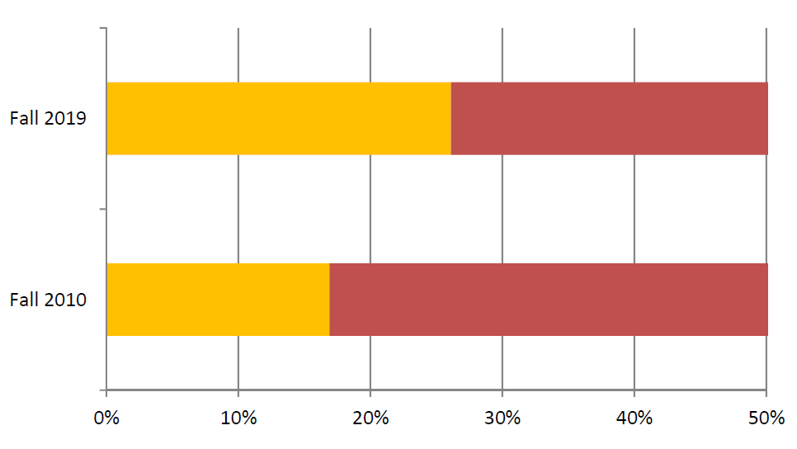
Remarkable Growth in Diversity
% of ALL Undergraduates Who are Underrepresented Minorities
54.4%
Growth in Enrollment of Students Who Are Under-represented Minorities
Underrepresented Minorities
All Students

Slide 10
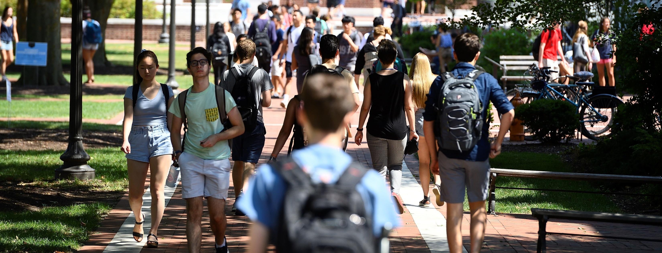
Serving Underrepresented
Minority Students
Serving Minority Students (MS)
3 MICUA member institutions have majority minority undergraduate student bodies
10 MICUA member institutions enjoy undergraduate minority representation of 30% or more
10
Notes:
Photo: Johns Hopkins University

Slide 11
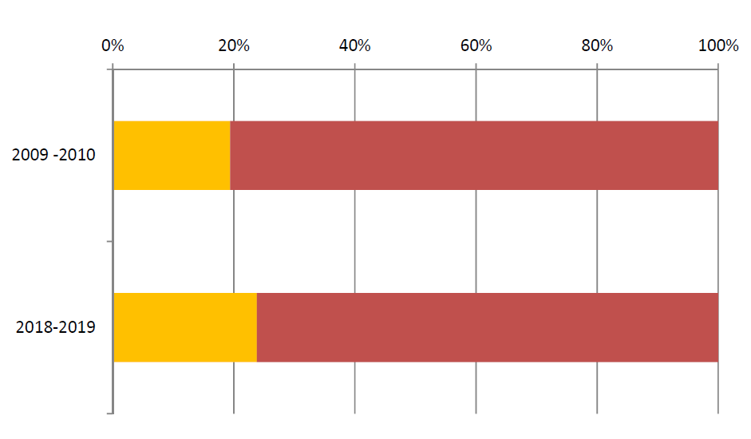
Remarkable Growth in Lower Income Students
23%
Growth in Enrollment of Students Who Are Pell Grant Recipients
Pell Recipients
All Students

Slide 12

MORE Academic Programs Offered
Maryland’s Independent Colleges and Universities offer
more than 1,600 approved academic programs
616 – Bachelor’s Degrees
563 – Master’s Degrees
143 – Doctoral Degrees
39 – Undergraduate Certificates
242 – Graduate Certificates
Notes:
Photo: Hood College

Slide 13
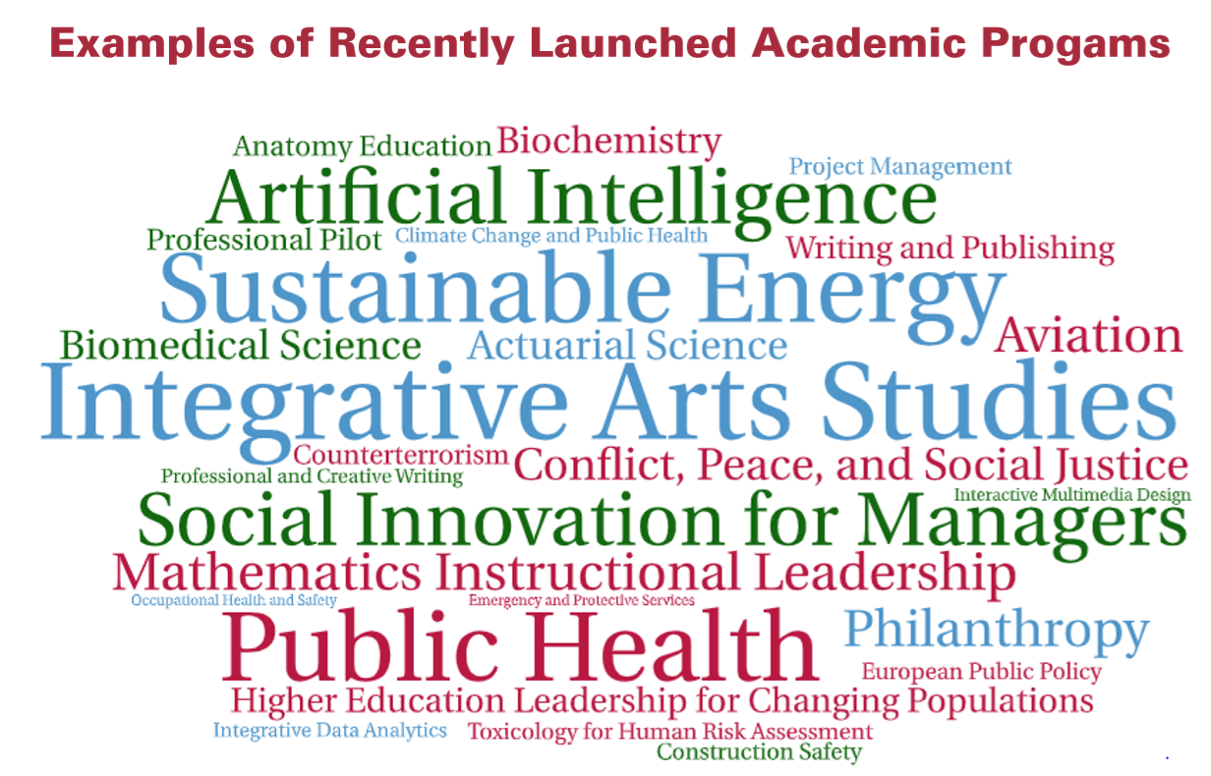

Slide 14
Innovative Practices at MICUA Institutions
Partnerships with Maryland Community Colleges to foster transfer students
JHU Amazon Portal
St. John’s College Tuition Reset
Coalition for College Cost Savings
CBIZ- Consortium
Remote education
Virtual commencement ceremonies
I-Fund Membership, including Administration of the National Security Scholars Program
Guaranteed Access Partnership Program (GAPP)

Slide 15

Retention & Graduation Rates
85% — Retention rate for undergraduate students
75% — FT/FT freshmen enrolled at a MICUA institution graduate from that same MICUA institution within six years
93% — FT/FT freshmen who first enroll at a MICUA institution graduate from that same MICUA institution or transfer institution within six years
15
Notes:
Photo: Goucher College

Slide 16
6-Year Graduation Rate of Pell Grant Recipients and Underrepresented Minorities at MICUA Institutions Surpasses the Overall National Average
75% of FT/FT
freshmen
graduate
from a MICUA institution within 6 years

Slide 17
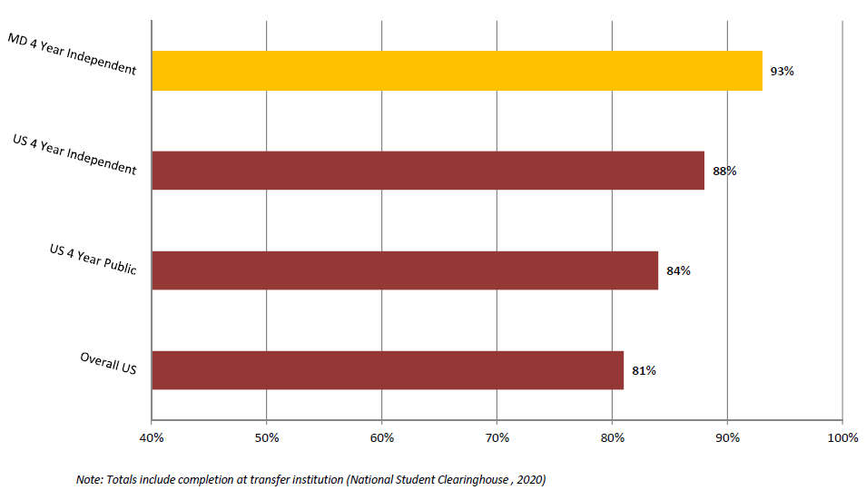
MICUA members have the HIGHEST graduation
rates in the State and are TOP RANKED nationally
6-year Graduation Rates for First-time Full-time (FT/FT) Degree Seeking Students
93% of FT/FT
freshmen
graduate
from a MICUA institution or a transfer institution within 6 years

Slide 18

Degrees Awarded by MICUA
State-Aided Institutions
Field | 5-YR Period
All | 80,442
Nursing | 4,454
Engineering | 5,851
Cybersecurity | 5,839
STEM | 23,539
Notes:
Photo: Mount St. Mary’s University

Slide 19
MICUA Graduate Earnings
Maryland Top Five Payscale 2019-2020 Rankings of All-Alumni
Mid-Career Earnings of Graduates
#1 United States Naval Academy
#2 Johns Hopkins University
#3 Loyola University Maryland
#4 University of Maryland, College Park
#5 Capitol Technology University
Notes:
Source: https://www.payscale.com/college-salary-report/best-schools-by-state/all-bachelors/maryland?orderBy=midCareerMedianPay&ascending=false

Slide 20
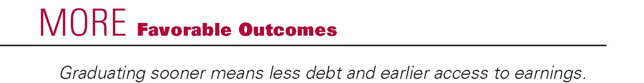
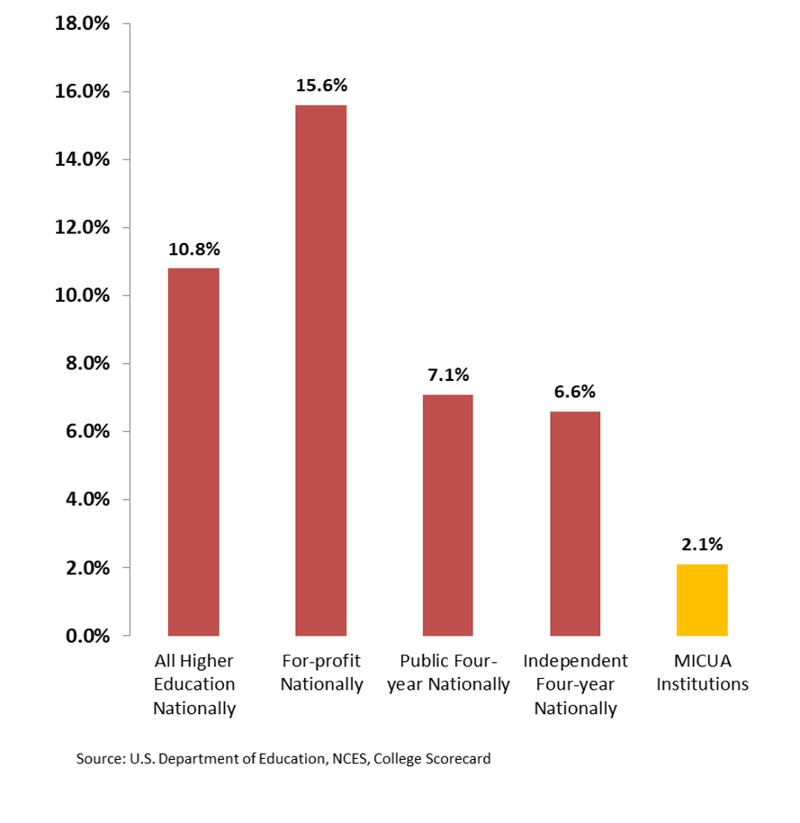
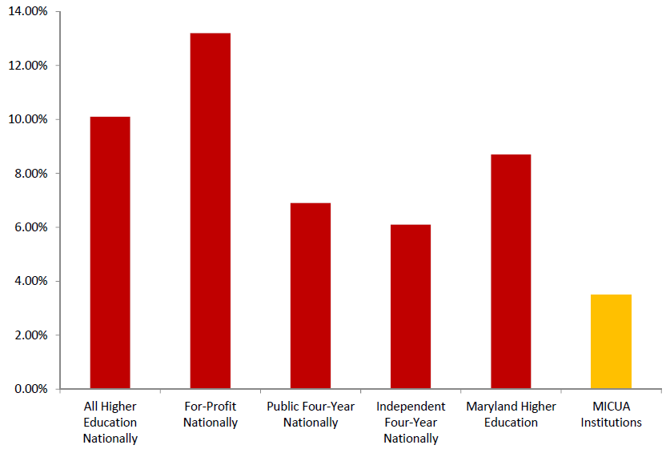
Default Rates on Student Loans
Default Rates on Student Loans
MICUA students
have the
LOWEST
student loan
default rates.
Stafford Loan Cohort 3-year Default Rate - FY 2016
14%
12%
10%
8%
6%
4%
2%
0%
All higher
education
For-profit
nationally
Public
four-year nationally
Independent
four-year
nationally
MICUA
institutions
Source: U.S. Department of Education
20

Slide 21
MICUA institutions contribute $2.8 billion in salaries and wages to Maryland’s economy

Slide 22

MICUA Requests for FY 2022
Sellinger
Capital Grants
Student Financial Aid
Notes:
Photo: Notre Dame of Maryland University

Slide 23
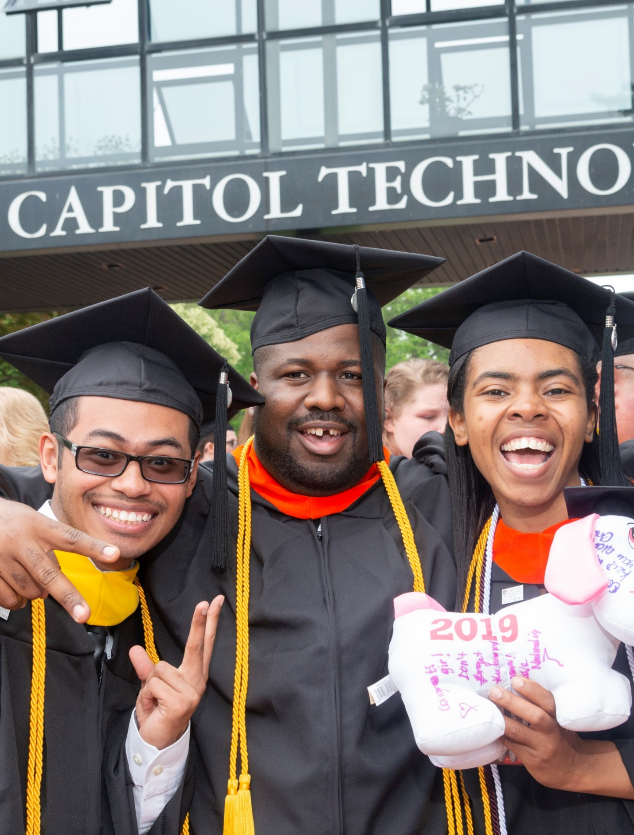
Sellinger Estimate for
FY 2022
 | FY 2022 Projection
Eligible Institutions | Estimated State Aid
Capitol Technology University | $989,952
Goucher College | $3,484,381
Hood College | $2,885,166
Johns Hopkins University | $45,540,145
Loyola University Maryland | $9,885,757
Maryland Institute College of Art | $4,351,023
McDaniel College | $4,828,949
Mount St Mary's University | $4,029,639
Notre Dame of Maryland University | $2,602,506
St John's College | $1,334,392
Stevenson University | $6,621,019
Washington Adventist University | $1,683,084
Washington College | $2,895,549
TOTAL
GRANT PER FTE | $2,064.12
$91,131,564
23
Notes:
Photo: Capitol Technology University

Slide 24
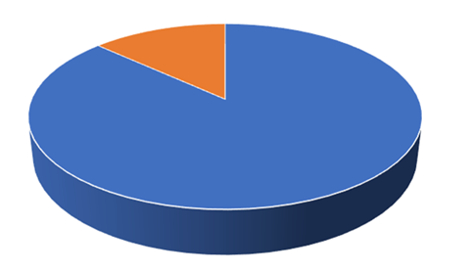
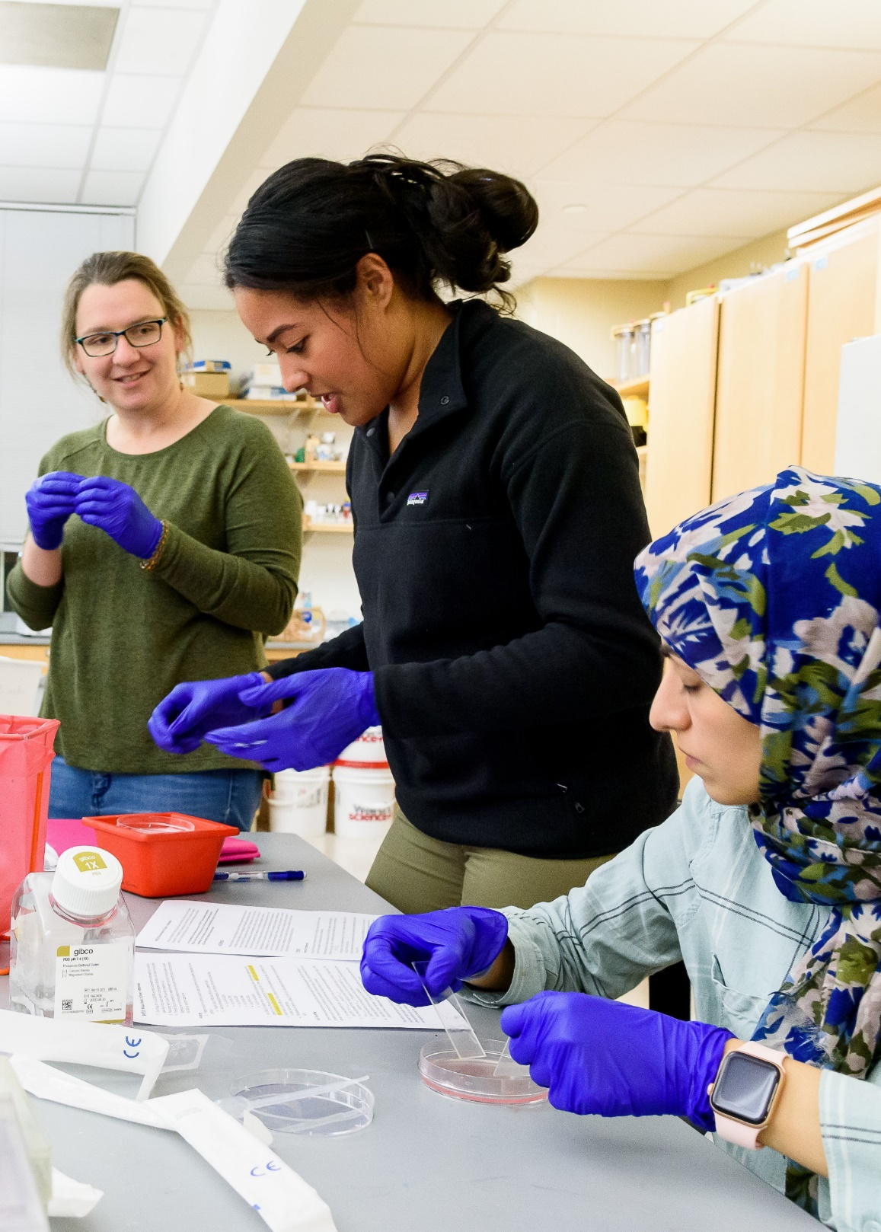
FY 2020 Sellinger Utilization of Funds
FY 2020 Sellinger Utilization of Funds
13%
87%
Other Access, Success, and Innovation Programs
Financial Aid
Notes:
Photo: Hood College

Slide 25
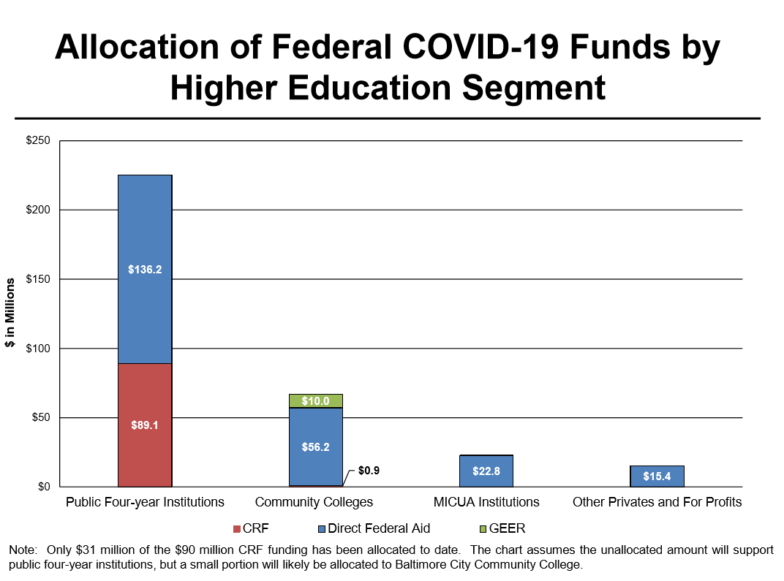
Source: DLS, September 3, 2020, as presented to the Senate Budget and Taxation Committee and the House Appropriations Committee.
Notes:
Note: Only $31 million of the $90 million CRF funding has been allocated to date. The chart assumes the unallocated amount will support public four-year institutions, but a small portion will likely be allocated to Baltimore City Community College.

Slide 26
COVID-19 Expenses
Throughout the summer and into the fall, MICUA institutions continue to experience COVID-related losses and expenses that include:
The cancelation of campus events such as summer camps and other sporting, recreational, and social gatherings;
Declined auxiliary service revenues;
Declined charitable giving;
Declining enrollment;
The provision of personal protective equipment;
Deep cleaning supplies and contracts; and
The need for medical supplies and equipment.

Slide 27
COVID-19 Expenses (cont.)
To implement virtual instruction, our campuses have:
Ensured that everyone has reliable internet service, often in the form of institution-provided hotspots, as well as a device from which to access remote instruction effectively.
Provided extensive training and technology support for faculty.
Increased Wi-Fi capacity and retrofitted classroom space so that students have the option to participate synchronously with in-person classes from a remote location.
Invested in cybersecurity programs to ensure that the increased data and other cyberspace information is being appropriately protected.

Slide 28
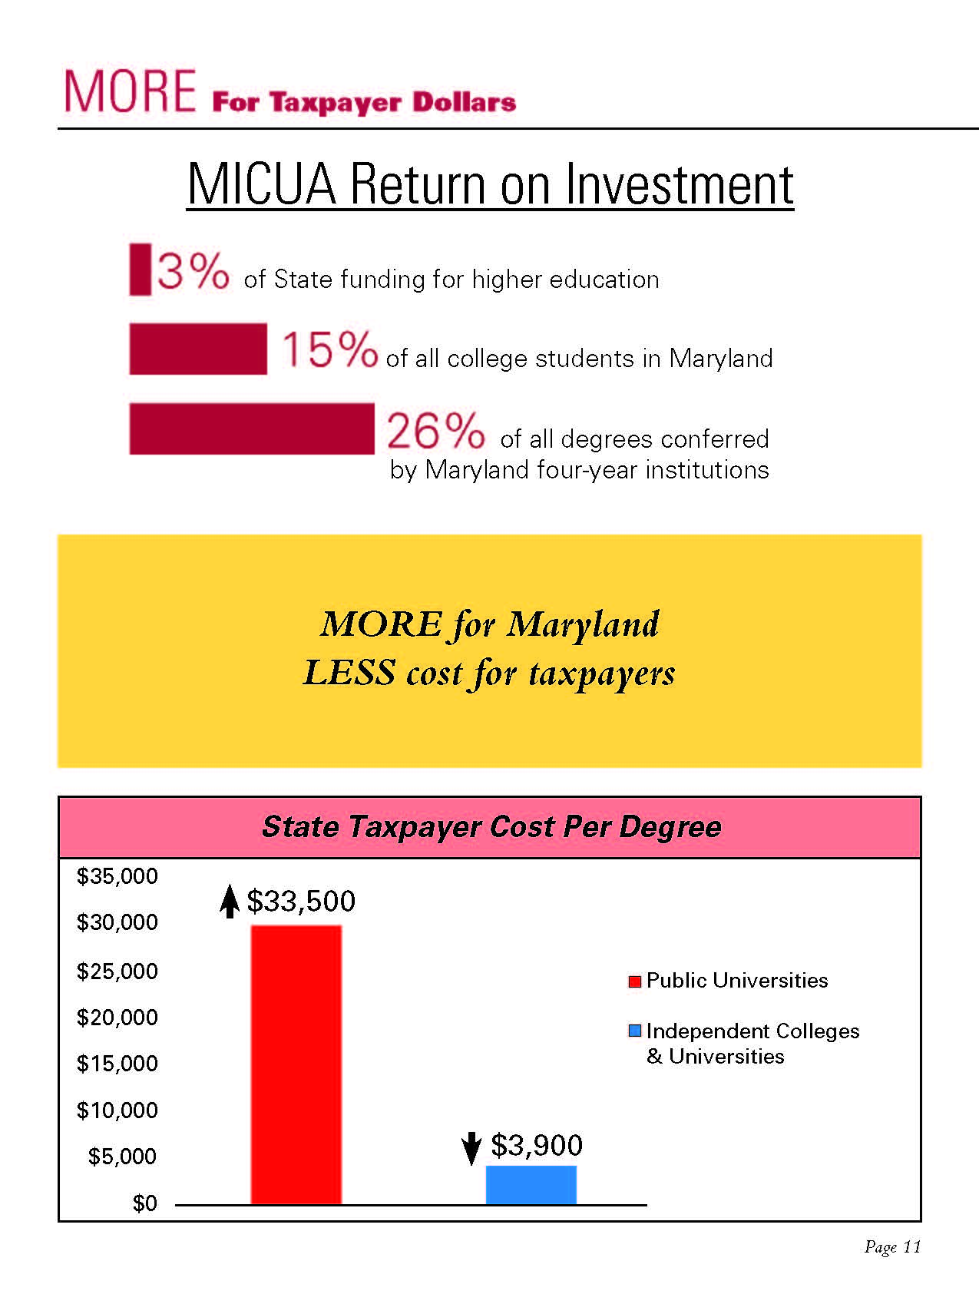
3%
of State funding for higher education
15%
of all college students in Maryland
27%
of all degrees conferred
By Maryland four-year institutions

Slide 29
MICUA Capital Grants
MICUA coordinates the capital budget requests:
Maintains stringent eligibility criteria to constrain requests
Limits how often an institution may request funds
Caps the amount an institution may request in any year
Requires approval by institution’s governing board
Reviews all projects for readiness
Prioritizes projects based on State and institutional needs

Slide 30
MICUA Capital Request for Fiscal 2022
$12 Million MICUA Capital Budget Request
Johns Hopkins University: $5 million to renovate the Eisenhower Library Building.
Mount St. Mary’s University: $2 million to construct an addition to the Coad Science Building.
St. John’s College: $5 million to renovate Mellon Hall (Phase 1) and construct a new mixed-use building.
The $12 million State investment in these projects will leverage over $100 million in private resources and support 800 construction jobs.

Slide 31
Student Financial Aid
MICUA Financial Aid for Maryland Students (2019-2020):
$51 million of State support through the Sellinger Program
$285 million in institutional based aid
NASSGAP – State Grant Aid per Undergraduate Student (2017-2018):
Maryland (5% of total support) = $490 (30th)
National Average (14% of total support) = $890
Best State – South Carolina (37% of total support) = $2,230

Slide 32


THANK YOU!
Notes:
Photo: Hood College

