Slide 1
An Overview of the Transfer with Success Act and Regulatory Changes
Maryland Higher Education Commission
November 15, 2023
Emily A. A. Dow, Ph.D., Assistant Secretary of Academic Affairs

Slide 2
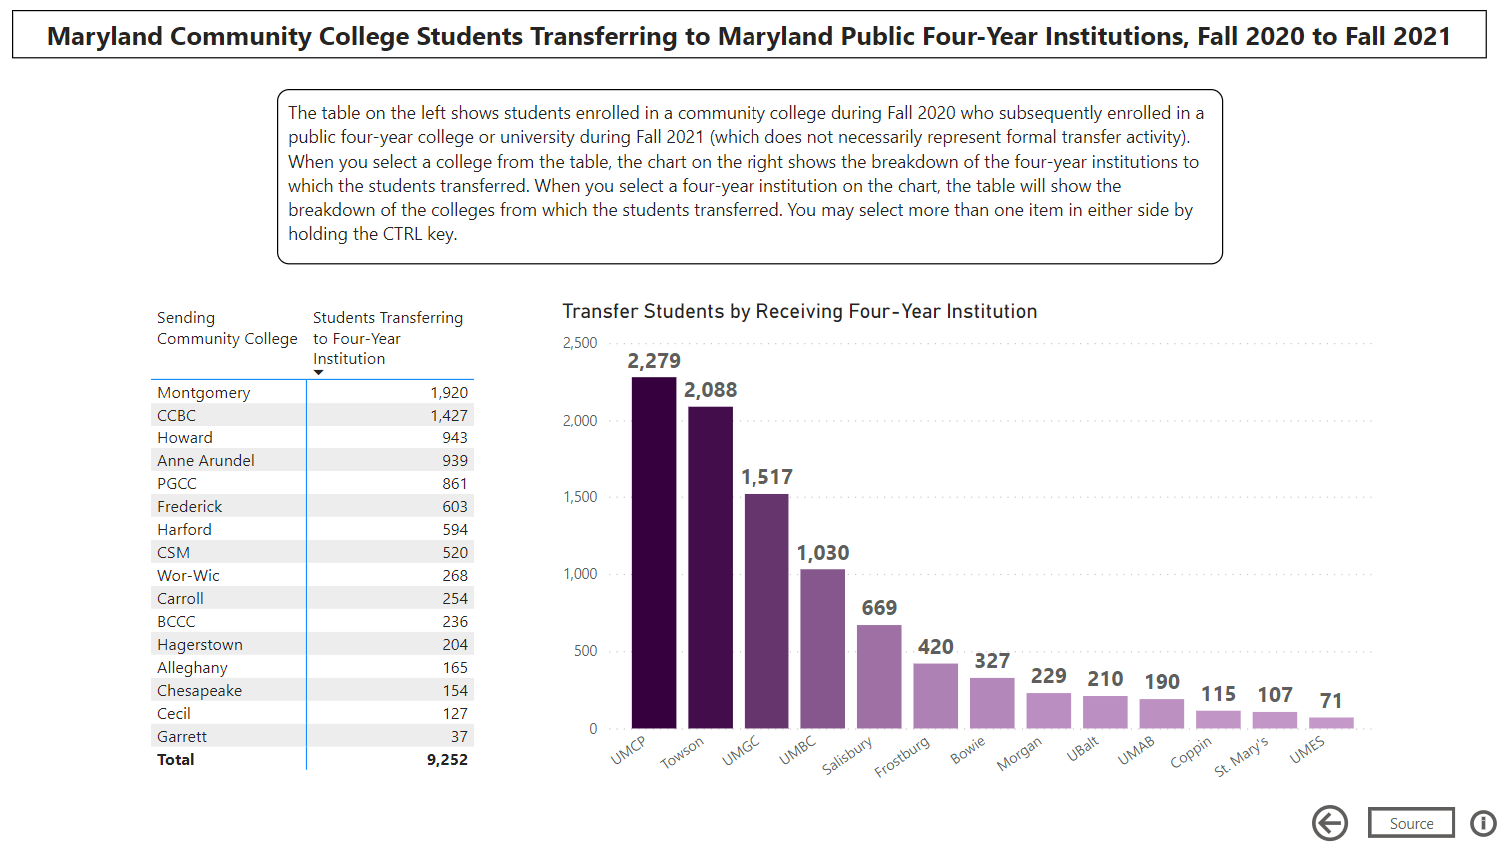
https://app.powerbigov.us/view?r=eyJrIjoiY2I4Y2FlYzUtZDQ4Yi00NjU2LWEyYjYtZmZkNGQ4MWRlOWIyIiwidCI6IjYwYWZlOWUyLTQ5Y2QtNDliMS04ODUxLTY0ZGYwMjc2YTJlOCJ9

Slide 3
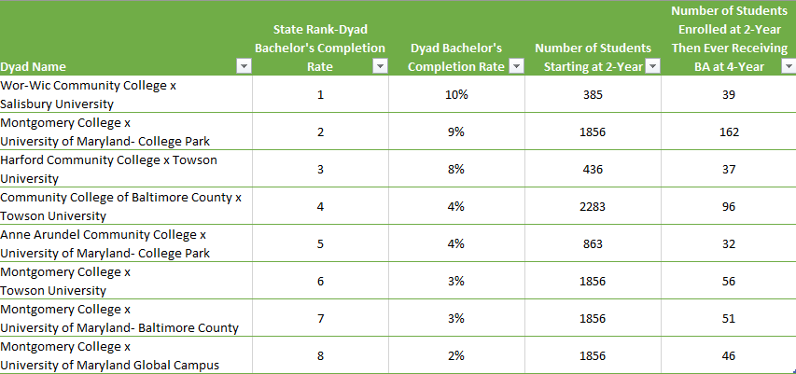
Students with Title IV aid and enrolled in community colleges as their first postsecondary institution in 2014; students followed for 8 years. Source: Office of Chief Economist, US Department of Education

Slide 4
Transfer with Success Act (HB460/SB886)
Legislation passed in 2021
Created a new requirement for public institutions to jointly review credits or courses that are denied when a student transfers from one public institution to another.
Created a new annual reporting requirement: institutions are now obligated to submit to the Commission a report listing all denials over the course of each year, including the reasons for each denial.

Slide 5
Recent Work
2021-2022: Stakeholder workgroup met regularly to inform regulatory changes
Late spring – summer 2022: regulations went through AELR process
Oct 2022: Guidance was released
Jan 2023: Implementation plans received

Slide 6
Current Work
Course Equivalency Guidance: document being prepared in consultation with the Faculty Advisory Council
Data Collection: Reviewing the initial submissions and developing the guidance for future submissions

Slide 7
Statewide Transfer Principles
Maximizing the Transfer of Courses and Credits
Difference between “credits” and “courses”
Difference between transferability and applicability
Transparency
Equality
Collaboration

Slide 8
Evaluation and Review Process
1. Transfer Evaluation Request
2. Evaluation of Course or Credit
3. Transfer Evaluation Report
4. Review of Denial
5. Final Determination

Slide 9
Evaluation and Review Process
1. Transfer Evaluation Request
2. Evaluation of Course or Credit
3. Transfer Evaluation Report
4. Review of Denial
5. Final Determination
Transfer Evaluation Request by Student
Student submits a request
The request shall be in the form and manner required by the receiving institution
Request shall identify each completed course and each credit awarded for prior learning that the student desires to transfer to the receiving institution.
Campuses can create an automatic opt-in or opt-out process

Slide 10
Evaluation and Review Process
1. Transfer Evaluation Request
2. Evaluation of Course or Credit
3. Transfer Evaluation Report
4. Review of Denial
5. Final Determination
Is it transferable?
Is there an articulation agreement, course equivalency list or other institutional publication specific to the course(s)/credits transfer?
Does the course/credit fulfill a general education requirement?
Is there a course equivalency?
Is the credit equivalent for credit for prior learning?
If yes to at least one, course is transferable.
If no to all, then course or credit is denied for transfer.

Slide 11
Evaluation and Review Process
1. Transfer Evaluation Request
2. Evaluation of Course or Credit
3. Transfer Evaluation Report
4. Review of Denial
5. Final Determination
Applicability is a different evaluative process from transferability
Exception: If more than 70 credits can be transferred, receiving institution should transfer the most valuable courses

Slide 12
Evaluation and Review Process
1. Transfer Evaluation Request
2. Evaluation of Course or Credit
3. Transfer Evaluation Report
4. Review of Denial
5. Final Determination
What about the grade earned: use the same standard as you would for a non-transfer student
Number of credits awarded: cannot be less than what the student earned at the sending institution

Slide 13
Evaluation and Review Process
1. Transfer Evaluation Request
2. Evaluation of Course or Credit
3. Transfer Evaluation Report
4. Review of Denial
5. Final Determination
-- must be done for both transfer and denied courses --
Transfer Evaluation Report – what is included:
A statement that the sending institution will review, without further action on the part of the student
Contact person and information
Transferred Credit
the basis for transferability
Denied Credit
a clear and detailed explanation for the denial
a clear and detailed explanation when over 70 credit limit
**Goes to both student and sending institution(s).

Slide 14
Evaluation and Review Process
1. Transfer Evaluation Request
2. Evaluation of Course or Credit
3. Transfer Evaluation Report
4. Review of Denial
5. Final Determination
Review of Denial
Only happens when:
There is a denial of transfer AND
The sending institution is a public Maryland college or university

Slide 15
Evaluation and Review Process
1. Transfer Evaluation Request
2. Evaluation of Course or Credit
3. Transfer Evaluation Report
4. Review of Denial
5. Final Determination
Review of Denial
Sending institution shall conduct an analysis
Does the sending institution agree or disagree with the receiving institution’s evaluation of denial?

Slide 16
Evaluation and Review Process
1. Transfer Evaluation Request
2. Evaluation of Course or Credit
3. Transfer Evaluation Report
4. Review of Denial
5. Final Determination
Review of Denial: Meeting
Institutions shall meet to discuss the analysis
Waiver of meeting can be requested to MHEC by sending institution for good cause
Sending institution will either revise the analysis or provide written notification that no revisions are necessary

Slide 17
Evaluation and Review Process
1. Transfer Evaluation Request
2. Evaluation of Course or Credit
3. Transfer Evaluation Report
4. Review of Denial
5. Final Determination
Final Determination
The receiving institution shall provide to the student:
A Revised Transfer Evaluation Report, or
Written notification that the review process has not resulted in any changes to the Transfer Evaluation Report.
The decision regarding the transferability arising out of the review process constitutes the final decision of the receiving institution and is not subject to appeal.
Notes:
80 days, at most, from start to finish

Slide 18
Course Equivalencies: The New 70% Rule
A course at a sending institution is deemed equivalent when the receiving institution determines that at least 70 percent of the course learning objectives* are the same for a course at the receiving institution.
No other standard or method can be used to determine equivalency (e.g., textbook, assessments)
Cannot consider the course numbers or levels to determine equivalency
Equivalencies must be determined by faculty who are subject matter experts
*“Learning objective” means a description of the knowledge, skills, competencies, or expertise that a student is expected to obtain, exhibit, or meet upon the successful completion of a specific course or program.
Notes:
Faculty who are subject matter experts determine course equivalencies (not non-academic staff)
Can only be transferred if grade earned is what is required of non-transfer students at receiving institution
An institution shall have an established process to evaluate course learning outcome equivalencies

Slide 19
Transfer of Courses & Credits General Education
General education courses transfer, no questions asked
The transferred course should be applied to the same core area at the receiving institution
Transfer should happen regardless of whether an equivalent course exists at receiving institution
Each public institution shall designate on the student transcript those courses that have met a general education requirement, including the specific core area (from Gen Ed regulations)
Notes:
(a) Arts and humanities,
(b) Social and behavioral sciences,
(c) Biological and physical sciences,
(d) Mathematics, and
(e) English composition;

Slide 20
Articulation Agreements via Academic Program Review
Academic Program Proposals for undergraduate degrees will be required to include:
A proposed articulation agreement, or
Proposed revisions to existing articulation agreement(s), or
Justification for why an articulation agreement in not feasible or applicable
Notes:
For both new program proposals and substantial modifications
Required for public institutions

Slide 21
Transfer Coordinators
Serves as a resource person to students seeking to transfer courses and credits.
Is responsible for coordinating the application of the policies and procedures established.
Is responsible for overseeing the process of the evaluation of student transfer requests.
Is not responsible for determining course equivalencies or credit for prior learning (that lives with faculty who are subject matter experts).

Slide 22
Articulation Agreements
Program Transfer Agreement
an articulation agreement between a receiving institution and a sending institution that sets forth the course and other degree requirements within a single bachelor’s degree program offered by the receiving institution that may be completed at the sending institution.
Articulation Agreement
a written agreement for the awarding of credit by an institution of higher education for the completion of coursework or prior learning at another institution or entity.
Course Transfer Agreement
an articulation agreement regarding the award of credit by a receiving institution for courses completed at the sending institution that are not specific to the completion of an academic program at the receiving institution.
Prior Learning Transfer Agreement
an articulation agreement for a receiving institution toward academic credit for demonstrated proficiency, a satisfactory score on a specific assessment, applied experience, or other learning experience completed at an institution of postsecondary education or other entity.

Slide 23
Current Work
Course Equivalency Guidance: document being prepared in consultation with the Faculty Advisory Council
Data Collection: Reviewing the initial submissions and developing the guidance for future submissions

