Slide 1
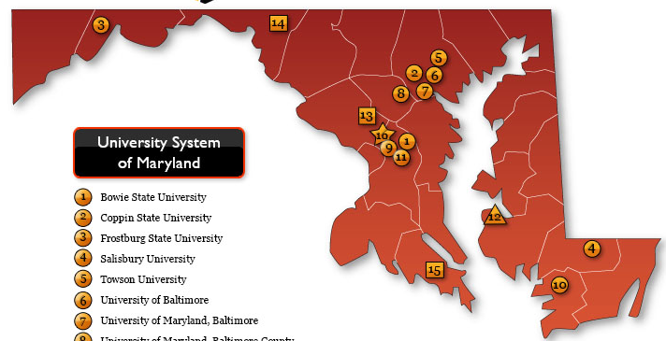
Presentation to the Maryland Higher Education Commission
Senior Vice Chancellor for Administration and Finance
Ellen Herbst
Senior Vice Chancellor for Academic and Student Affairs
Alison Wrynn, Ph.D.
September 13, 2023

Slide 2
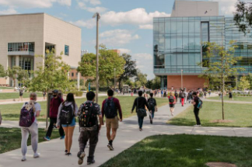
Operating & Capital Budget Overview
USM Contributions to Maryland
FY 2025 Priorities
Operating Budget
Capital Budget
OUR MISSION
To educate and serve the people of Maryland;
advance equity, justice and opportunity;
and produce the research and scholarship that improves lives.

Slide 3
OUR GOALS ARE ALIGNED
Attract, retain and graduate more aspiring Maryland students
Improve transfer pathways
Student
Success
Governor
Moore’s
Priorities
Commitment to high-quality postsecondary education Maryland
Transform Maryland’s Education System
Set students up for success
Modern workforce readiness
Attract and retain education workforce
Remove administrative barriers to degree completion
Innovative programs resulting in new credentials
Promote best practices to enhance inclusion and promote equity
Expand number of graduates in fields critical to Maryland’s economy
Innovative pathways to respond to workforce demands
Enhance the ways postsecondary education is a platform for lifelong learning
Analyze access to affordable and quality postsecondary education
USM Strategic Plan:
Vision 2030
MHEC Plan For
Higher Education
Expand pipeline of underrepresented minorities in critical fields

Slide 4
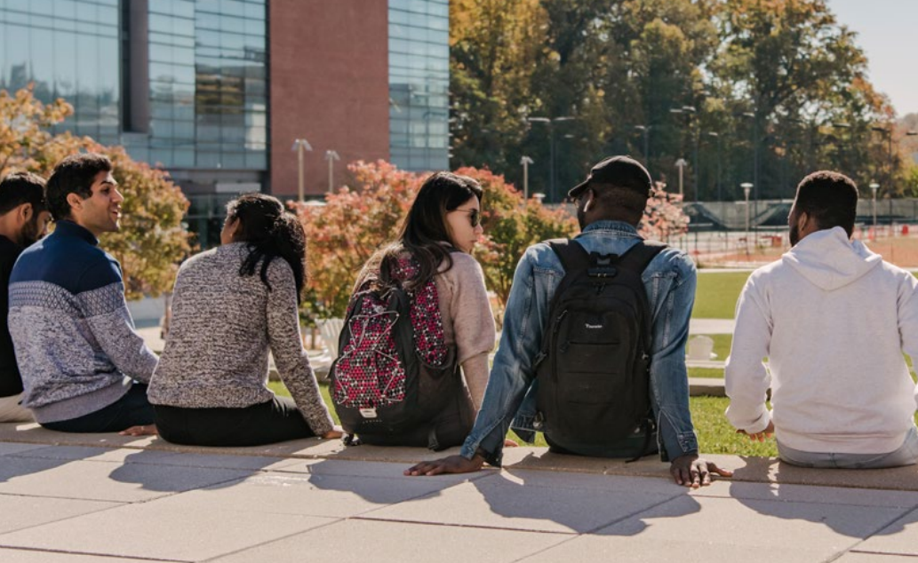


USM Contributions to Maryland
Diversity, Equity and Inclusion
Raise the profile of our 3 HBCUs and 3 MSIs by supporting implementation of ambitious strategies for student success and enrollment management
Consider integration of civic education into general education curricula
Implement new programs to foster an ethos of committed public engagement
Half of the student population identifies as a racial/ethnic minority

Slide 5
Ensuring Equitable Access to High-Quality Education
Enhance academic programs
Improve access
Expand and innovate at RHECs
Disburse more aid
Strengthen & expand our HBCUs
EQUITY

Slide 6
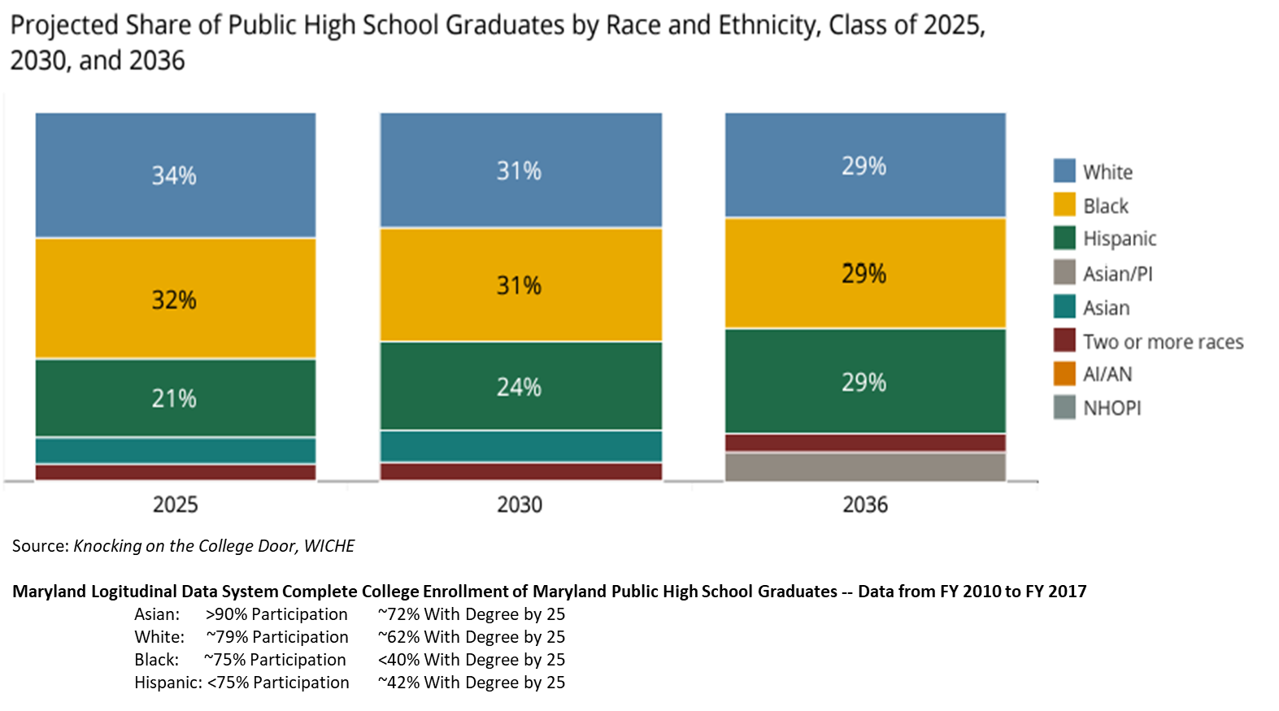
Changing Demographics (WICHE – Knocking on the College Door)

Slide 7
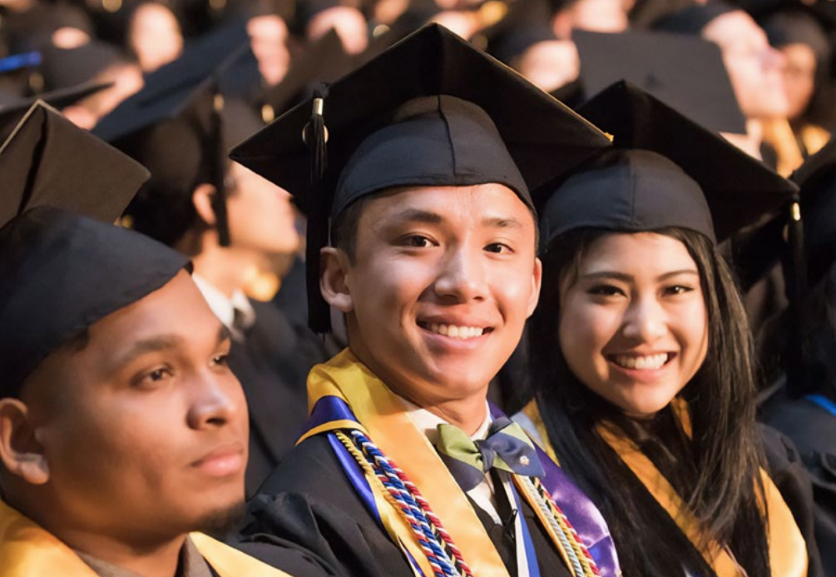
USM Contributions to Maryland
Access
Affordability and Achievement
Attract, retain and graduate more Maryland students
163,000 students enrolled
Including 33,000-38,000 new transfers annually
43,000 degrees awarded annually
National average debt for in-state bachelor degree recipients is approximately $30,000
With low cost of attendance, half of undergraduates avoid loans

Slide 8
Make the Student the Center
Campus-wide efforts
Strategic use of need-based aid
Wrap-around services
Intentional interventions and intrusive advising
Academic pathways
Preparing students for entry

Slide 9
Student Success Factors
Wrap-around Supports
Family Responsibilities
Mental Health
Disability & Access Services
Advising
Facilitation of On Ramps & Off Ramps
Transfer Practices

Slide 10

USM Contributions to Maryland
Academic Excellence and Innovation
First-time undergraduates
84% average 2-year retention rate
71% average 6-year graduation rate
Improving excellence through increased diversity and inclusion
30% of faculty & 44% of staff identify as a member of a minority racial/ethnic group
USM - Retention and Graduation Rates
MHEC - Retention and Graduation Rates

Slide 11
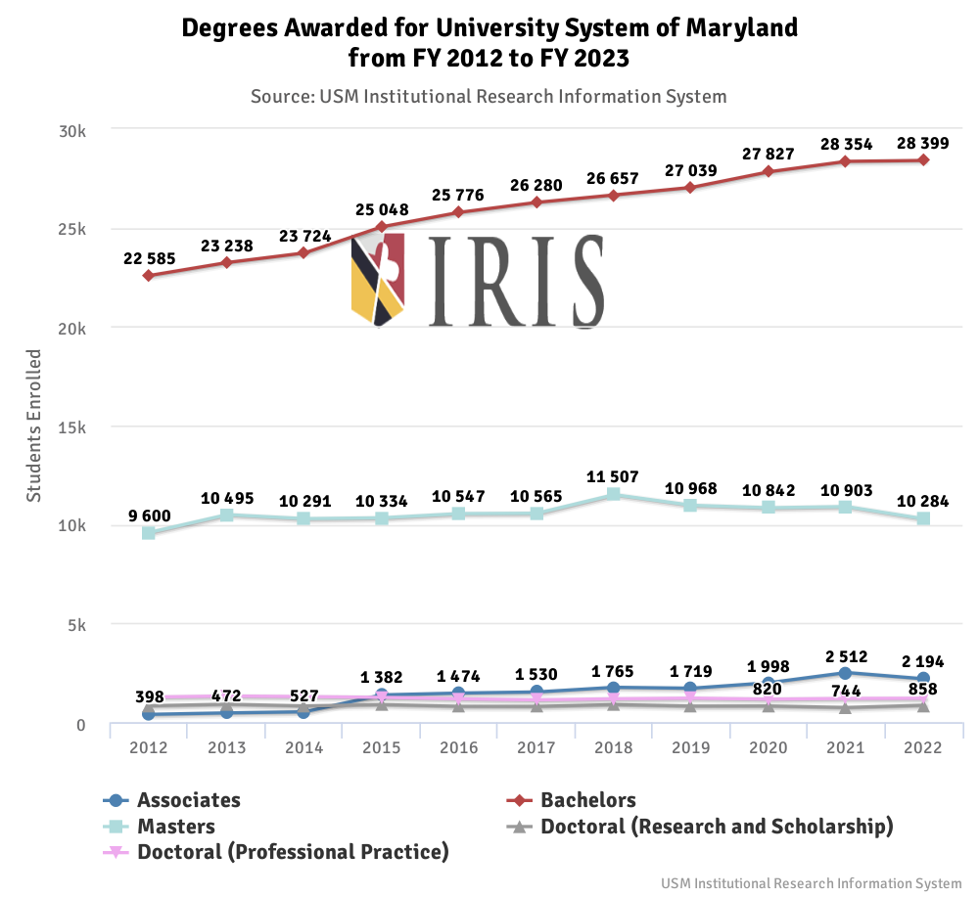

Slide 12

USM Contributions to Maryland
Workforce and Economic Development
Annually USM graduates:
12,000 STEM graduates
including 7,000+
Computer Science, IT, Cyber
1,800+ engineers
1,500 new teachers
1,300 nurses
150 medical doctors
600+ new companies created/facilitated (since 2011)

Slide 13
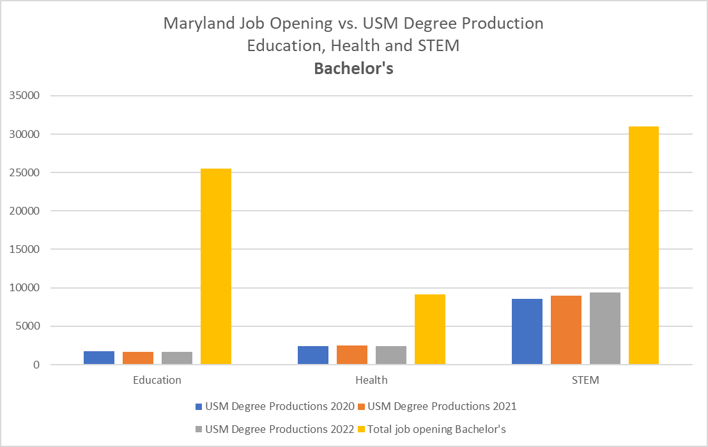
USM Provides 80% of Bachelor’s Degrees
Maryland’s job openings exceed supply

Slide 14
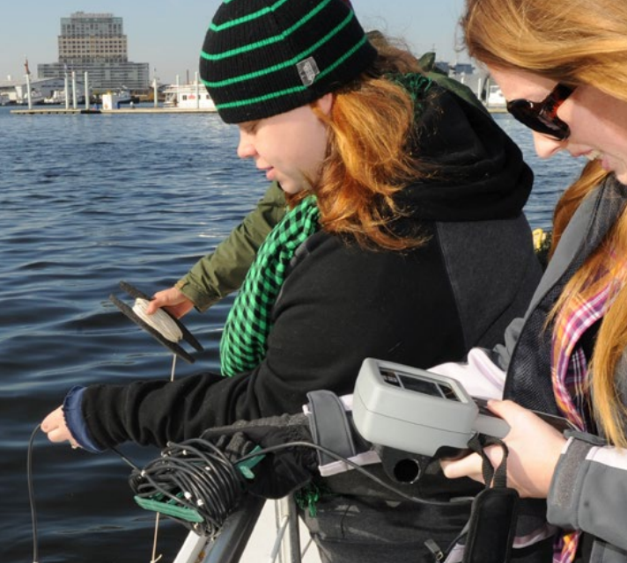
USM Contributions to Maryland (cont.)
Research and Impact
$1.4B in R&D attracted annually
Over 20 joint academic collaborations and student enrichment programs
UMD-UMB maintain top 10 NSF research ranking among publics
Enhanced national and international reputation

Slide 15
Research is Driver for Modern Workforce Readiness
STEM occupations are expected to grow at more than twice the rate
of non-STEM professions and can offer more than double the median income
Table 1.11 Employment in STEM occupations, 2021 and projected 2031 (Numbers in thousands)
 | Employment
Occupation Category | 2021 | 2031 | 2021-31 Change | 2021-31 Change | 2021 Median Annual Wage
Total, all occupations | 158,134 | 166,452 | 8,317 | 5.3% | $45,760
STEM occupations | 9,880 | 10,944 | 1,064 | 10.8% | $95,420
Non-STEM occupations | 148,254 | 155,508 | 7,253 | 4.9% | $40,120
"Employment in STEM occupations." U.S. Bureau of Labor Statistics, September 8, 2021.
https://www.bls.gov/emp/tables/stem-employment.htm

Slide 16
The Operating Budget
16

Slide 17
FY 2024 Operating Budget Sources (in billions)
FY 2024 Budget |  | $7.1
 | General Funds & HEIF | 2.2
 | Tuition and Fees | 1.9
 | Restricted Funds | 1.6
 | Auxiliary Services | 0.8
 | Other Revenues | 0.6
Source: Approved FY 2024 BOR Operating Budget Item
1

Slide 18
FY 2024 Operating Budget Uses by Natural Category (in billions)
FY 2024 Budget |  | $7.1
 | Salaries and Wages | 4.4
 | Contractual Services | 1.0
 | Student Aid/Subsidies | .7
 | Supplies and Materials | .2
 | Other Operating | .8

Slide 19
FY 2024 Operating Budget Uses by Function (in billions)
FY 2024 Budget |  | $7.1
 | Educate Students | 3.3
 | Research and Public Service | 1.9
 | Institutional Support | 0.8
 | Auxiliary Services | 0.6
 | Plant O&M | 0.5

Slide 20
Base for FY 2024 Current Services
FY 2024 Legislative appropriation $2.1B
Tuition ranking 20th out of 50 states
Ranked highest to lowest
Enrollment
Headcount 163,000
FTES 124,000
Positions 40,000
Faculty 16,500
Non-faculty staff (includes grad assistants) 23,500

Slide 21
FY 2025 USM Funding Priorities
Student Access and Success Initiatives
Get students into college, through college and successfully transitioned into professional careers
Develop and expand pathways from K-12 and community colleges to obtain a 4-year degree
Provide equitable access to high quality education
Increase financial aid for Maryland students
Create innovation hubs in regional higher education centers
Continually monitor and improve student support services to increase retention and graduation with priority focus on our HBCUs.
Develop innovative education programs to help Marylanders gain credentials, reskill and upskill to meet the state’s changing workforce need

Slide 22
Use Institutional Aid Strategically…
… to increase student success.
…to decrease student
debt.

Slide 23
The Capital Budget

Slide 24
The Importance of State Capital Support
State support helps address continued maintenance and repair needs of State assets
State investment in facilities supports USM programs that provide economic benefit
Construction activity helps sustain the State’s economy

Slide 25
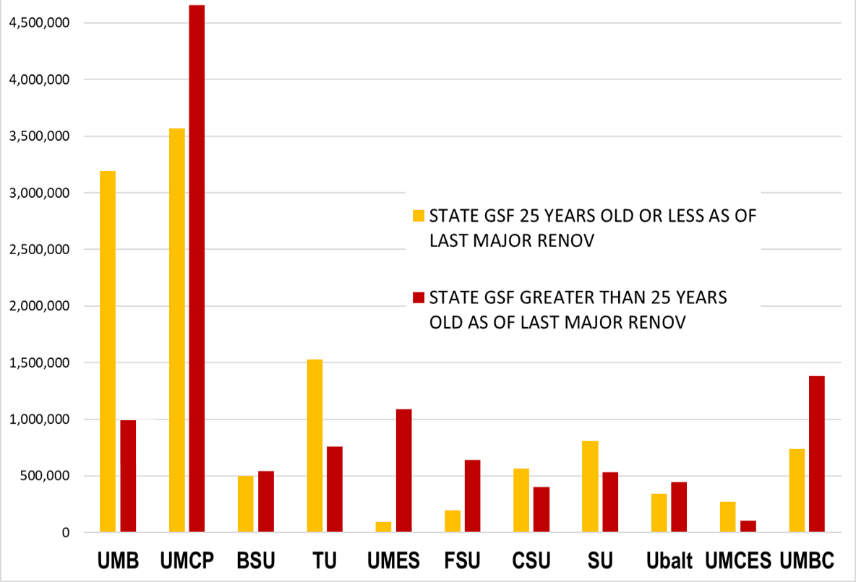
The Scope of the Maintenance Problem: Age of Campus Buildings by Institution
A significant number of buildings at many institutions are in need of repair.

Slide 26
Rebuild: Five Year (FY24-28) capital requests by the Board of Regents underscore need for renovation/repair
$1.02B
Renovation, replacement and deferred maintenance
Based on $993M Five Year Program per Governor’s CIP (FY24 already enacted)

Slide 27
Characteristics of the USM Capital Program
Student safety and health remain our top priority
We monitor cost escalation and supply chain uncertainty in construction market
Future plans are focused on:
Maintenance and repair needs (highest priority projects)
Enhanced flexibility and advanced technology
Expansion of research and health care programs
Board of Regents request is consistent with these priorities

Slide 28
Thank you

Slide 29
Appendices

Slide 30
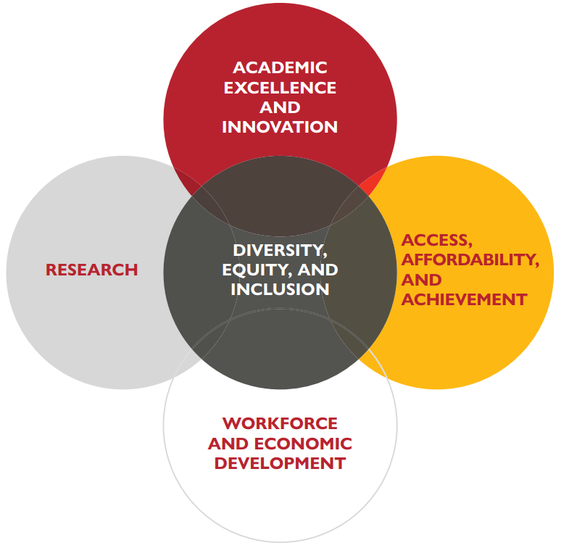
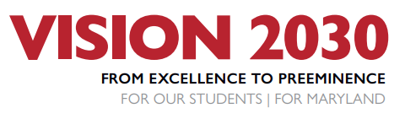
USM Strategic Plan
https://www.usmd.edu/vision2030/

Slide 31
USM’s Vision 2030: From Excellence to Preeminence
USM Strategic Plan Implementation
Shifting from institution-focused to student-centric
Priorities concentrate on learner outcomes
Connecting to Maryland’s needs as identified in the State Plan

Slide 32
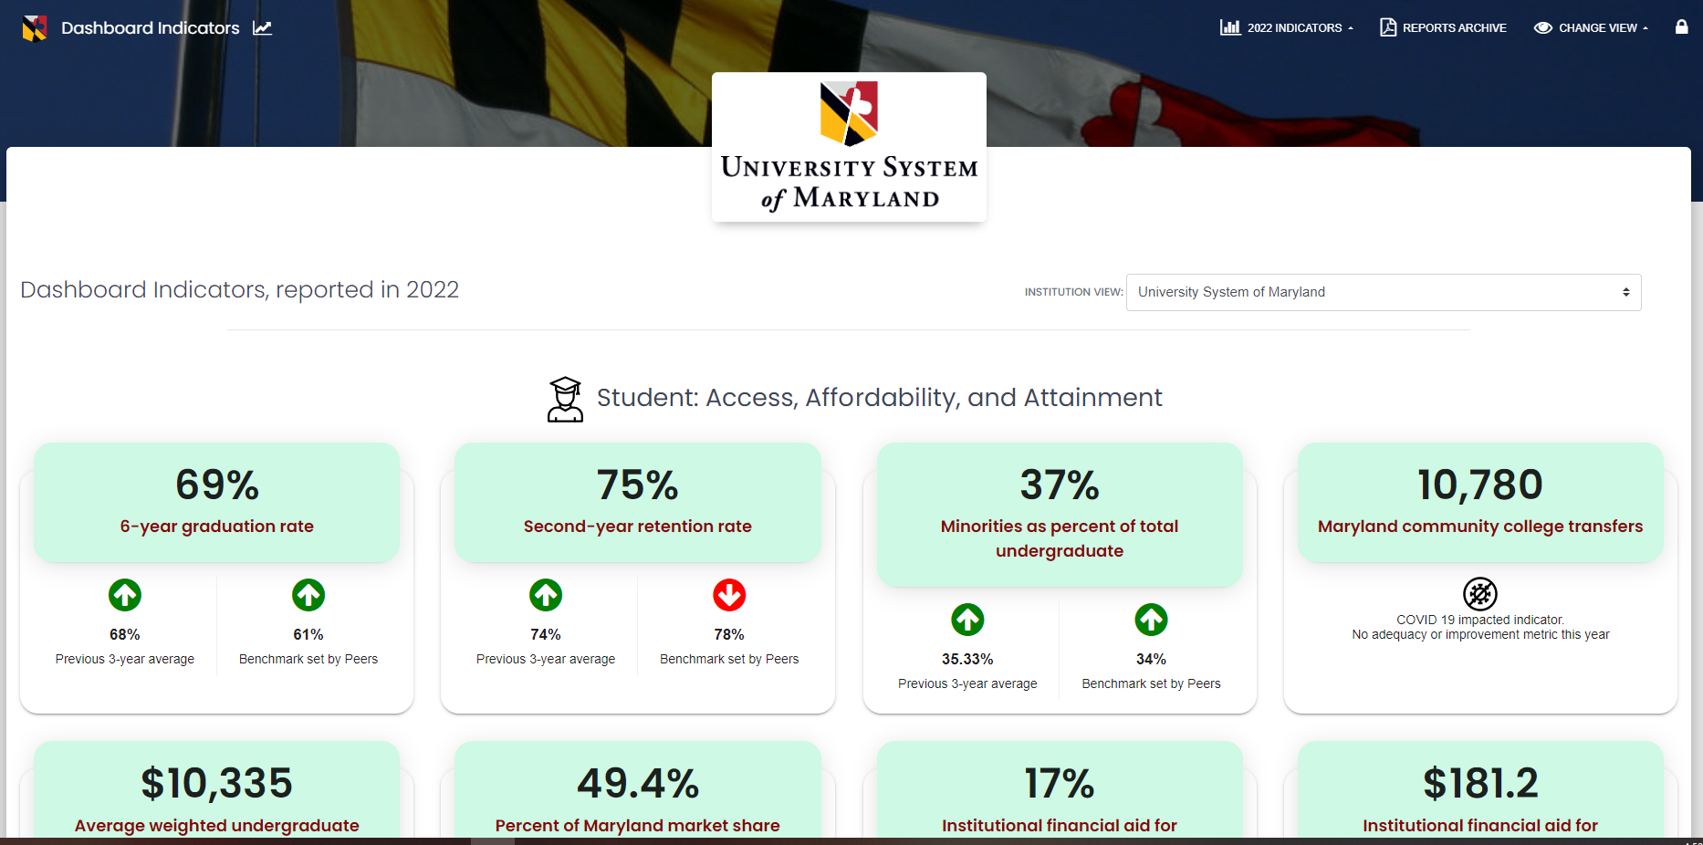
Dashboard Indicators
www.usmd.edu/dashboard-indicators

Slide 33
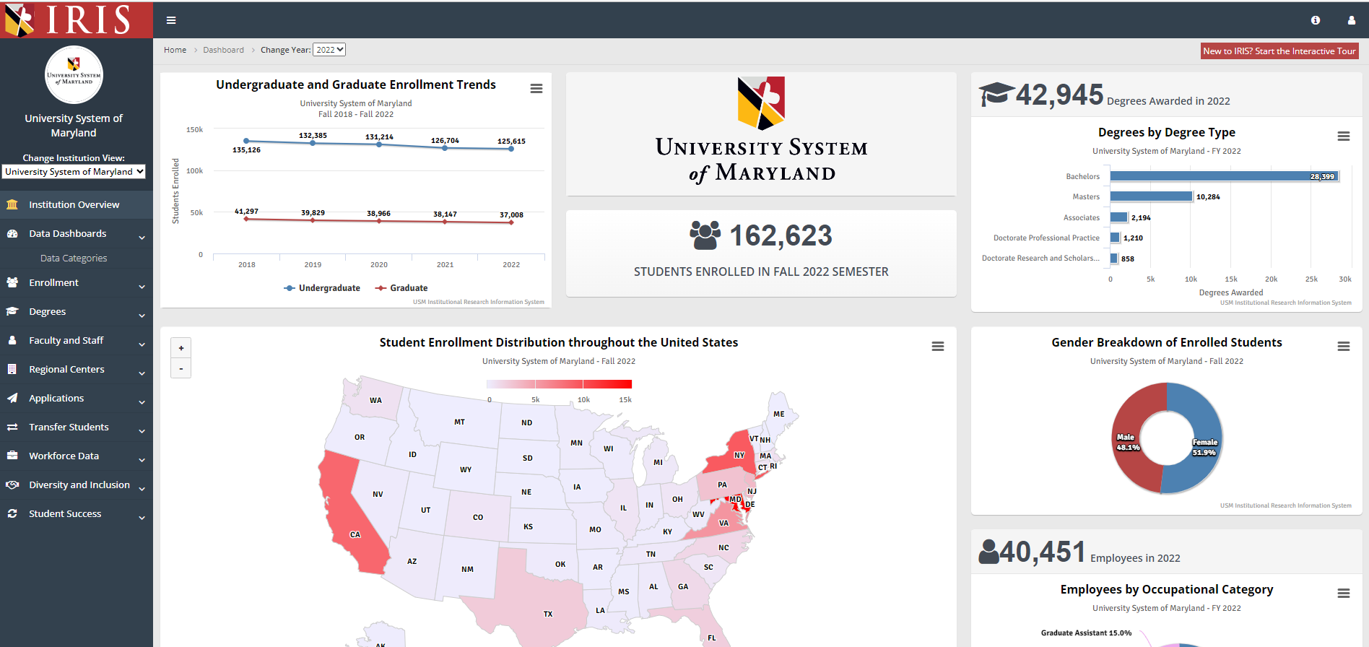
USM IRIS
www.usmd.edu/IRIS

Slide 34
University System of Maryland FY 2024 State Funding
 |  |  |  | Appropriation Increases
 | FY 2023 |  | ***FY 2024
 | Budget |  | Request | **EFI & HBCU | Salary | Total | % Increase
 | Base State |  | State | Legislative Lawsuit | & Fringe | Estimated FY24 | over base
Institution: | Funds |  | Funds | Mandates Increases | Increases | State Funds | FY 2023
UMB | $316,825,752 |  | $315,325,752 | $1,361,750 | $50,596,381 | $367,283,883 | 15.9%
UMCP | $718,895,457 |  | $727,045,457 | (1,182,095) | 122,866,010 | 848,729,372 | 18.1%
BSU | $59,861,210 |  | $58,361,210 | 730,507 18,193,432 | 8,295,774 | 85,580,923 | 43.0%
TU | $174,042,649 |  | $174,685,372 | 885,007 | 29,206,816 | 204,777,195 | 17.7%
UMES | $55,804,455 |  | $55,804,455 | 2,948,493 9,000,000 | 7,326,352 | 75,079,300 | 34.5%
FSU | $53,401,608 |  | $53,401,608 | - | 7,120,745 | 60,522,353 | 13.3%
CSU | $55,616,734 |  | $55,616,734 | - 9,000,000 | 5,837,316 | 70,454,050 | 26.7%
UBalt | $52,795,889 |  | $52,795,889 | 1,620,894 | 7,905,066 | 62,321,849 | 18.0%
SU | $75,631,798 |  | $79,631,798 | (27,500) | 12,698,980 | 92,303,278 | 22.0%
UMGC | $55,545,052 |  | $55,545,052 | 974,924 | 10,217,732 | 66,737,708 | 20.2%
UMBC | $185,814,992 |  | $186,214,992 | (215,106) | 24,724,692 | 210,724,578 | 13.4%
UMCES | $25,696,521 |  | $26,005,268 | - | 2,421,366 | 28,426,634 | 10.6%
USMO | $24,291,265 |  | $24,331,265 | - | 2,290,095 | 26,621,360 | 9.6%
PAYGO |  |  | $0 | 17,562,000 | - | 17,562,000 | 0.0%
USG | $24,503,052 |  | $29,503,052 | 3,262,847 | 1,186,124 | 33,952,023 | 38.6%
USM total | $1,878,726,434 |  | $1,894,267,904 | $27,921,721 $36,193,432 | $292,693,449 | $2,251,076,506 | 19.8%
*For FY2024 there is a GF/HEIF swap of $10.6M
**EFI is Enrollment Funding Initiative reallocated to USG
***Does not include HBCU settlement funding

Slide 35
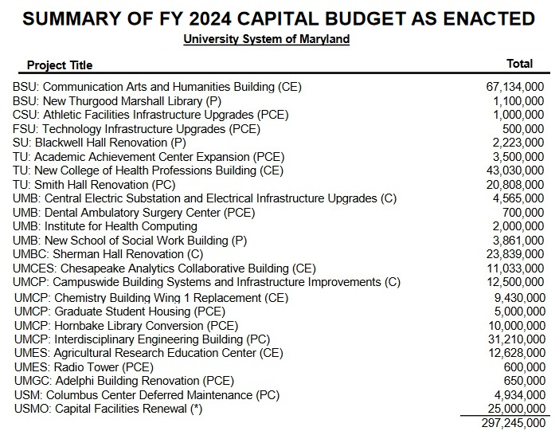

Slide 36
